Slide 1
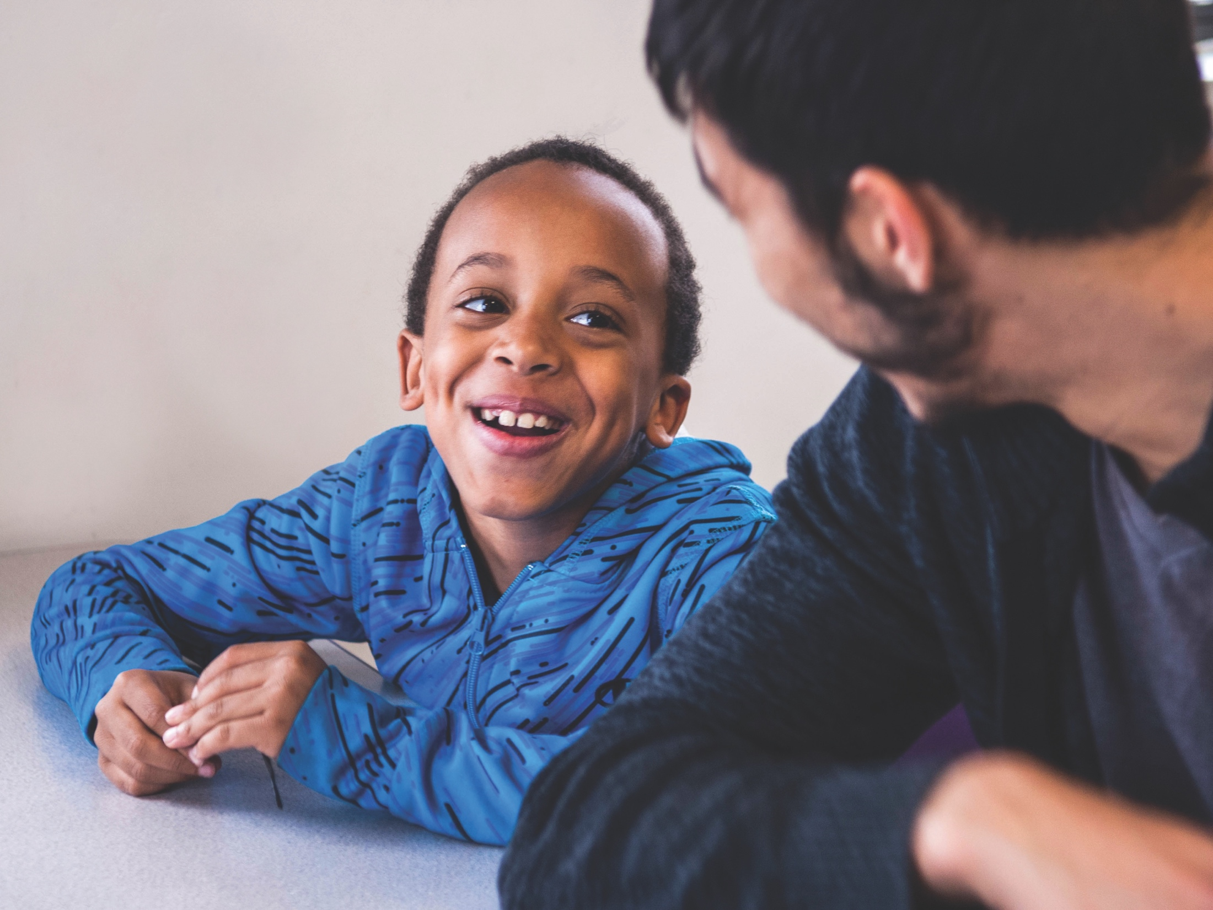
Session Four
Cultivate Connection
ARC Reflections

Slide 3
ARC Reflections
ARC, or Attachment, Regulation and Competency, is a framework for working with children and teens who have experienced trauma. Developed by Margaret Blaustein and Kristine Kinniburgh of the Justice Resource Institute, ARC builds on the resilience of children, teens and families
ARC Reflections — an ARC-informed caregiver training curriculum for foster parents, kin and other caregivers — was written by Blaustein and Kinniburgh with support and consultation from the Annie E. Casey Foundation

Slide 4
Welcome
This group will meet nine times for two hours each time
Please attend all sessions
Each session will include the following segments:
Warm-up
Opening check-in
Review and report back
Theme of the day
Self-reflection
Take home
Practice
Closing check-in

Slide 5
WARM-UP

Slide 6
Warm-Up
Pair up with the person next to you
In five minutes, identify five things you have in common

Slide 7
OPENING CHECK-IN

Slide 8
What Is Your Energy Right Now?
Totally Comfortable
z
Great Match
+10
+5
0
-5
-10
Really Uncomfortable
Terrible Match

Slide 9
Get Comfortable
If your energy is comfortable and a good match, great!
If not, what can you do to get it there?

Slide 10
REVIEW AND REPORT BACK

Slide 11
Review
Parenting is hard. Foster parenting is harder
Your feelings matter, for a lot of reasons
Self-care is easy on good days, but harder on hard days
Keep in mind what makes a hard day
Stay on the main road
Acknowledge your feelings
Stay aware
Build and use a self-care toolbox

Slide 12
Report Back
In small groups, discuss what you practiced
What went well?
What was challenging?
What was something you noticed?

Slide 13
CULTIVATE CONNECTION

Slide 14
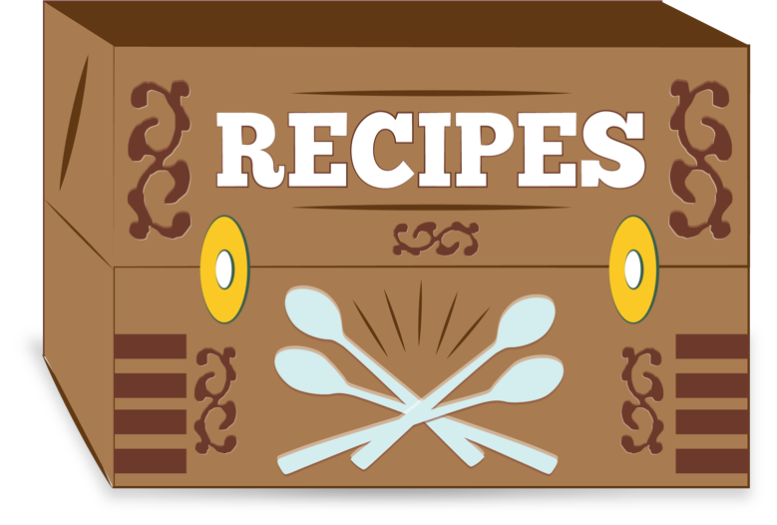
Building a Relationship
What are the ingredients of a good relationship?

Slide 15
Possible Ingredients
recipe:
recipe:
recipe:
recipe:
Mutuality
Respect
Joy
Trust
recipe:
recipe:
recipe:
Curiosity
Acceptance
Repair

Slide 16
The Child’s or Teen’s Experience
What do you think these words mean to children and teens in your care?
recipe:
recipe:
recipe:
recipe:
Mutuality
Respect
Joy
Trust
recipe:
recipe:
recipe:
Curiosity
Acceptance
Repair

Slide 17
The Child’s or Teen’s Experience
What do you think these words mean to children and teens in your care?
recipe:
recipe:
recipe:
recipe:
Ytilautum
Tcepser
Yoj
Tsurt
recipe:
recipe:
recipe:
Ytisoiruc
Ecnatpecca
Riaper

Slide 18
Question
How many people in this room have ever been hurt in a relationship?

Slide 19
Keep in Mind
When entering into the relationship, don’t forget the child’s or teen’s lens: Who is in the room?

Slide 20
Question
What do you think your foster child’s or teen’s expectations might be when he or she meets you?

Slide 21
What Are Some Steps to Building a Relationship?
Steps to building the relationship…
Before the child or teen arrives
As the child or teen arrives (the basics)
Ease into the relationship
Build the relationship
Meet the child’s or teen’s pace
Ride the roller coaster
Address the disconnects
Engage with joy

Slide 22
Before Entry
Make sure the whole family is on board
Have a support plan: Anticipate your family’s self-care needs and resources
Prepare siblings and other children in the home
Connect with extended family and community. Don’t let yourself get isolated

Slide 23
Start With the Basics
Welcome kits
Establish the child’s or teen’s space and provide permission to use it
Ask about the child’s or teen’s preferences (food, clothing, routines, hygiene, colors/decoration)
Be clear about household expectations
Give the child or teen choices

Slide 24
Ease Into the Relationship
Move at the child’s or teen’s pace. It’s hard for a relationship to start in the middle
Let the child or teen choose how much of himself or herself to share with you. Ease the pressure
Expect the good. Don’t assume that history will dictate the present
Keep the expectations realistic. Your early goal is to build safety and comfort
Give the child or teen choices about what to call you and other family members

Slide 25
Build the Relationship
Be curious about the whole child: Interests, fears, talents, wants, needs
Find time to engage with your child or teen and support him or her in engaging with other family members
Acknowledge (or be aware of) both hopes and fears about relationships (your own and the child’s or teen’s)
Honor history. Your child’s or teen’s life began before he or she entered your home. Support continuity
Consider things like previous connections, culture and rituals
Ask your child or teen what he or she wants or needs from you; be aware of what you are asking of him or her

Slide 26
Meet the Child Where He or She Is
Think of the many different ways we express our needs, form connections, manage our feelings, etc.
Instead of expecting your child or teen to do things your way, get curious. Keep asking yourself, “What am I learning about this child’s way?” Try to meet the child or teen where he or she is

Slide 27
Olivia
Olivia is now 6 years old and on her fourth foster placement. The home she is in is noisy — four kids, two dogs and some extended family. Her foster mother works in child care and is enthusiastic about playing with Olivia
Olivia is overwhelmed by all the chaos. She has lost three homes in three years and does not trust that this one will stick
She is quiet and watchful and resists her foster mother’s attempts to engage her. When her foster mother tries to play, Olivia sometimes shuts down, but may explode, yell and scream

Slide 28
Ride the Roller Coaster
Remember:
All relationships shift over time
All of us have good days and hard days
All of us have changing moods that affect our relationships
All of us have moments when we feel disconnected from those we care about
All of this is even harder for children or teens who have experienced trauma or been hurt in relationships

Slide 29
DISCONNECTion is often about PROTECTion, not
REJECTion

Slide 30
How to Address the Disconnects
Don’t take it personally
Anticipate that things will change…even when they are going really well
Believe that reconnection is possible. Take responsibility for it. Don’t expect the child or teen to take the first step
Get curious: What might have led to the disconnect? Step into the child’s world

Slide 31
How to Address the Disconnects
Reaffirm the relationship. Find a way to reassure the child or teen that your relationship exists and can continue, even when times are hard
Reconnect at the child’s pace. Give the child or teen permission to protect himself or herself (even if you don’t feel like they need to)
If needed, make repairs. Give apologies, but don’t expect them
Move on. Try to shift out of whatever is hard and into something that is positive. You’re not reinforcing the negative when you reconnect in positive ways

Slide 32
Expect and Create Joyful Opportunities
Experiencing good times in relationships makes it easier to weather hard times
Look for ways to engage in the positive:
Find, explore and try to share the child’s or teen’s interests
Look for opportunities for one-on-one time and for whole-family experiences
Make sure every day includes at least five minutes of positive connection (or on very busy days, at least two)

Slide 33
Wrap-Up
Good relationships require many ingredients
When building the relationship, remember the child’s or teen’s lens
Relationships take time:
Prepare
Ease in
Meet the child or teen where he or she is
Ride the roller coaster
Reconnect
Cultivate joy

Slide 34
SELF-REFLECTION

Slide 35
Thinking About Your Own Relationships
What has led you to disconnect in relationships?
What has helped you ease back into relationships? Think about what you do and what you want others to do for you as you reconnect

Slide 36
TAKE HOME
What is one sentence (idea, concept or something you have learned) that you can take away from today? Write it in your log.

Slide 37
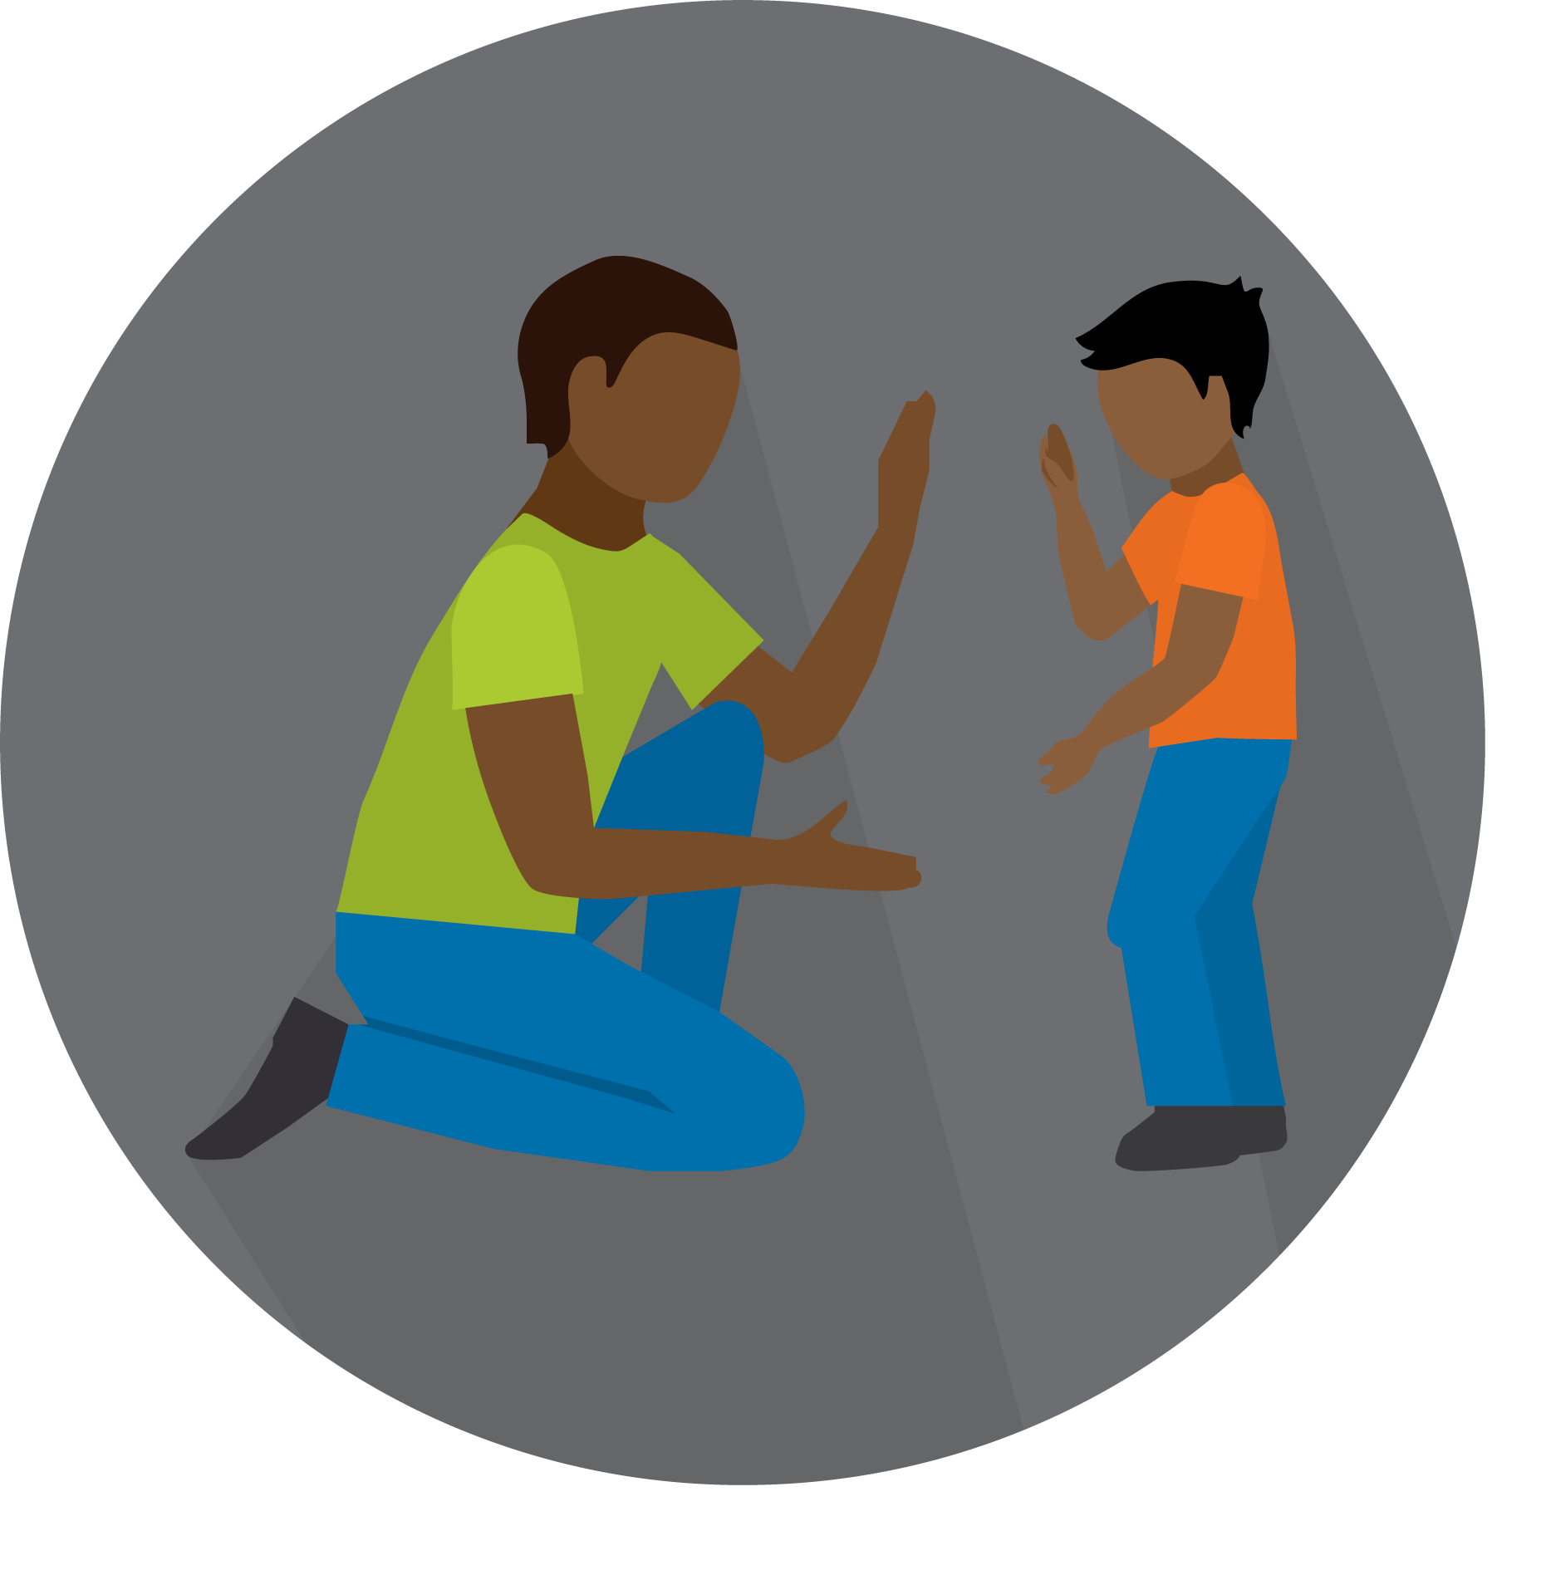
PRACTICE

Slide 38
Practice
This week make a list. How many five-minute joy activities can you come up with?
Try to bring back a list of at least five joy/engagement activities to share with the group
Try to engage in one every day

Slide 39
CLOSING CHECK-IN

Slide 40
What Is Your Energy Right Now?
Totally Comfortable
z
Great Match
+10
+5
0
-5
-10
Really Uncomfortable
Terrible Match

Slide 41
See you next time!

