Slide 1

Today’s Face, Tomorrow’s Future
Friends of Talladega College Meeting
New York, NY
October 11, 2005
PowerPoint Presentation
DVD
Notes:
Starting suggestions and observations:
You should be familiar with all of the materials and information in the Race Matters Toolkit before giving this presentation.
To start, you can talk about how achievement of your organization’s mission is tied to creating opportunity for all and getting equitable results.
The approach described in this PowerPoint and reflected in the Race Matters Toolkit differs from alternative ways of addressing race, such as emphases on reconciliation or diversity. See I. Shapiro, Training for Racial Equity and Inclusion, Aspen Institute, 2002, for important distinctions among these approaches.
This presentation includes (1) a point of view on addressing unequal opportunities by race, and (2) tools to help you create opportunity for all.

Slide 2
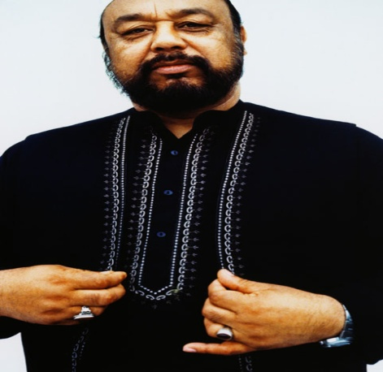
Our Working Assumptions
Race Matters. Almost every indicator of well-being shows troubling disparities/disproportionalities by race
Disparities are often created and maintained inadvertently through policies and practices that contain barriers to opportunity
It’s possible-- and only possible-- to close equity gaps by using strategies determined through an intentional focus on race
If opportunities in all key areas of well-being are equitable, then equitable results will follow
Given the right message, analysis, and tools, people will work toward racial equity
Notes:
Suggested talking points:
These assumptions are in contrast to race-neutral and/or color-blind approaches
These assumptions are empirically based: Strategies determined through an intentional focus on race can produce more equitable results than those taking a race-neutral or color-blind approach.

Slide 3

Overview of the Presentation
Illustrative stories through the lens of “embedded racial inequities”
What are embedded racial inequities?
What’s different about work that uses an embedded racial inequities lens?
How can the Race Matters Toolkit help?
Q & A

Slide 4

The GI Bill: A Story of Embedded Racial Inequity
Notes:
Information about the GI Bill:
Also known as the Servicemen’s Readjustment Act, following WWII
Purported to be the greatest piece of social legislation ever
U.S. spent $95 billion on this social program (Put this number in today’s perspective – e.g., double the estimate to rebuild the Gulf Coast after Hurricane Katrina)
Assisted 16 million returning soldiers to be reintegrated into US society
Provided veterans with access to job training, college tuition, home loans and small business support
Created the modern day middle-class and fueled development of the suburbs
For more information on the GI Bill and its effects, see When Affirmative Action was White by Ira Katznelson, Columbia University Press, 2005.
Background for the next slides:
The story to be told is about three young boys whose fathers served in WWII and how this social legislation from 60 years ago continues to impact their families.
It is a story about how advantage and disadvantage accumulate because of the unequal opportunities embedded in the GI Bill.

Slide 5

Philip’s Story
Child Born Father’s GI Bill: FHA Consequences Consequences
Right After Status & VA loans for Child’s for Child’s
WWII Education Well-being in
Adulthood
Low-income, White Able to use Family borrowed Philip gets
White veteran, high low-interest from home equity professional
school mortgage to support child’s job, buys own
diploma, from provisions to college education house, Philadelphia move family (first in family to inherits from public go to college) appreciated
housing to house
segregated when
suburban father
home ownership dies
Notes:
Observation:
For this and the next two slides, each column highlights a feature of the child’s profile as it is played out around one aspect of the GI Bill, the unequal availability of FHA and VA loans to purchase a home.

Slide 6

Thomas’s Story
Child Born Father’s GI Bill: FHA Consequences Consequences
Right After Status & VA loans for Child’s for Child’s
WWII Education Well-being in
Adulthood
Low-income, Black Could not access Family could not Thomas works
Black veteran, high home loan b/c of afford to send in minimum
school racially-restrictive child to college; wage jobs,
diploma, from underwriting high school continues to
Philadelphia criteria; family diploma is from live in family remained in rental under-resourced home,
housing in the city segregated school considers joining the Army, has to
borrow $
when father
dies to give
him decent
funeral
Notes:
Suggested talking point:
The GI Bill was open to all veterans; however, its implementation proved to be discriminatory. Congress had agreed that GI Bill supports could be administered locally. Local implementers maintained the racially discriminatory actions that characterized local public and private sector behaviors prior to the war.

Slide 7

Juan’s Story
Child Born Father’s GI Bill: FHA Consequences Consequences
Right After Status & VA loans for Child’s for Child’s
WWII Education Well-being in
Adulthood
Low-income, Latino Could not access Family could not Juan works
Latino veteran, high home loan b/c of afford to send in minimum
school racially-restrictive child to college; wage jobs,
diploma, from underwriting high school continues to
Texas criteria; family diploma is from live in family remained in rural under-resourced home,
rental housing language marries segregated and newcomer racially Latina, sends segregated part of
school family’s limited
income to her
extended family
in Mexico

Slide 8

Fast Forward to Today . . .
Philip’s Children: Thomas’ and Juan’s Children:
Philip gives children his father’s They have no houses to
appreciated house inherit
They live in thriving communities They live in disinvested communities
Their college education’s paid At work, they complete college on work study and by home equity student loans, with subsequent starting debts to pay back
Philip establishes trust fund Thomas and Juan have few personal assets to leave
for grandchildren grandchildren
Notes:
Suggested talking points:
Reinforce for the audience that social policy created 60 years ago continues to have disparate impact. These stories challenge the assumption that discrimination is a thing of the past by demonstrating that even past discrimination has ongoing consequences for today’s population. Benefits and disadvantages accumulate over time.
Note that these stories followed only one aspect of the GI Bill: home loans. If job training, educational support, and small business loans were also tracked, additional layers of unequal opportunity would be revealed to add to the home ownership inequities.

Slide 9

Other Inequality of Opportunity Stories that Still Matter Today
Initial social security coverage
Unemployment insurance coverage
Other social policies?
Notes:
Suggested talking points:
See Ira Katznelson’s When Affirmative Action was White for additional information about the discriminatory nature of initial social security and unemployment insurance policies. The disparate effects of these could also be added to the stories of Philip, Thomas, and Juan.
Invite the audience to provide other examples of inequality of opportunity from the past and to describe how they still matter today. In addition, the audience could be asked to identify policies today that operate to build upon the inequities of the past (e.g., repeal of the estate tax would further enrich those whose wealth was built upon inequities like those revealed in the previous stories).
In preparation for the next slide:
Note that in the three decades following WWII, major court decisions and federal legislation were handed down in an effort to secure equal opportunity by race.

Slide 10
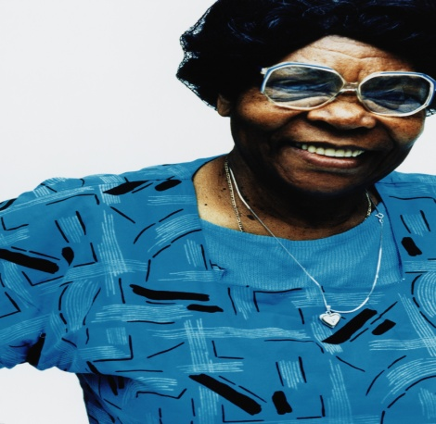
Era of Equal Opportunity Policies (50s, 60s, and 70s)
Opportunity Victories . . . But Inequitable Outcomes
Mendez vs. Westminister Schools today
Brown vs. Board of Education remain racially segregated and still unequal in terms of access to resources.
Fair Housing Act of 1968 Discrimination persists
in zoning, real estate practices, and lending.
Affirmative Action Largest beneficiaries have
been White women.
Voting Rights Act of 1965 More elected officials of color but w/o adequate resources in urban areas to govern effectively; redistricting to erode political power;
ballot box inequities.
Notes:
Suggested talking points:
The politics of this era produced significant victories regarding opportunity for all, as noted in the first column.
But these legal and legislative victories haven’t produced the outcomes they intended, as the second column describes. See the Race Matters Fact Sheets on education, neighborhood vitality, family economic success, and civic participation for specific data about inequities in education, housing, jobs, and voting, respectively.
Invite the audience to add other opportunity victories here along with their inequitable outcomes.
In preparation for the next slide:
Despite ongoing inequality, the opportunity victories are being challenged.

Slide 11

Era of Retrenchment (80s, 90s, 00s)
Challenge to Opportunity Victories Inequitable Outcomes
English Only Laws as state referenda Deprives civil
rights (e.g. vote, legal proceed- ings, and education) for those with limited English proficiency
“Racial Privacy” Act as state referenda If passed, no data for accountability to promote equity in education, public contracting, or employment
Anti-affirmative action legal challenges Erode the small employment and education gains that have been made and increase the likelihood of return to previous practices
Notes:
Suggested talking point:
Invite the audience to add other challenges to opportunity victories and describe their likely outcomes.

Slide 12

Bottom Line
Being classified as Black, Asian, Native American or Latino has never carried, and still doesn’t carry, the same advantages as being classified as White.
Notes:
Suggested talking points:
The previous stories have been about how racial inequities are deeply embedded in social policies and practices. This is the case whether the policies and practices use the word “race” or not.
The quick march through 60 years of U.S. history points out that opportunity for all is a goal that has sometimes been closer to realization, other times less so. The history of race in the U.S. is one of steps forward and steps backward (retrenchment) – in contrast to the popularly held belief that this history is one of continual progress.

Slide 13

What are Embedded Racial Inequities?

Slide 14

What are Embedded Racial Inequities?
Notes:
Observations:
Cartoon source: Harvard Business Review, October 2005, pg. 95.
Because humor can help eliminate tensions that usually emerge in meetings about race, insert other cartoons as relevant throughout the presentation.

Slide 15

What are Embedded Racial Inequities?
  the accumulated advantages for whites as a group
  the accumulated disadvantages for people of color as a group.
  produced by public and private sector policies and practices
Notes:
Suggested talking point:
There are of course individual examples of some whites faring worse than some people of color, but that doesn’t deny the existence of the widespread disparities across groups or the differential impact of policies and practices on groups.
Observation:
Audiences may want to talk about other issues throughout the presentation (such as individual responsibility), but the conversation needs always to be brought back to embedded racial inequities and the policies and practices that produce them. These are the subject of this presentation and the Race Matters Toolkit. If particular topics off this subject seem critical to discuss, plan a different session to do so.

Slide 16

What are Embedded Racial Inequities?
  These effects are reinforced by:
  Differential perceptions and images of people of color and whites
  Dominant U.S. norms and values
Notes:
Examples of differential perceptions:
After Hurricane Katrina, media reports depicted people of color as looters in stores and whites as taking food from stores for survival
Whites can make mistakes without their shortcomings being generalized to whites as a group. The mistakes by individuals of color are often generalized to the whole group.
Invite the audience to add other examples of differential perceptions.

Slide 17

What’s different about work that uses an embedded racial inequities lens?
Notes:
Observation:
This section moves the presentation from conceptual orientation to practical application.

Slide 18

What’s different about work that uses an embedded racial inequities lens?
Makes the case differently
Shapes the message differently
Does the actual work differently
Notes:
Suggested talking point:
The following slides build out each of these dimensions. For each different approach to the work, the slides:
Highlight the often-found approach
Describe the difference from the often-found approach
Illustrate how the use of an embedded racial inequities lens reveals a different view of a concrete issue
Identify a specific tool in the Race Matters Toolkit to help do the work differently

Slide 19

Making the Case: Looking at data and analyzing the problem differently
Different from what?
Across the board aggregated data or quick assumptions on the basis of simple disaggregation
How is it different?
Data are always disaggregated by race and deeply analyzed (e.g., school suspensions and expulsions).
TOOL: What’s Race Got to Do With It?
Notes:
Suggested talking points:
Different from what?
Often policy makers and practitioners don’t break data out by race to see if disparities exist.
If they do, they usually stop after a simple breakout by race. This tells us if disparities exist, but not how they were produced.
2) How is it different?
Data analysis needs to go beyond simple breakout by race to understand how disparities are produced.
3) Example:
Simple disaggregation shows that African American and Latino males are disproportionately suspended and expelled. If the analysis stops here it’s possible to conclude that these youth act out more in school (which reflects a pervasive stereotype).
The Harvard Civil Rights Project analyzes the data more deeply and finds that African American and Latino males are disproportionately suspended and expelled for behaviors subject to the discretion of teachers’ definitions, such as “insubordination” or “disrespect.” When the reasons for suspensions or expulsions are more objective like carrying a weapon, Whites are suspended and expelled at a similar rate.
This deeper analysis suggests the need for re-examination of discretionary decision-making by school officials to determine if stereotypes are in play.
The tool called “What’s Race Got to Do With It?” prompts users to deeply analyze data by race.

Slide 20

Making the Case: Telling a different story of race
Different from what?
Typical focus on the individual
How is it different?
Focus on structural explanations for racial disparities
(i.e., polices and practices)
e.g. News magazine report on pedestrian fatality and racially-drawn public transportation routes.
TOOL: Fact Sheets
Notes:
Suggested talking points:
Different from what?
When people look for explanations for problems, they tend to look for individual faults.
2) How is it different?
This approach asks how policies and practices can contribute to individual problems.
3) Example:
A TV news magazine reported the story of an African American female bus rider who exited her bus, crossed the highway to a nearby suburban shopping mall, and was killed by an oncoming car. This story could have been perceived as a random pedestrian fatality.
But their investigation showed that the White owners of the shopping mall had persuaded the public bus system not to locate the bus stop in the mall because they wanted to discourage shoppers from inner city neighborhoods of color who would differentially need public transportation to get there.
So the location of the bus stop and the differential hazard it created for riders of color contributed to the individual pedestrian fatality.
The Race Matters Fact Sheets help to identify the usual structural explanations for disparities in specific issue areas.

Slide 21

Shaping the Message:
Talking about issues differently
Different from what?
Divisive, rhetorical, and individually focused messages
How is it different?
Leading with values that unite instead of divide; bundling solutions with problem descriptions; leading with structural and embedded issues
e.g., community good over interest group; predatory lending before financial literacy
TOOL: How to Talk About Race
Notes:
Suggested talking points:
Different from what?
Talk about racial disparities is often framed in us-them language, fails to provide deep analysis or specific solutions, and (depending on who’s speaking) uses the lens of individualism.
2) How is it different?
This approach focuses on how the promotion of opportunity for all helps us all, comes out of a deeply analyzed examination of issues that includes specific strategies for how disparities can be reduced, and emphasizes the structural reasons for inequities.
3) Examples:
Community good over interest group: the unifying message is that a community benefits when all children have good schools as opposed to a divisive message that pits inner city school children against suburban school children.
Leading with structural and embedded issues: if the goal of family economic success includes both financial literacy and the elimination of predatory lending, lead with the structural problem of predatory lending. Leading with financial literacy prompts the listener to adopt individual focus, and individually-focused thinking always trumps structurally-focused thinking when it’s introduced first.
The tool “How to Talk About Race” offers state-of-the-art advice about framing messages and discussions about race in a way that moves conversations forward.

Slide 22

Doing the Work: Defining success differently
Different from what?
Generic, across-the-board outcomes
How is it different?
Equitable outcomes (e.g., juvenile detention)
TOOL: Racial Equity Impact Analysis
Notes:
Suggested talking points:
Different from what?
Success is often defined as a single outcome for everyone, without regard to how policies and practices play out on various groups (e.g., raising children’s educational scores so many points, providing home loans for a certain number of families).
2) How is it different?
This approach envisions success as producing outcomes that provide opportunity for all to benefit (e.g., providing a certain number of home loans for families, with the benefit having no hidden barriers for any racial group and ensuring that similarly situated families have the same opportunity of access– remember what happened to Thomas’ and Juan’s families, despite the fact that the GI Bill was designed to offer opportunity to all).
3) Example:
If we want to reduce inappropriate juvenile detention, the goal of equity is to ensure that, regardless of a juvenile’s race, they receive the most appropriate disposition for their case.
The only way to determine this is to shift from data that simply describe case dispositions across the board to data that disaggregate and deeply analyze dispositions by race. The next slide provides an actual case where racial equity in juvenile detention was achieved.
The tool “Racial Equity Impact Analysis” helps sort out whether current or proposed policies and practices are likely to produce equitable outcomes.

Slide 23

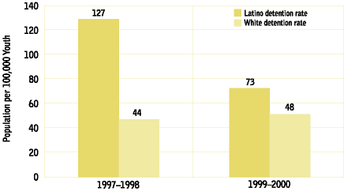
Juvenile Detention
Alternative Initiatives
Detention rate for Latino youth decline by 43% from 1997–1998 to 1999–2000. During that time, the average daily population of the detention center dropped from 49 to 37.
Notes:
Suggested talking points:
This is an example from the Annie E. Casey Foundation’s Juvenile Detention Alternatives Initiative. (The full detail can be found in Pathways to Juvenile Detention Reform: Reducing Racial Disparities #8. The Annie E. Casey Foundation).
Equitable outcomes by race were achieved by:
Focusing intentionally on the goal of reducing inappropriate racial disproportionality in detention
Developing objective culturally appropriate criteria to use in case decision-making
Closing the worst detention facilities, which housed youth of color disproportionately
Appropriately assigning those youth to alternative settings using the new criteria
The results didn’t sacrifice public safety because all youth considered harmful – as determined by applying the new criteria -- were kept in detention. Note that when this was done, a few more white youth were detained, which has troubled some pilot audiences. However, it should be pointed out those detained were judged a threat to public safety and under old practices had been allowed to remain in the community inappropriately.
These results suggest that previous practices were infused with racial stereotyping, which fails to provide equal opportunities for case disposition, regardless of race. Responsible parties in this case intentionally shifted from an across-the-board definition of success regarding juvenile case dispositions to one of racially equitable outcomes. They then analyzed dispositions using objective criteria, thereby taking steps that corrected the inequitable outcomes of past practices.

Slide 24

Doing the Work: Thinking about interventions differently
Different from what?
Color-blind approach
How is it different?
Race-informed approach (e.g., caseload reduction)
TOOL: System Reform Strategies and Community Building Strategies
Notes:
Suggested talking points:
Different from what?
Interventions are often designed without consideration to how they may play out across different racial groups. The assumption is that good practice will produce good outcomes across the board.
2) How is it different?
This approach emphasizes the need to be race-informed – that is, to understand how interventions may play out differently across racial groups and take necessary steps to ensure access to opportunity for all.
3) Example:
In public systems, caseload reduction is often a necessary strategy to enabling better services, but if it’s done without being race-informed, it won’t be sufficient.
Why? The previous example about juvenile detention showed us that caseworkers may operate on the basis of stereotypes about their clients. Stereotypical decision-making will not necessarily be changed regardless of change in the size of caseload.
For public systems to produce equitable results, caseload reduction should be coupled with culturally appropriate decision-making criteria.
Race informed approaches typically require additional steps built onto basically good ideas.
The tools of “System Reform Strategies” and “Community Building Strategies” offer guides for additional steps that may be needed alongside otherwise important policy and practice interventions and community change strategies.

Slide 25

Doing the Work: Thinking about ourselves differently
Different from what?
Good people with good intentions
How is it different?
Assessing our capacity to do work that uses an embedded racial inequities lens
e.g., Do we have the right competencies? Are we making the right investments? Does our organization operate in ways that eliminate embedded racial inequities?
TOOL: Organizational Self-Assessment
Notes:
Suggested talking points:
Different from what?
It is not uncommon to believe that well-intentioned people will necessarily produce opportunity for all. But because racial inequities are deeply embedded and are readily reinforced by dominant ways of viewing people and issues, there is no guarantee that good people with good intentions will necessarily produce good results.
2) How is it different?
This approach emphasizes the need for individuals and organizations to have specific race-informed capacities in order to produce opportunity for all.
3) Example:
Because embedded racial inequities often get produced unintentionally, it is not useful to focus on peoples’ motives. It is important to focus on their competencies for doing race-informed work.
Similarly, because embedded racial inequities often get produced unintentionally, it is not useful to focus on organizations’ missions. It is important to focus on their investments and operations for modeling opportunity for all.

Slide 26

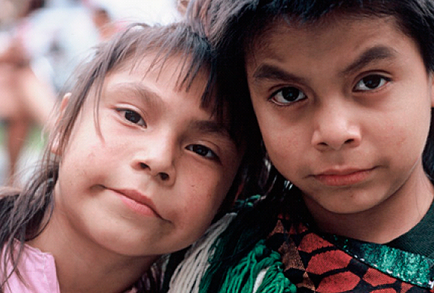
How Can the Race
Matters Tool Kit Help?
Notes:
Observation:
This section of the presentation gives an overview of the Race Matters Toolkit.

Slide 27

Table of Contents
I. Race Matters
  Race Matters User’s Guide
  Race Matters PowerPoint
II. Making the Case
  What’s Race Got to Do With It
  Fact Sheets
III. Shaping the Message
  How to Talk about Race
IV. Race Matters
  Race Matters User’s Guide
  Race Matters PowerPoint
  Community Building Strategies
  Organizational Self-Assessment
Notes:
Suggested talking points:
The contents of the Race Matters Toolkit are provided here.
These tools evolved from extensive examination of the best available practices for providing opportunity for all, testing of various drafts of the tools with focus groups around the country, and continuous feedback from racial equity advocates.
The slides that follow identify each Race Matters tool, tell why it’s useful, and indicate what it will accomplish.

Slide 28

How Can the Race
Matters Toolkit Help?
Race Matters PowerPoint
Q: Why should I use this tool?
A: Any effective focus on race needs a shared knowledge base and a shared language, which this PowerPoint provides.
Q: What will the tool help me accomplish?
A:
a focused conversation about race
a common understanding of how policies and practices contribute to inequities
an overview of the Race Matters Toolkit and how the tools enable a new way of working toward equitable results

Slide 29

How Can the Race
Matters Toolkit Help?
Making the Case: What’s Race Got to Do With It?
Q: Why should I use this tool?
A:
Sometimes race matters in situations that aren’t even presented in racial terms.
Other times the story behind the data is far more complicated than initial data reveal.
And sometimes race isn’t a major factor, even when a situation is presented as such.
Q: What will the tool help me accomplish?
A: It guides you in determining whether disparities are products of unequal opportunities by race or more so the result of other factors.

Slide 30

How Can the Race
Matters Toolkit Help?
Making the Case: Fact Sheets
Q: Why should I use this tool?
A: There’s limited attention to policies and practices as the sources of racial inequities.
Q: What will the tool help me accomplish?
A:
A quick source for analyzing problems created by policies and practices and identifying strategies to solve them
A quick source of information for proposal writing and advocacy
A model for ways to think through issues around race by moving from analysis to strategy

Slide 31

How Can the Race
Matters Toolkit Help?
Shaping the Message: How to Talk About Race
Q: Why should I use this tool?
A: Productive conversations about race are difficult to have. Based in communications research, this tool makes such conversations more likely to achieve results everyone can embrace.
Q: What will the tool help me accomplish?
A:
  Frame conversations about racial inequities in ways that keep others engaged and on point
  Get through predictably sensitive moments that typically arise when people talk about race
  Think about communications strategies for advocacy work

Slide 32

How Can the Race
Matters Toolkit Help?
Doing the Work: Racial Equity Impact Analysis
Q: Why should I use this tool?
A: Today many racially inequitable impacts are produced inadvertently, through decisions that may not even explicitly address race, may appear race neutral, or may even be offered to address racial inequities.
Q: What will the tool help me accomplish?
A: It guides you to review existing and proposed policies, programs, and practices to determine if they are likely to provide opportunity for all.

Slide 33

How Can the Race
Matters Toolkit Help?
Doing the Work: System Reform Strategies
Q: Why should I use this tool?
A: Some otherwise good system reform ideas can fall short of maximizing opportunity for all if not intentionally viewed for how they play out around race.
Q: What will the tool help me accomplish?
A: It offers a systematic process for assessing opportunity for all in policy and practice reform by walking you through key questions you should ask about reform strategies.

Slide 34

How Can the Race
Matters Toolkit Help?
Doing the Work: Community Building Strategies
Q: Why should I use this tool?
A: Some otherwise good community building strategies and practices can fall short of maximizing opportunity for all if not intentionally viewed for how they play out around race.
Q: What will the tool help me accomplish?
A: It offers a systematic process for assessing opportunity for all in community building by walking you through key questions you should ask about planned strategies.

Slide 35

How Can the Race
Matters Toolkit Help?
Doing the Work: Organizational Self-Assessment
Q: Why should I use this tool?
A: Because racial inequity is deeply embedded, it requires intentionality to produce opportunity for all.
Q: What will the tool help me accomplish?
A: It can be used to raise organizational awareness, development organizational equity action plans, and track organizational change.

Slide 36
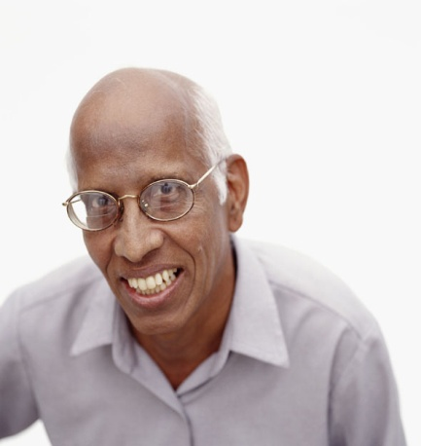
How Can the Race
Matters Toolkit Help?
Going Deeper on a
Race Matters tool that might help YOU
in your next steps
Notes:
Observation:
Here you can select a specific Race Matters tool in which your audience will have particular interest and go deeper on it. “Going deeper” could include: reviewing the tool in detail, applying it to a particular issue of shared audience concern, or applying it to a hypothetical case.

Slide 37

Q & A
What are your burning thoughts and questions?
How might the Race Matters Toolkit help you specifically?
Notes:
Observation:
Add your own questions here to help frame the discussion. Be sure to keep the discussion focused on embedded racial inequities.

