Slide 1
Elevating youth Engagement
TRACK ONE — FOR ADULT SUPPORTERS
1.1 Foundations of Authentic Youth Engagement
Jim Casey Youth Opportunities Initiative®

Slide 2
Agenda
Review module results
Check in
Review of authentic youth engagement
Four components of the authentic youth engagement approach
Benefits of authentic youth engagement
Discussion
Check out

Slide 3

Module Results
Participants will:
understand the philosophies and approaches that support authentic youth engagement;
understand the benefits of engaging young people in their community; and
commit to an action that will increase authentic youth engagement in their community.

Slide 4

Check In
Name
Location, organization and role
From your perspective, what is a characteristic of authentic youth engagement?

Slide 5
Module Context
FOCUS:
ASSUMPTION:
Qualities of youth-adult partnerships
Authentic youth engagement being mutually beneficial
Participants agree that including young people who have experienced foster care is necessary to improve system policy and practice.

Slide 6

Definition of Authentic Youth Engagement
It is a philosophical and strategic approach to working with young people.
Through this signature practice, young people use their individual and collective power and expertise in helping to shape a better future for those in and transitioning from foster care into adulthood.

Slide 7
Characteristics of Authentic Youth Engagement
This approach prioritizes young people’s expertise and ability to help shape solutions. It also provides meaningful opportunities for professional development.
Skill Building
Problem
Solving
Partnering
Mutual Learning
Leading Together

Slide 8
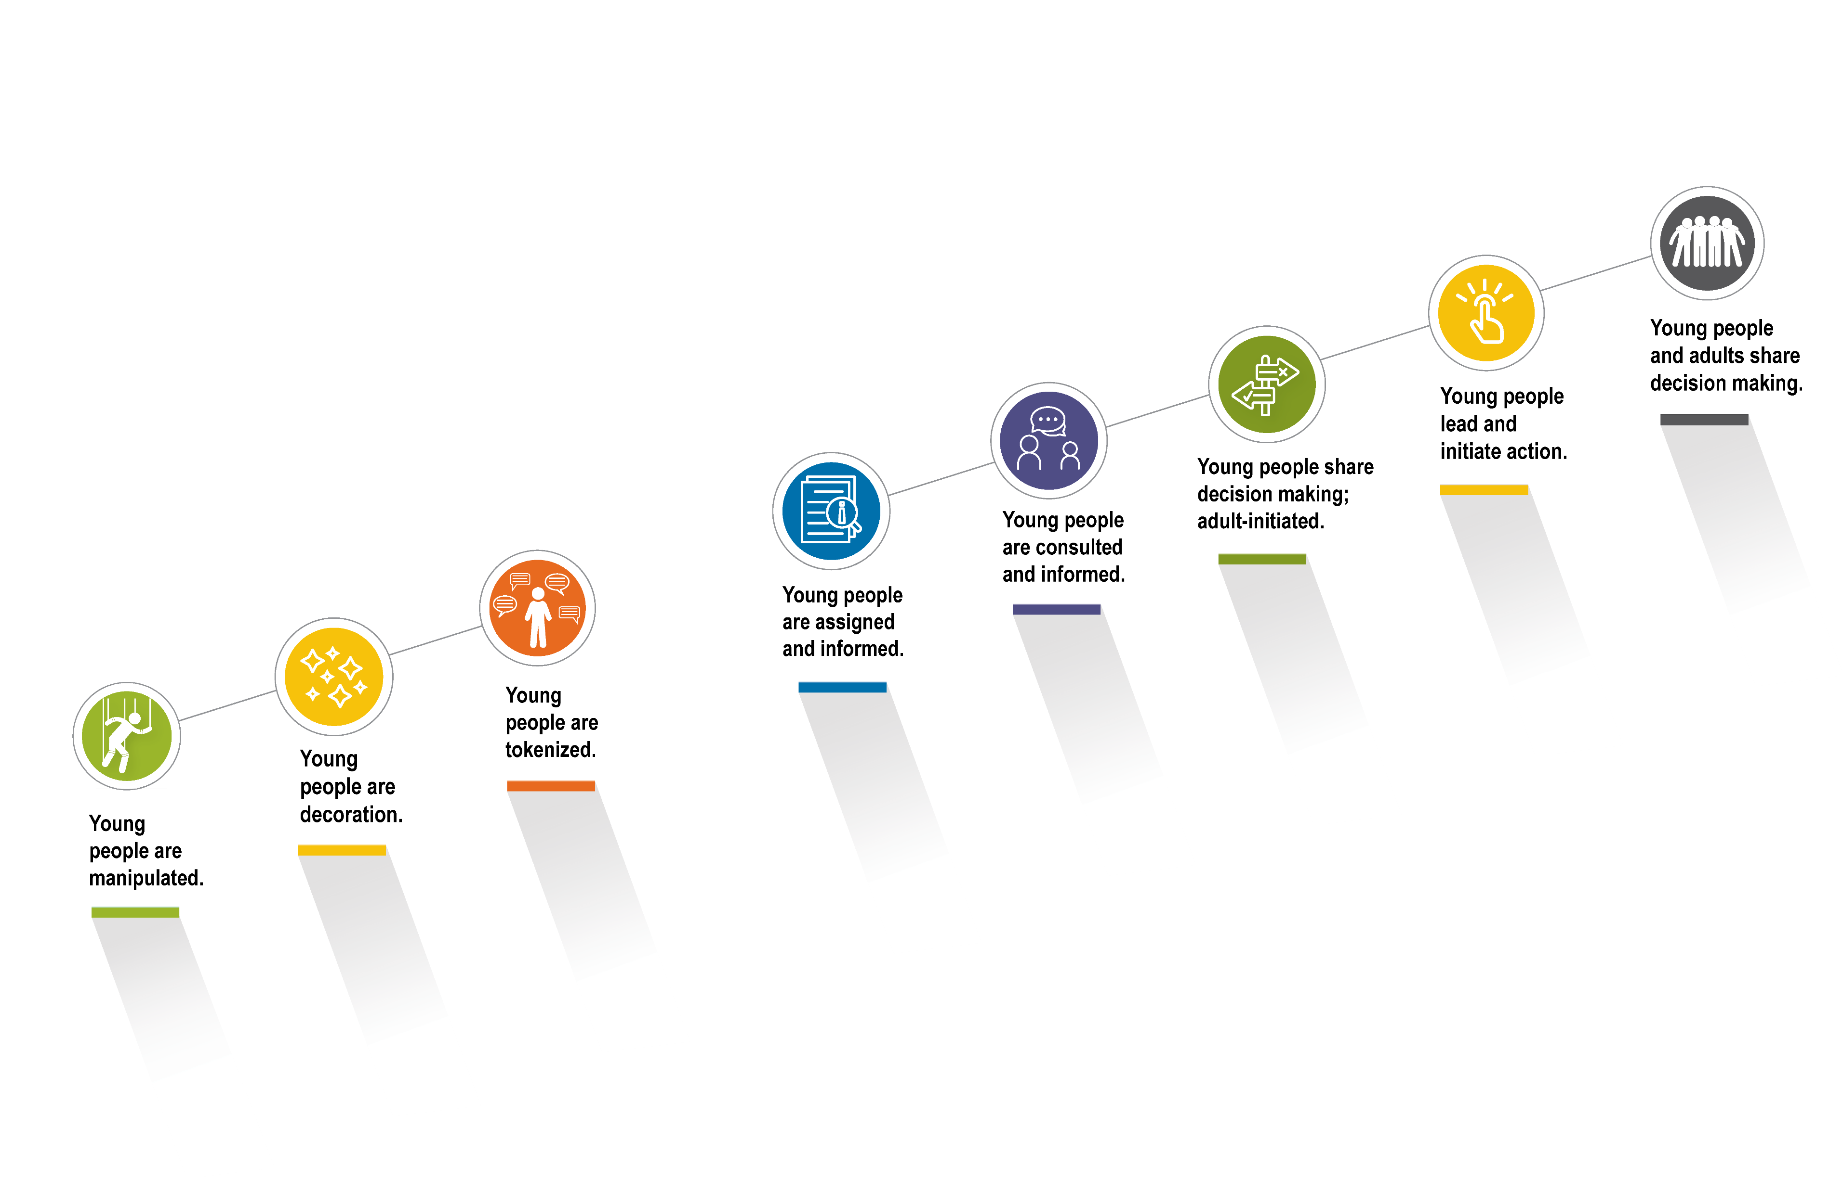
Spectrum of Youth Participation
Nonparticipation
Degrees of Participation
SOURCE: Cetera Inc., adapted from Hart, R. A. (1992). Children's participation: From tokenism to citizenship. Innocenti Essays, No. 4. UNICEF International Child Development Centre. Used with permission.

Slide 9

Activity
Think about a recent project or initiative you were involved with that included young people.
Identify the level of participation at which you involved young people.
Ask yourself: What would it take to move youth engagement efforts within this project to a higher level on the spectrum.

Slide 10

Authentic Youth Engagement Approach
Youth-adult partnership
Opportunity
Preparation
Support

Slide 11

Authentic Youth Engagement: Youth-Adult Partnership
Quality and characteristics of the relationship
Clear expectations about decision making authority
Clear boundaries about roles
Trust and honest conversations
Respect for varied experiences and opinions
Both parties valued as equal partners

Slide 12

Authentic Youth Engagement: Opportunity
Providing avenues for exercising skills
Identified and created within the youth-adult partnership
Linked to personal and professional goals identified by the young person

Slide 13

Authentic Youth Engagement: Preparation
Guiding youth to benefit from an opportunity or experience
Building awareness of individual needs (e.g., developmental, social, cognitive)
Practicing new skills
Being flexible
Exploring attitudes and beliefs toward the opportunity
Identifying strengths

Slide 14

Authentic Youth Engagement: Support
Providing help and encouragement to maximize learning and skill development
Happens in the context of the youth-adult partnership
Includes addressing physical, emotional and financial needs
Is tailored to the needs of each young person

Slide 15
Benefits of Authentic Youth Engagement for Youth
Self-Determination
Competence
Autonomy
Positive Relationships

Slide 16

Benefits for Organizations and Communities
Organizational leaders better understand the value of engaging young people.
Policies and practices more accurately reflect the needs of those they intend to support.
Diversity in perspectives contributes to developing and implementing services that aim to improve outcomes for everyone, especially those with the greatest need.

Slide 17

Large Group Discussion
What is one way that authentic youth engagement is showing up in your work?
What is one new way you can incorporate authentic youth engagement in your work?

Slide 18

Check Out
What is one action commitment related to authentic youth engagement that you are leaving with today?

