Slide 1
Elevating youth Engagement
TRACK ONE — FOR ADULT SUPPORTERS
1.2 Coaching as a Youth Engagement Practice
Jim Casey Youth Opportunities Initiative®

Slide 2
Agenda
PART ONE:
PART TWO:
Definitions and guiding principles
Coaching and authentic youth engagement
3A Coaching Process
Practice opportunities

Slide 3

Module Results
Participants will:
understand the approach of coaching and how it applies to authentic youth engagement practices; and
gain skills to incorporate coaching into their work with young people.

Slide 4

Check In
Name
Location, organization and role
Reflect on a person in your life who helped you grow.
What was the most important quality of that relationship?

Slide 5
Module Context
FOCUS:
ASSUMPTION:
Coaching relates to being able to meaningfully engage young people.
A coaching approach is suitable for youth who have experienced foster care.
Participants agree that including young people who have experienced foster care is necessary to improve system policy and practice.

Slide 6

Definition of Authentic Youth Engagement
It is a philosophical and strategic approach to working with young people.
Through this signature practice, young people use their individual and collective power and expertise in helping to shape a better future for those in and transitioning from foster care into adulthood.

Slide 7
Characteristics of Authentic Youth Engagement
This approach prioritizes young people’s expertise and ability to help shape solutions. It also provides meaningful opportunities for professional development.
Skill Building
Problem
Solving
Partnering
Mutual Learning
Leading Together

Slide 8
Part One: Coaching as a Youth Engagement Practice

Slide 9

Authentic Youth Engagement and Coaching
Coaching:
is a practice approach that helps adults form authentic relationships with young people to help them achieve their goals;
is person-centered; and
leverages knowledge and insights to motivate growth.

Slide 10
Defining Characteristics of Coaching
COACHING
Goal and outcome driven
Present and future oriented
Relational and focused on a balance of power
Follows a predictable process of practice

Slide 11
Defining Characteristics of Evidence-Based Coaching
NONDIRECTIVE
SEMI-DIRECTIVE
CONTENT SPECIFIC

Slide 12
Coaching vs. Other Helping Approaches
Therapist
Parent
Mentor

Slide 13
Defining Humanistic Coaching
Humanistic Coaching:
A human-centered approach to enhancing growth.
Coaches support young people in exploring their inner resources and strengths.
Coaches support young people in increasing motivation and growth to achieve self-identified outcomes.
SOURCE: Stober, D. R. (2006). Coaching from the humanistic perspective. In D. R. Stober & A. M. Grant (Eds.), Evidence based coaching handbook (pp. 17–50). Wiley.

Slide 14
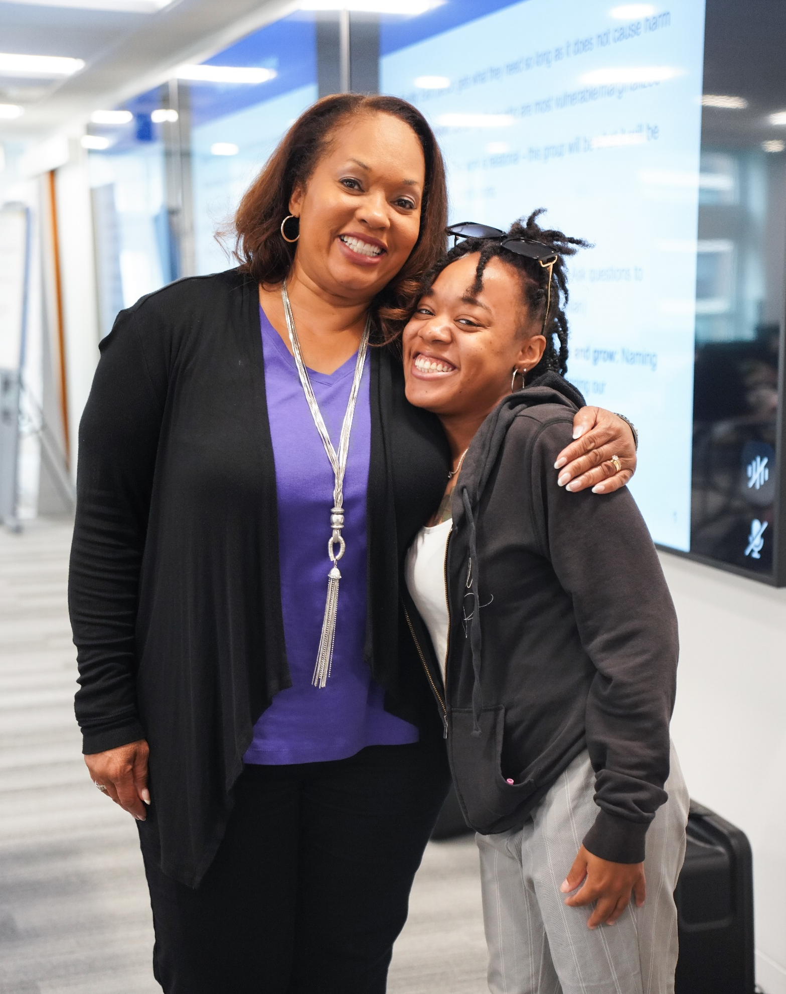
Guiding Principle 1: Relationship Is Essential
Listen for understanding of experiences and use empathy.
Connect with acceptance and without judgment.
Communicate feedback in an honest, genuine and caring manner.
Establish partnered relationships.
Do “with” not “to” or “for” them.

Slide 15

Guiding Principle 2: Young People Source and Drive Change
Facilitate youth-led agendas and goals.
Recognize that young people have expertise in goals and avenues for success.
Provide information and seek to design next steps together.
Avoid telling youth what they should do.

Slide 16

Guiding Principle 3: The Young Person Is Whole and Unique
Get to know the background of the young people as individuals.
Be aware of how those varied experiences have shaped their perspectives.
Support alignment of goals across varied areas of life.

Slide 17

Guiding Principle 4: Adult Supporters Should Facilitate Growth
Support growth at both behavioral and emotional levels.
Stay open and curious. Do not jump to solutions or attempt to fix them.
Prompt reflection to expand the young person’s awareness of strengths, resources and challenges.
Support decision making through brainstorming and processing options.
Facilitate goal setting and accountability.

Slide 18
Coaching and Authentic Youth Engagement
Relationship
COACHING
Growth

Slide 19
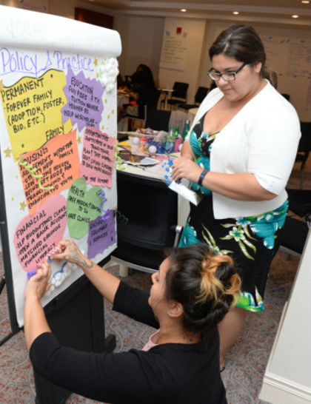
Benefits of Using a Coaching Approach
Provides a relationship that is supportive and intentional about authority and autonomy.
Feels more normative than other roles youth have relied on (e.g., therapist or case manager).
Provides a space for planning and reflecting on actions that support healthy development.

Slide 20

Discussion
What are the opportunities for you to engage youth with a coaching approach?
What are the challenges you must overcome to engage youth with a coaching approach?

Slide 21
Authentic Youth Engagement and Coaching Crosswalk
Humanistic Coaching
Authentic Youth Engagement
.

Slide 22
BREAK TIME!

Slide 23
Part Two: Coaching as a Youth Engagement Practice

Slide 24
3A Coaching Process
AGREEMENT
ACTIONS
ACCOUNTABILITY

Slide 25
3A Coaching Process
AGREEMENT
ACTIONS
ACCOUNTABILITY

Slide 26
The Coaching Agreement
What: Codesigning the coaching agenda or topic.
Why: Supports preparation and accountability for meetings and other engagements.
How: Guides young people to give input on areas of focus that are important to them.
Ask
How should we spend our time today?
What is the most important thing to focus on?
Do we have permission to add our agenda items?

Slide 27
Powerful Questions for Information Gathering
Information Gathering Questions
Open-ended or closed
Specific and intentional
Used to identify the current status of a young person’s work, needs, goals and wants
Ask
In what ways have you planned for your youth board meeting so far?

Slide 28
Powerful Questions for Reflection
Reflective Questions
Open-ended
Prompt reflection and curiosity
No right or wrong answers
A way to identify intrinsic motivation
Ask
How has planning for your youth board meeting helped with your goal to be a lawyer?

Slide 29
Tips for Powerful Questions
Avoid leading or fixing questions
Hold space for young people to join the work
Have you…?
You did this, right?
You should/need to…
What do you think is a good place to start?
What have you tried already to work on this?

Slide 30

Practice Is Key
You will ask your partner about a goal they have recently been working toward.
Each person gets one or two minutes to ask questions.
Focus on asking powerful questions and listening.

Slide 31
3A Coaching Process
AGREEMENT
ACTIONS
ACCOUNTABILITY

Slide 32
Designing Actions
What: Creating action steps toward the young person’s goals.
Why: Supports the development of skills, such as planning and reflection.
How: Guides the young person to name action steps. Your role as partner is to provide feedback and ideas while supporting self-determination.
Ask
What do you think is a good first step toward this goal?
What are some things that could get in the way of your plans?
Can I share an idea that might be useful?
Notes:
Invites the youth to the work as a partner who has valuable input.

Slide 33
Sharing Information and Giving Advice
SHARING INFORMATION IS:
GIVING ADVICE IS:
Providing facts, knowledge or insights about a situation.
Neutral and nondirective and should be paired with powerful questions to prompt next steps.
Telling what you think should happen or be done.
Directive, biased and typically related to our own views and needs.

Slide 34

Example of Sharing Information
Sharing information
“The stipend you get for your youth board conference is intended to cover food while you travel, including on the way home after the event. That means you will need to budget to make sure you have enough to eat during your 10-hour trip back home. In the past, how have you budgeted money to last a certain period of time?”

Slide 35
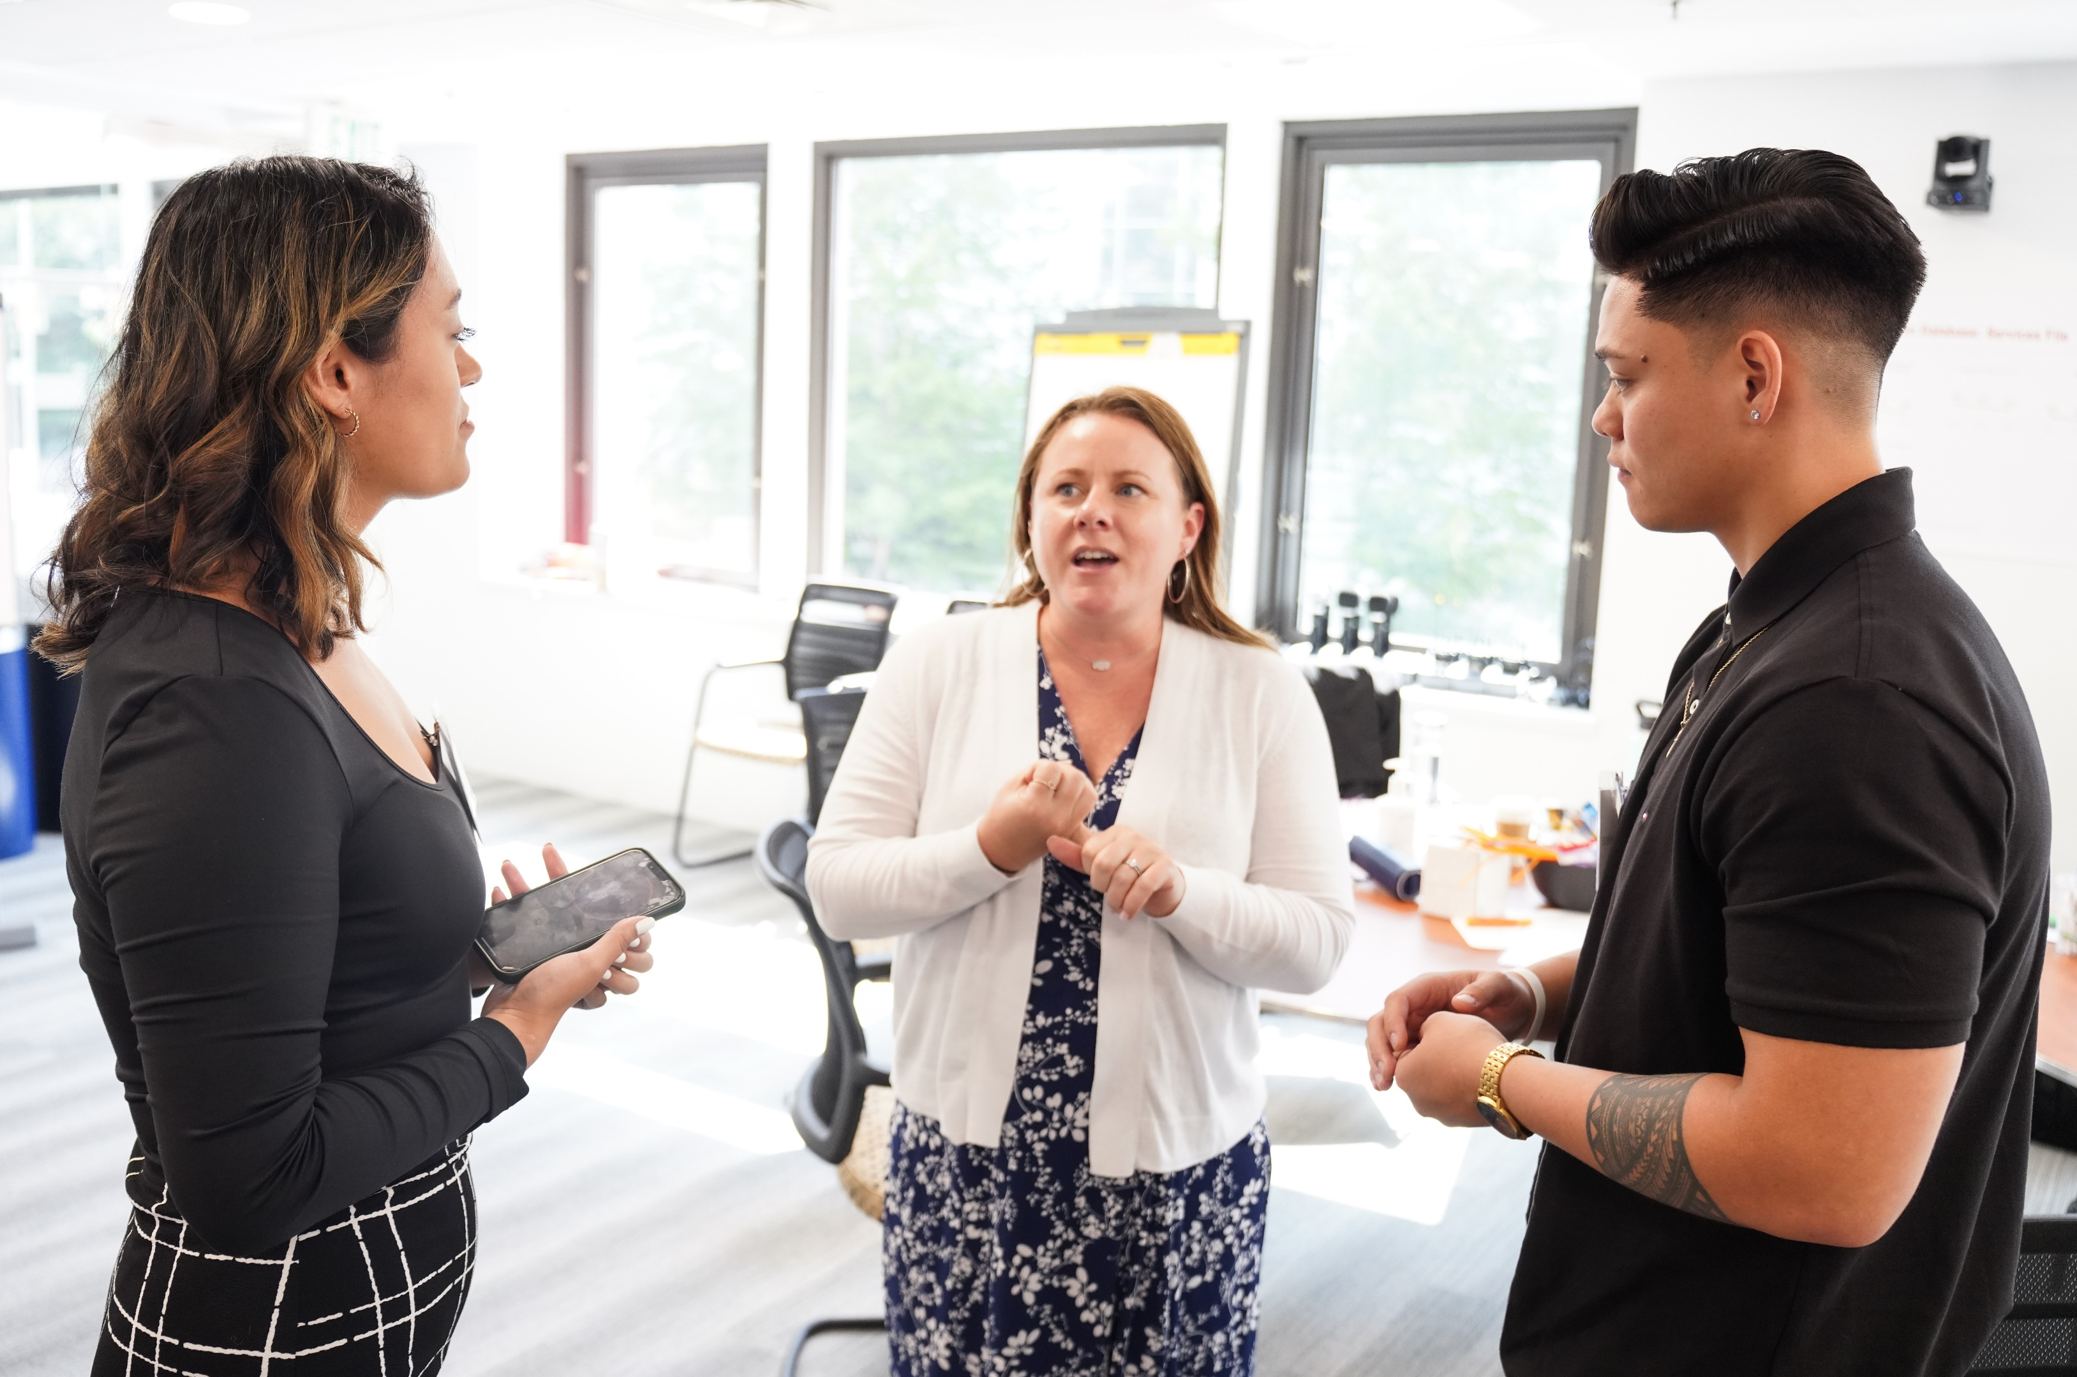
Example of Giving Advice
Giving advice
“You will get $300 for the duration of the conference, which is also intended to cover food while you travel, including on the way home after the event ends. You should plan to take the $300 amount, and divide it by five days, and save the fifth day amount for your travel. When I travel, I usually need at least $30 for food, so you should save that.”

Slide 36


Designing Actions Using SMART Goals
Always use SMART goals: Specific, Measurable, Attainable, Realistic, Time-oriented
Link the goals to intrinsic motivation and brain development.
Why is the goal important to the young person?
How does it contribute to their long- and short-term goals?
How does working toward this goal build skills?

Slide 37
3A Coaching Process
AGREEMENT
ACTIONS
ACCOUNTABILITY

Slide 38

Accountability
What: Building accountability skills that young people can practice with you in preparation for all areas of their lives.
Why: Creates opportunities for teachable moments in a safe environment and for both the adult supporter and the youth to create next steps for mutual accountability.
How: Invites the young person to develop a mutual accountability plan that is focused on skills and action.

Slide 39
Accountability Requires
Following through and checking in
Planning
Tracking progress
What else?
Ask
How will you remember your action steps?
When will you get started?
How are we relying on each other for this goal?
When and how will you provide an update on progress?

Slide 40
Beliefs and Accountability
What beliefs about young people drive our responses when they are not practicing accountability?

Slide 41
Accountability: Maximizing Teachable Moments
Checking authority and recognizing our own emotions requires:
seeking to understand rather than enforcing a rule or policy; and
holding oneself accountable for commitments.
Balance your response with strengths and praise to motivate and encourage the young person.
Ask
What got in the way of you completing this action step?
What do you think can help you move forward today?

Slide 42
3A Coaching Process
AGREEMENT
ACTIONS
ACCOUNTABILITY

Slide 43

Coaching Demo and Practice
Listen for:
Partnering
Using the 3A Coaching Process: agreement, actions, accountability
Sharing power and checking authority
Asking powerful questions
Linking to the whole person

Slide 44

Check Out
What is one way you will align your practice with a coaching approach?

