Slide 1
Elevating youth Engagement
TRACK TWO — FOR YOUNG LEADERS
2.1 Youth Advocacy 101
Jim Casey Youth Opportunities Initiative®

Slide 2
Agenda
Review module results
Check in
Review of authentic youth engagement
Policy advocacy breakdown
The lawmaking process
Advocacy strategies and advocacy in action
Break
Considerations for developing a policy agenda
Sample policy agenda and fact sheet activity
Discussion
Check out

Slide 3
Module Results
Participants will:
develop their understanding of public policy and its connection to the state and federal legislative processes;
increase their knowledge of key legislative terms and strategies for effective policy advocacy; and
exercise skills related to policy advocacy and analysis by learning the fundamentals of developing a policy agenda.

Slide 4

Check In
Name
City/State
NOTE TO FACILITATOR: Insert relevant check-in question.

Slide 5
Module Context
FOCUS:
ASSUMPTION:
Youth voice and involvement with policy advocacy
Strategies for effective advocacy
Policy and practice advocacy
Lawmaking process
Participants agree that including young people who have experienced foster care is necessary to improve system policy and practice.

Slide 6

Definition of Authentic Youth Engagement
It is a philosophical and strategic approach to working with young people.
Through this signature practice, young people use their individual and collective power and expertise in helping to shape a better future for those in and transitioning from foster care into adulthood.

Slide 7
Characteristics of Authentic Youth Engagement
This approach prioritizes young people’s expertise and ability to help shape solutions. It also provides meaningful opportunities for professional development.
Skill Building
Problem
Solving
Partnering
Mutual Learning
Leading Together

Slide 8

What It Means to Be an Advocate
Advocacy is speaking up about your needs and wants and your ideas for improving services that affect you and other youth in foster care.
  Example: When you voice your needs in a meeting about your case plan, you’re practicing self-advocacy.
Policy advocacy is the act of speaking out to ask for or influence government policies, practices and funding.
  Example: When you gather data about older youth in foster care and share it to educate child welfare policymakers, you’re engaging in policy advocacy.

Slide 9

Types of Policy Advocacy
Administrative
Legislative
Budget

Slide 10
Educating or Lobbying: Know the Difference
Examples of policy advocacy defined as EDUCATING:
Examples of policy advocacy defined as
LOBBYING:
Sharing your story to show how a policy or practice change would help youth safely transition from foster care to adulthood
Creating a fact sheet to present data that supports the need for change
Holding a town hall discussion to present facts and hear from youth who have experienced foster care
Engaging in activity intended to directly influence legislation (city, state or federal) or to influence an election’s outcome
Telling lawmakers to support or reject legislation or telling voters which candidate to choose in an election
Urging the public to contact legislators to take a position on legislation

Slide 11

Defining Law and Legislation
A law (also called a statute) is a formal rule or requirement that:
  is passed by a legislative body, such as Congress or a state legislature;
  requires a formal process to pass (e.g., voting); and
  can be enforced by court action.
Legislation is the process of making laws. It includes writing,
discussing and voting on new rules by a group of lawmakers.
We use the word "legislation" to talk about these rules while
they are still being worked on and before they officially
become law.

Slide 12

Defining Administrative Policy
An administrative policy:
  is a rule, guideline or procedure created by a government agency (not legislators) to explain how a law will be carried out or enforced;
  explains or guides how laws are to be implemented in everyday practice, but are not laws themselves; and
  can vary by agency or state.
Certain administrative policies, like regulations, are legally
binding and can be enforced by several means, possibly
even court action.

Slide 13
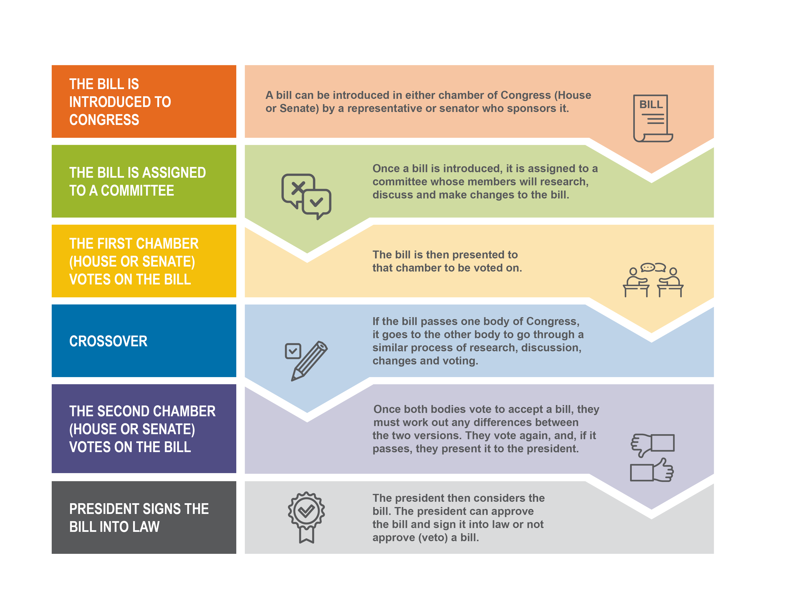
High-Level Overview of the Lawmaking Process

Slide 14

Discussion: Contributing to the Lawmaking Process
How can advocates and young leaders contribute to the lawmaking process?
If you have participated in policy advocacy, how did you contribute?

Slide 15






Advocacy Strategies
Advocacy messaging: Tailoring your message to your audience and understanding the importance of who is delivering the message.
Engagement in government relations: Directly influencing and making appeals to lawmakers.
Research and data analysis: Developing and circulating powerful information to make a case showing the importance of the issue and validating it as an issue.
Mobilization: Showing lawmakers that there is a base of support for the issue.
ADVOCACY STRATEGIES

Slide 16
Engaging With Legislators
WHAT TO DO:
Be engaged on social media (posts and hashtags)
Write letters, send emails and make phone calls
Visit your state capitol or the United States Capitol during the legislative session or Foster Care Day
WHAT NOT TO DO:
Be long-winded about your issue
Be demanding or disrespectful if legislators or their staff members do not value your issue
Be unprepared or not have your remarks planned and practiced
Be late

Slide 17
State-Level Advocacy in Action
In 2018, Rhode Island amended state law to create a voluntary extended foster care program and the option for reentry into foster care for youth between ages 18 and 21.
Youth advocates played a key role in its passage by:
mobilizing local youth advocacy boards to partner with members of the Rhode Island state legislature to draft legislation and sponsor an extension of care bill;
providing testimony in committee meetings in support of the bill; and
participating in facilitated conversations with bill sponsors around areas to modify the legislation to help ensure its passage.

Slide 18
BREAK TIME!

Slide 19

Case Study: The Breakdown of a Policy Agenda

Slide 20
What Is a Policy Agenda?
A policy agenda is the strategic layout of a social issue, the issue’s impact on society and proposed solutions.
Policy agendas are meant to get the attention of people involved in policymaking, such as government officials.
Why is setting a policy agenda important?
It allows you to:
be clear on what you are advocating for;
figure out the specifics of the policy; and
determine if now is the time to advocate for the policy.

Slide 21

Review a Sample Policy Agenda and Fact Sheet

Slide 22
Framework for Developing a Policy Agenda
Name It
Claim It
Tame It
Frame It

Slide 23
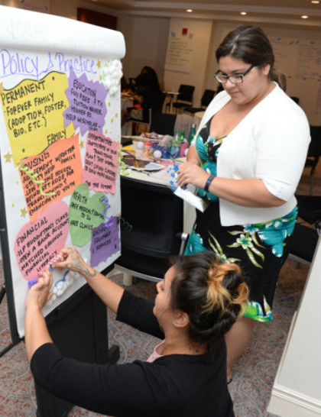
Name It
What is the social issue that your advocacy will address?
What is the urgency behind the issue?
Are there data points available on the issue? If so, what do they tell us?

Slide 24

Claim It
Is public policy the solution?
Who is affected?
Should government intervene? Are rights and freedoms violated?

Slide 25

Tame It
What are possible public policy solutions?
What solutions does your policy agenda elevate that contribute to improving the issue?
How do the solutions advance policies and practices that will improve outcomes for young people with the greatest need?

Slide 26

Frame It
Is now the time for this agenda?
What is the financial cost of introducing this policy into law? Is it feasible?
What happens if action is not taken on this issue?

Slide 27

Discussion: Report Findings for Exercise
Part 1: Two-Minute Team Report
What were your findings from each part of the activity?
Part 2: Individual Report
What was your most meaningful takeaway?

Slide 28

Check Out
NOTE TO FACILITATOR: Insert relevant question here.

