Slide 1
Elevating youth Engagement
TRACK TWO — FOR YOUNG LEADERS
2.2 Wellness and Advocacy for Young Leaders
Jim Casey Youth Opportunities Initiative®

Slide 2

Agenda
Review module results
Check in
Review of authentic youth engagement
Wellness and self-awareness
Personal reflection activity
Advocacy and risks
The Four C’s of Resilience
Discussion
Check out

Slide 3

Module Results
Participants will:
explore the connection between self-awareness, personal wellness and advocacy;
reflect on personal experiences to help identify trauma triggers; and
learn about tools for managing their well-being to minimize harm when advocating for themselves and others.

Slide 4
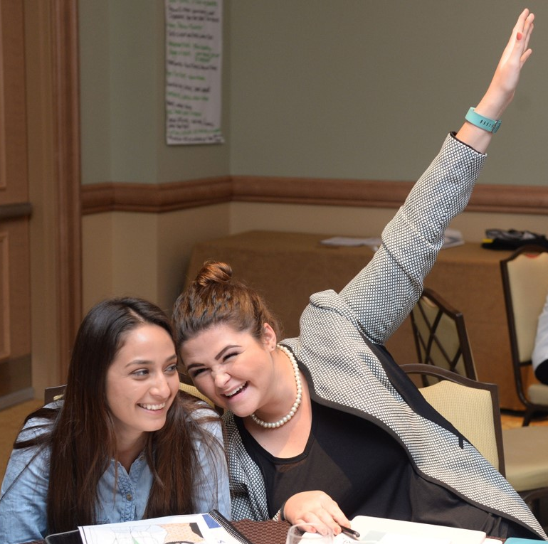
Check In
Name
City, state
NOTE TO FACILITATOR: Insert relevant check-in question.

Slide 5
Module Context
FOCUS:
ASSUMPTION:
Self-awareness
Personal reflection
Setting boundaries
Wellness
Participants agree that including young people who have experienced foster care is necessary to improve system policy and practice.

Slide 6

Definition of Authentic Youth Engagement
It is a philosophical and strategic approach to working with young people.
Through this signature practice, young people use their individual and collective power and expertise in helping to shape a better future for those in and transitioning from foster care into adulthood.

Slide 7
Characteristics of Authentic Youth Engagement
This approach prioritizes young people’s expertise and ability to help shape solutions. It also provides meaningful opportunities for professional development.
Skill Building
Problem
Solving
Partnering
Mutual Learning
Leading Together

Slide 8

The Intersection Between Advocacy and Wellness
Advocacy is speaking up about your needs and wants and your ideas for improving services that affect you and other youth in foster care.
In advocacy, we often use stories, experiences and ideas as instruments for change. This means, it is critical that we:
  understand how our stories affect us in the moment; and
  have well-being practices ready before, during and after engaging in advocacy.

Slide 9
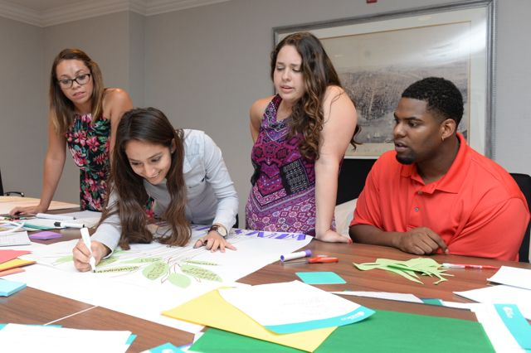
The Significance of Self-Awareness and Advocacy
Being self-aware means you’re able to accurately recognize your emotions, thoughts and values. It also means you understand how your emotions, thoughts and values affect your behavior.

Slide 10

Self-Awareness Activity
PERSONAL REFLECTION
Describe yourself in three words.
What qualities do you most admire in yourself?
What is your biggest weakness?
What is your biggest strength?
What things scare you?
What excites you?

Slide 11

Personal Reflection and Wellness
Personal reflection allows you to:
use your story as a tool for change;
avoid being trapped by situations or people that may have wounded you;
be aware of how your experiences have shaped you; and
advocate effectively, even in situations where there may be opposition.

Slide 12
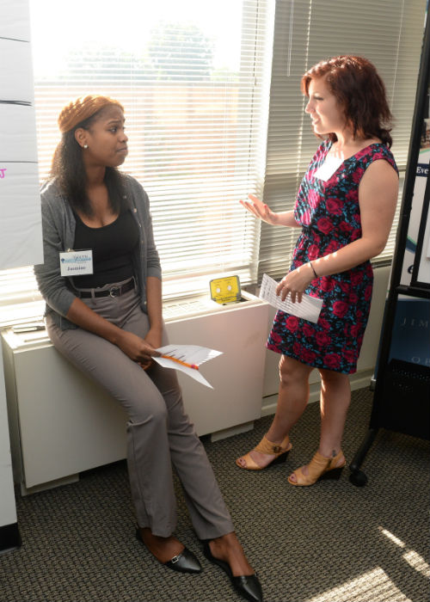
Four Tips for Advocacy and Well-Being
Think through your experiences that reflect popular advocacy themes, such as housing, education, professional development and parenting.
Highlight who and what have helped you thrive.
Reflect on tough experiences that may trigger you when speaking or presenting.
Set boundaries and communicate your comfort level with certain topics as a safety measure when participating in advocacy opportunities.

Slide 13
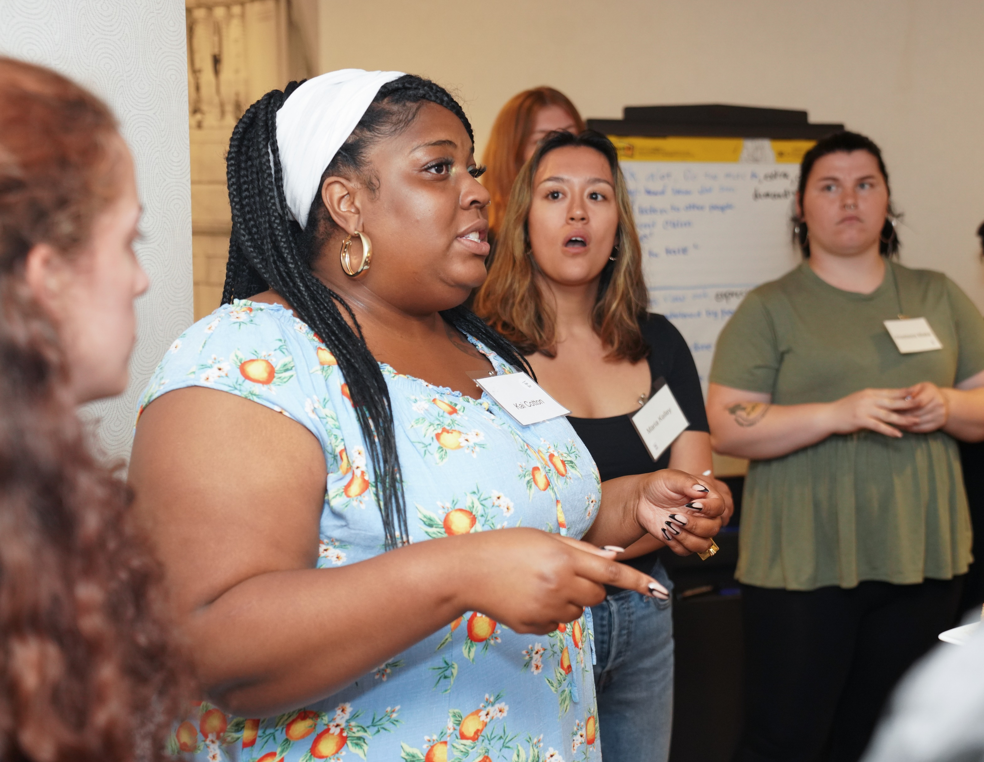
Sometimes Advocating Comes With Risks
Trauma triggers
Painful memories
Oversharing
Stress response
Anxiousness
Stage fright

Slide 14
Prioritizing Wellness and Identity Shifts
Identity shifts are normal for advocates. You may:
become a parent;
transition into formal job opportunities;
reach an age where you feel like advocacy roles may not suit you; or
start to feel that some adults you work with struggle to view you as a young professional.
These feelings are normal. Just make sure that you:
Communicate what you need.
Ask if there may be opportunities that are appropriate for you, such as becoming an adult supporter, consultant — or even a staff member. (Yes, see if you may be able to get a job.)

Slide 15

Stress Reponses Reflection
How do your stress responses show up in your role as an advocate?
In what ways are you shifting from being a youth in foster care to being a young advocate or professional?

Slide 16
The Four C’s of Resilience
Coping
Competency
Control
Connections

Slide 17
Coping
Coping is what people do to try to minimize stress.
How do you cope when an advocacy opportunity doesn’t go well?
Examples of coping skills
Calling a mentor or friend
Spending time processing through the trigger to reduce the chance of the trigger coming up again
Having a good cry or getting a hug
Writing in a journal

Slide 18
Competency
Competency is the ability to do something successfully or effectively.
Competence also applies to understanding how participating in the opportunity might affect you.
Will you be sharing a lot of your story?
Will there be people present who do not understand that your experience could be oppositional?
Is the opportunity safe?
As an advocate, competence applies to your understanding of the opportunity.
Do you feel prepared to speak or share?
Is your advocacy aligned with the mission or theme?

Slide 19
Control
In the context of resilience, control means you have the capacity to act independently and make your own choices every time that you participate in an advocacy opportunity.
Minimizing re-traumatization
The following are examples of ways to exercise control when advocating:
Set boundaries
Know when to say no to opportunities
Focus on emotional awareness

Slide 20
Connections
Connection is the state of being joined or linked to people, places or things.
Being connected to loving and supportive people helps you cope if you are in a situation where you may feel triggered.
For advocates, being connected can mean having someone who:
supports you by being an anchor in the audience when you are speaking or sharing your story;
shares constructive feedback;
helps you practice and prepare your remarks; or
is an ally and advocates for you when you need support.

Slide 21
Discussion
Based on today’s conversation, what is one way you plan to manage your well-being while advocating?

Slide 22

Check Out
NOTE TO FACILITATOR: Insert checkout question here.

