Slide 1
Elevating youth Engagement
TRACK THREE — FOR YOUNG PEOPLE AND ADULT SUPPORTERS
3.2 Youth-Adult Partnerships and Adolescent Brain Development
Jim Casey Youth Opportunities Initiative®

Slide 2
Agenda
Review module results
Check in
Review of authentic youth engagement
The experience of foster care
Adolescent brain development
Changing the narrative
Discussion
Check out

Slide 3
Module Results
Participants will understand:
how the experience of foster care affects the adolescent brain;
the developmental milestones occurring in the adolescent brain; and
how to incorporate insights about adolescent brain development in their work to achieve authentic youth engagement.

Slide 4

Check In
Name
Location, Role
What is one way a relationship affected you positively when you were a teen?

Slide 5
Module Context
FOCUS:
ASSUMPTION:
The experience of foster care
How to apply adolescent brain development to authentic youth engagement
Participants agree that including young people who have experienced foster care is necessary to improve system policy and practice.

Slide 6

Definition of Authentic Youth Engagement
It is a philosophical and strategic approach to working with young people.
Through this signature practice, young people use their individual and collective power and expertise in helping to shape a better future for those in and transitioning from foster care into adulthood.

Slide 7
Characteristics of Authentic Youth Engagement
This approach prioritizes young people’s expertise and ability to help shape solutions. It also provides meaningful opportunities for professional development.
Skill Building
Problem
Solving
Partnering
Mutual Learning
Leading Together

Slide 8

The Experience of Foster Care
Upon entering foster care, young people may lose opportunities to:
make decisions about their lives;
take developmentally typical risks; and
experience normal and prosocial adolescent activities, such as after-school clubs or sports.

Slide 9

The Experience of Foster Care
Many policies and practices that affect youth in foster care:
attempt to fix problems for youth;
result in decisions being made without the young people’s input; and
are based on assumptions that adults know better than young people.
Often, policies and practices do not align with the science of adolescent brain development.

Slide 10

Authentic Youth Engagement: Consider the Adolescent Brain

Slide 11
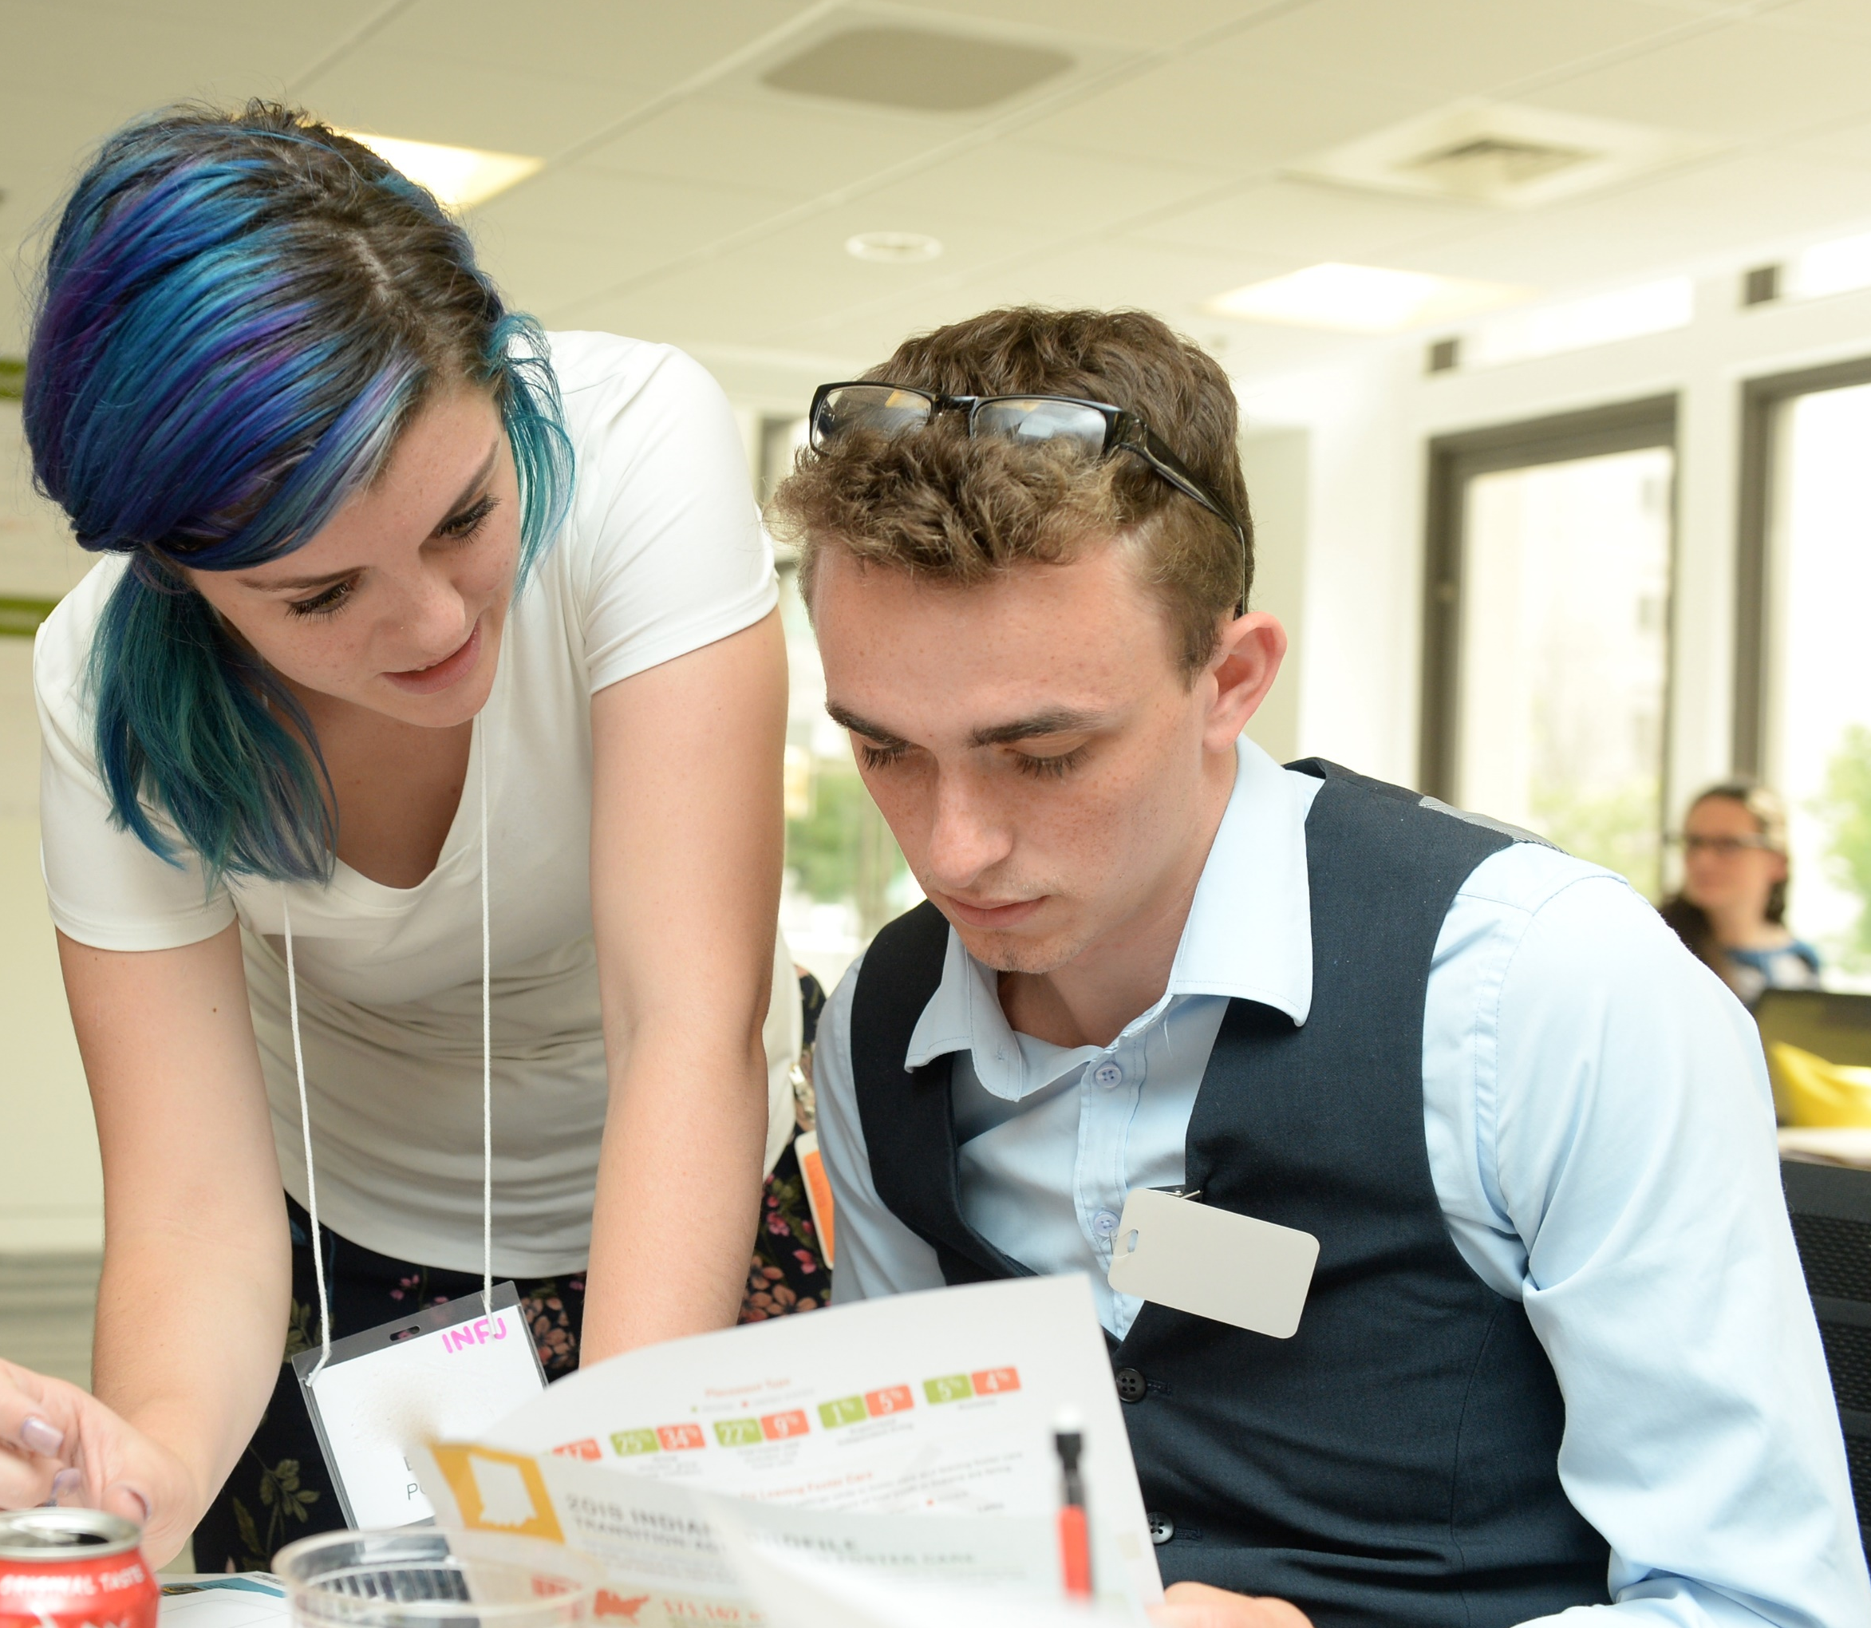
Adolescent Brain Development: The Highlights
Characteristics of adolescence
It is a developmental window that is similar in milestones to the one in early childhood.
Different parts of the brain are integrating for more efficient information flow, meaning less reliance on the emotional center of the brain for decision making.
A surge in the brain’s “neuroplasticity” and “pruning” means new neural pathways are formed, old pathways are removed and existing connections are strengthened.
It’s sometimes the most exciting and memorable phase throughout the lifespan.

Slide 12
Adolescent Brain Development: How Does It Play Out?
THE REGULATORY SYSTEM
THE RELATIONSHIP SYSTEM
Impulse control and risk taking
“Hot cognition” moments
Sensitivity to social acceptance and rejection
Best learning in peer groups
THE REWARD SYSTEM
EXECUTIVE FUNCTIONS
Receptivity to reward-based learning
Emotional regulation, planning, organizing, introspection, flexibility and critical thinking

Slide 13
Adolescent Brain Development: The Experience of Foster Care
Youth may have few opportunities to make independent decisions and take on consistent responsibilities in a supportive environment.
Risk-averse caregivers
Examples: no going to sleepovers or learning to drive
Independent living classes vs. interdependent relationships and families
Tendency to pathologize behavior that is typical for youth this age
Strong emotions interpreted as behavioral issues

Slide 14
Adolescent Brain Development: Trauma and Adversity
Trauma and adversity interfere with healthy adolescent brain development
Prolonged exposure to toxic stress and adverse childhood experiences alters the architecture of the developing brain.
When young people are required to adapt to an environment where chronic stress and frequent transitions are the norm, young brains prime themselves to focus on survival.
However, this period of rapid change and rewiring poses a critical moment for healing and growth as young people learn from their experiences.

Slide 15

Change the Narrative From Impulsive to Creative Contributors
Young people are:
uniquely primed for learning;
more sensitive and receptive to the influence of others; and
motivated by curiosity, passion and excitement.

Slide 16

Large Group Discussion: Change the Narrative
What opportunities do young people need to support their adolescent brain development?

Slide 17
Reflection Activity
Individual Reflection
What experiences have been impactful in your life and may have contributed to your brain development in a positive way?
Small Group Discussion
Identify a specific example of when adolescent brain development was not considered.
Identify ways you may be able to influence a practice to better incorporate the science of adolescent brain development.

Slide 18

How It Looks in Practice
Implement these four practices in partnership with each other and in the context of adolescent brain development to achieve authentic youth engagement:
Youth-adult partnership
Opportunity
Preparation
Support

Slide 19

Check Out
What support do you need to better incorporate the science of adolescent brain development in your work?

