Slide 1
Elevating youth Engagement
TRACK THREE — FOR YOUNG PEOPLE AND ADULT SUPPORTERS
3.3 Partnership to Action
Jim Casey Youth Opportunities Initiative®

Slide 2

Agenda
Review module results
Check in
Review of authentic youth engagement
Adolescent brain development
Youth engagement in practice
Partnership and youth engagement
Youth engagement in action
Effective preparation and support
Check out

Slide 3

Module Results
Participants will:
gain knowledge of the elements of authentic youth engagement;
deepen their knowledge of practices that increase authentic youth engagement in their work; and
gain tools to support young people in opportunities for leadership development and policy advocacy.

Slide 4

Check In
Name
Location, Role
What is one characteristic of partnership that is important to you?

Slide 5
Module Context
FOCUS:
ASSUMPTION:
Brain development and authentic youth engagement
Practices and benefits of youth-adult partnerships
Participants agree that including young people who have experienced foster care is necessary to improve system policy and practice.

Slide 6

Definition of Authentic Youth Engagement
It is a philosophical and strategic approach to working with young people.
Through this signature practice, young people use their individual and collective power and expertise in helping to shape a better future for those in and transitioning from foster care into adulthood.

Slide 7
Characteristics of Authentic Youth Engagement
This approach prioritizes young people’s expertise and ability to help shape solutions. It also provides meaningful opportunities for professional development.
Skill Building
Problem
Solving
Partnering
Mutual Learning
Leading Together

Slide 8

Adolescent Brain Science
Key points and highlights
This is a developmental window that is similar in milestones to the one in early childhood.
Different parts of the brain are integrating for more efficient information flow, meaning less reliance on the emotional center of the brain for decision making.
A surge in the brain’s “neuroplasticity” and “pruning” means new neural pathways are formed, old pathways are removed and existing connections are strengthened.
It’s sometimes the most exciting and memorable phase throughout the lifespan.

Slide 9

Achieving Authentic Youth Engagement
How it looks in practice
Implement these four practices in partnership with each other and in the context of adolescent brain development to achieve authentic youth engagement:
Youth-adult partnership
Opportunity
Preparation
Support

Slide 10
Change the Narrative From Impulsive to Creative Contributors
Young people are:
wired for learning and taking on opportunities that challenge them;
more sensitive and receptive to the influence of others; and
motivated by curiosity, passion and excitement.
Young people need opportunities to:
try new things;
take on consistent responsibilities; and
learn through relationships.

Slide 11
Adolescent Brain Science
Individual Reflection
In your role, how are the cornerstones of adolescent brain development incorporated into your work?
Small Group Discussion
Identify new opportunities in your work to partner with young people to encourage healthy wiring of the brain.
Bonus
Select one person with whom you can share adolescent brain science to influence policy and practice change for young people from foster care.

Slide 12
Partnership and Authentic Youth Engagement

Slide 13
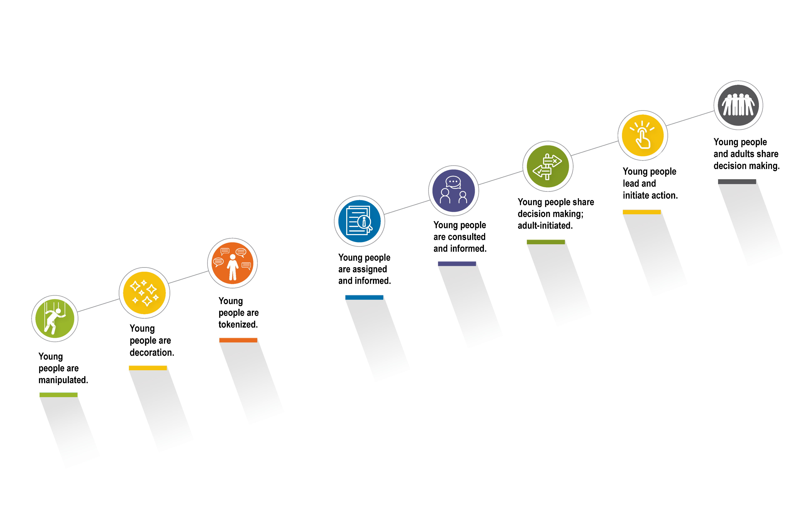
Using the Spectrum of Youth Participation
Nonparticipation
Degrees of Participation
SOURCE: Cetera Inc., adapted from Hart, R. A. (1992). Children's participation: From tokenism to citizenship. Innocenti Essays, No. 4. UNICEF International Child Development Centre. Used with permission.
13

Slide 14
What Partnership Looks Like
Partnership is:
doing “with” not “for” or “to;” and
intentionally engaging as equal partners.
Partnership looks like:
asking for, listening to and incorporating feedback;
using interpersonal skills for building trust and relationships; and
integrating youth voice into organizational decisions.
Partnership requires:
self-reflection on personal beliefs and biases; and
interdependent relationships between adults and young people.

Slide 15
Benefits of Successful Youth-Adult Partnerships
Moving from transactional to relational
Young person
Adult
Organization
increases self-efficacy, self-esteem, hope and belonging;
develops communications skills and leadership experience; and
strengthens problem-solving skills, such as reasoning, decision making and self-regulation.
increases alignment with youth in case planning and recommended services;
expands resources and gains thought partners in problem solving; and
gains insight and understanding of each youth’s expertise, competence and needs.
ties policy and practice shifts to frontline experience;
improves recruitment and retention of young adults in programs; and
values and includes all young people, families and communities, especially those with the greatest need.

Slide 16
Youth-Adult Partnership Scenarios
Nonparticipation
Degrees of Participation
SOURCE: Cetera Inc., adapted from Hart, R. A. (1992). Children's participation: From tokenism to citizenship. Innocenti Essays, No. 4. UNICEF International Child Development Centre. Used with permission.
16

Slide 17
Authentic Youth Engagement in Action

Slide 18
The Elements of Authentic Youth Engagement
To build individual leadership and advocacy skills, authentic youth engagement:
focuses on partnership with young people;
prepares young people to be active partners;
supports young people at all stages; and
provides opportunities for individual growth and policy advocacy.
Leadership Development
Youth-Adult Partnership
Preparation
Opportunities
Support
Policy Advocacy

Slide 19
Creating Opportunities
To promote learning, growth and skill development:
Identify
Evaluate
Create
opportunities that have been presented to you;
opportunities that you seek out; and
opportunities that young people bring forward.
if the opportunity meets the needs of the young person;
if the opportunity contributes to the work; and
if there are support structures in place.
committees;
policy review;
panel discussions;
presentations and facilitation; and
opportunities for advocating and testifying.
Notes:
the Jim Casey Initiative indicators.

Slide 20

Benefits of Creating Opportunities
Create opportunities for young leaders to:
experience normalcy;
experience positive relationships;
take healthy, safe risks;
advocate and lead; and
build professional and social networks that help them achieve employment, education and other goals.

Slide 21
Six Steps: Effective Preparation and Support in Practice
1
Consider the Opportunity
2
Initial preparation for opportunity
3
Final preparation for opportunity
4
Show up for the opportunity
5
Support during the opportunity
6
Support after the opportunity

Slide 22
Effective Preparation Checklist
Consider the Opportunity
Initial Preparation for Opportunity
Final Preparation for Opportunity
What is the opportunity?
Why this young person?
What are the young person’s feelings and thoughts about the ask?
What knowledge and experience does the young person have?
What are the benefits for the young person?
How will the young person be financially compensated?
Are travel or lodging accommodations required?
Schedule conference calls.
Secure and review end results/objectives.
Provide necessary tools/ materials/technology.
Work with youth on key messages.
Practice with the young person.
Identify options for financial compensation.
Identify how travel and lodging accommodations will be supported.
Support young person in making child care, pet care or other dependent care plans.
Review expectations.
Review key messages.
Review techniques for managing triggers.
Review techniques for managing the audience.
Check out the physical space.
Conduct a final run-through.
22

Slide 23
Effective Support Checklist
Show Up for Opportunity
Support During Opportunity
Support After Opportunity
Book flights and arrange transportation.
Provide a letter for work and/or school.
Provide important details and/or help them obtain the information.
Finalize wellness and basic needs planning.
Attend the opportunity with the young person.
If attending is not possible, plan to immediately check-in.
Use nonverbal cues to support timing and self-care.
Provide encouragement and praise.
Provide a key message refresher.
Debrief.
Provide feedback and praise.
Listen and respond to feedback.
Answer questions.
Continue to encourage self-care.
Follow up on results of the project, meeting and next steps.
Ensure financial compensation was issued based on initial agreements.

Slide 24

Check Out
ACTIVITY: HEAD, HEART, HANDS
HEAD: What is one new piece of information you are taking away?
HEART: What is one new awareness you are taking away?
HANDS: What is one action you commit to doing to increase your youth-adult partnerships?

