Slide 1
Agenda: List of Training Activities
TRAINING METHOD | TOPIC | TIME ESTIMATED
Presentation | Welcome, Keys Curriculum Overview and Session Objectives Tech Details for Zoom Workshops; Icebreaker | 15 minutes
Presentation, Video and Facilitated Discussions | Understanding the Definition of Financial Well-Being | 10 minutes
Presentation and Facilitated Discussion | Isabella’s Vision; Get Clear on Your Vision; Your Vision and Your Values; Your Values: Ranking Activity; Factors That Influence Values | 10 minutes
Presentation, Video and Group Activity | Goals (Play Video); Reflection Question; Zari’s Savings Goal | 10 minutes
Presentation and Group Activity | Finding Money to Save; Savings Strategies; Saving Smart, Not Hard | 10 minutes
Presentation | Assets and Liabilities; Put It Together — Financial Capability | 5 minutes
Closing | Questions? What Is One Thing Learned? Next Training Date and Time | 5 minutes
TOTAL TIME ESTIMATE |  | About 1 to 1.5 hours
Notes:
For internal use by facilitators. This sample agenda mirrors the agenda in the facilitators’ guide. Recent updates to the curriculum appear in this slide but may not yet appear in the facilitators’ guide. Updates to the guides are in progress. Facilitators will want to keep close track of session time and balance delivering the content and encouraging discussions to keep the session one to 1.5 hours long.

Slide 2
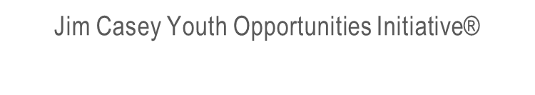
Keys to your financial future
Key 1: Building the Foundation for Your Financial Future
Notes:
Facilitator: Introduce yourself. Ask participants to say take themselves off mute and say their names, or if they are more comfortable, they may say hello by putting their name in the chat box.

Slide 3

Overview of the Eight Keys
Building the Foundation
Understanding Credit History
Getting the Credit and Loans You Need
Understanding Your Income
Paying Bills and Budgeting
Saving and Investing
Banking
Protecting Your Identity
Notes:
Explain how the eight Keys were developed by experts, including young adults, to help young people develop the skills to make informed decisions about their financial lives. Ask a participant to read the titles for the eight Keys.
Let the participants know that the original Keys and their Participant Guide can be found at:
https://www.aecf.org/resources/keys-to-your-financial-future-participant-guides/#:~:text=Updated%20in%20August%202019%2C%20Keys,developed%20by%20the%20Annie%20E.&text=The%20curriculum%20was%20created%20with,as%20they%20transitioned%20into%20adulthood.
Describe your program, how many sessions there will be and what topics will be covered.

Slide 4

What You’re Going to Know or Be Able to Do
Understand the personal finance ecosystem.
Describe your vision.
Identify or name your values.
Identify influences on values and how you use money.
Set goals.
Identify resources needed to accomplish your goals.
Calculate saving targets to reach your goals.
Define financial capability and asset building and identify assets that make up an asset-building portfolio.
Notes:
Discuss the content that is covered in Key 1: Building the Foundation for Your Financial Future.
Let the participants know that there is a lot of material in the Key, and you will not be able to cover it all in this virtual format. Encourage them to check the participant guide for the entire content.
Be sure that you cover these two main points during this workshop:
It’s important for young people to think about what they envision for themselves in the future and set goals to achieve that vision. Vision provides purpose and direction to their actions. Money will affect these visions and needs to be factored into their goals.
It’s also important for young people to understand their own values. Being aware of them can help them understand the reasons why they make certain choices and financial decisions.

Slide 5


Tech Details for Workshops Presented on Zoom
Participant toolbar on a cell phone
Participant toolbar on a computer
We want to see you!
Notes:
Explain the features of the online platform you are using, such as chat box, mute, raising hand, polls, reactions. Encourage participants to use their video so all may see each other.
Discuss ground rules for workshop participation and ask the young people for their ideas and suggestions. Some ideas are:
Express ideas/thoughts.
Respect other’s ideas and comments.
Don’t make fun of others.
Be on time for the training.

Slide 6

Why do you think a lot of people encounter financial hardships?
Notes:
An alternative icebreaker question: What is financial well-being?

Slide 7
When You Complete the Keys Training, You Will…
Feel confident in your ability to get, manage and plan for your financial needs;
Describe a vision for your life and set goals;
Prioritize spending and find money to save;
Advocate for yourself when there are mistakes or injustices;
Develop knowledge on personal finance topics; and
Build a positive relationship with money.
Notes:
Ask a young person to read the goals for participating in the Keys Training.

Slide 8
Definition of Financial Well-Being
Financial well-being is a state in which a person is meeting their current and ongoing obligations and able to make choices to enjoy life and have a secure future.
  Managing day-to-day finances
  Absorbing financial shocks
  Meeting financial goals
  Having the ability to make choices to enjoy life.
SOURCE: Consumer Financial Protection Bureau (CPFB)
Notes:
Let participants know that the Consumer Financial Protection Bureau (the federal government agency that implements and enforces federal consumer financial law) conducted surveys of Americans to develop a definition of financial well-being.
Ask someone to read the statement in the green box. Explain that financial well-being translates into four behaviors:
A person can manage their day-to-day finances — be able to have housing, transportation, food and other things they need and be able to pay for them without incurring debt.
Be able to handle financial shocks, such as a car repair, by having emergency savings.
Explain that it also means thinking about what are a person's financial goals and how they are working toward achieving them.
Lastly, talk about being able to have enough money to make decisions that are fun for the person.
Ask the group: What do you think are some factors that influence your financial well-being? Mention that not everyone has all of these pieces of financial health in a good place at all times. It takes time to build financial well-being and learning the content in the Keys curriculum will help them on their journey to financial well-being.

Slide 9

Isabella’s Vision
ISABELLA:
Is 19 years old
Has a 2-year-old son named Samuel
Works 25 hours a week in a restaurant
Is working on getting her GED® in six months
Has a hard time paying all her bills on time
Isabella’s priority is to make a better life for Samuel than she had.
Notes:
Facilitators: Review and familiarize yourself with Isabella’s scenario, which is included in the facilitators’ guide here:
https://www.aecf.org/m/resourcedoc/aecf-keyscurriculumfacilitator-key1-2019.pdf
You may present a shorter summary version by explaining the details listed on the slide.

Slide 10









Get Clear on Your Vision
A vision is not just a statement about where you want to go; it is a description of your hopes and dreams. It’s a statement or picture of what you want to build with your life. It provides direction and inspiration to you.
graduate college
house
community
Isabella’s Vision Board
good school district
happy son
garden
volunteer
accounting
10
Notes:
Define Vision: Having a vision is not only about knowing what you want to do with your life, but also about seeing it.
Review two pieces of Isabella’s vision.
Ask a participant to read the text that explains why a vision is important.
Ask all participants to either state or put in the chat box what they dream for themselves.
Where do they see themselves in 5 years? 10 years?
Discuss how they can create a vision board on their own, after the session.
Discuss how money plays a role in their vision. Introduce the concept of having to save for some elements of their vision.

Slide 11
Your Vision and Your Values
Values are beliefs that are most important to you.
Your vision is based on your values.
What values do you see reflected in Isabella’s vision?
graduate college
house
community
Isabella’s Vision Board
good school district
happy son
garden
volunteer
accounting
11
Notes:
Ask if anyone has an example of a value.
Ask if anyone can talk about Isabella's values and how those values inform her vision.

Slide 12
Your Values: Ranking Activity
An exciting or spontaneous life
Education
Financial security
Clothes
Self-care
Giving
Relationship with family and friends
Faith
1 (highest value)
8 (lowest value)
12
Notes:
Ask the young people to rank these eight values from one to eight, with one being the highest value to them and eight being the lowest.
Ask anyone to share their list. Note the differences and emphasize that values are different for everyone.
For those that participated, asked if they can share their reasoning as to why they ranked values the way they did.

Slide 13

Factors That Influence Values
Family
Media
Lived experiences
Social media
Friends
What we saw in our households, in school and on social media — as well as our experiences — have shaped what we think is important: our values.
Why would it be important to acknowledge these factors?
13
Notes:
Talk about how people generally don’t actively or consciously think about their values. However, being aware of your values can give you information about the reasons you make certain choices.
Discuss the many factors that influence values. Ask participants to pick one value listed on the slide and talk about how it might influence their values.
Give an example about how these factors affect spending decisions. Ask if anyone felt influenced to buy something they saw on Instagram or other social media sites, or if they ever went out to a dinner with a friend when they didn’t really have the money available for that?
Summarize by saying that it’s important to know what our values are and how we are influenced by certain factors, so that we can evaluate these to make sure our spending will help achieve our vision. Tie this back to Isabella by saying that a piece of Isabella’s vision is to go to college, and one of her values is education. She will need to be careful when social media posts urge her to spend money on products, so that she can save for college.

Slide 14

Goals
WRITING YOUR GOALS
Just thinking about your goals is not enough. Writing goals is an important step.
Sharing your goals with others and putting them somewhere you will see them every day will help make you more accountable for them.
By seeing your goals daily, you are more likely to make decisions that will lead to achieving your goals.
What is the difference between Goal A and Goal B?
Goal A: I will be healthier..
Goal B: I will save $500 for an emergency fund by setting aside $50 in a savings account at my credit union for the next 10 months..
Watch the video: “Learn How to Save Like Mike”
SOURCE: Consumer Financial Protection Bureau (CFPB), consumerfinance.gov.” Learn How to Save Like Mike” https://www.youtube.com/watch?v=kZcUAcbtH5M
14
Notes:
Define goals and briefly reference SMART goal setting method. See pages 20-24 of the facilitator guide for more information on SMART goals.
Ask a participant to read the Key Concept in the blue box. Ask if anyone agrees with the need to put goals in writing. Ask if anyone has a way to make their goal visual, e.g., make a screensaver with an image of their goal, or put it on sticky notes around their room? Ask what do they use to write their goal down, e.g., put steps in their calendar.
Discuss how there can be multiple goals being worked on at one time.
Talk about how goals may need to be adjusted and changed. Use a savings goal as an example, such as someone who is saving for a computer. They have a goal of saving $50 a week. One week, their hours at work cut back so they will have to adjust the savings that week.
Activity:
Show the embedded video, which is from the Consumer Financial Protection Bureau, about setting a goal of getting a new car. The video can also be found here: https://www.youtube.com/watch?v=kZcUAcbtH5M

Slide 15
Does anyone have a success story about a goal they set and how they were able to achieve it?

Slide 16

Zari’s Savings Goal
ZARI:
Is graduating in six months with a technical welding certificate
Needs to buy a car and build her credit score
Needs $1,000 for car down payment in six months
What are the resources she needs to reach her goal?
  Amount needed: $1,000
  # weeks to save: 6 months x 4 weeks = 24
  Weekly savings goal: $1,000/24 weeks = $42 each week
16
Notes:
Read the scenario for Zari: “Zari is graduating from a career and technical college in six months with a technical welding certificate. There will be many job opportunities for her. But she needs a car. She has been working on building a credit history so she can get an affordable loan from a credit union. She knows she’ll need to save $1,000 for the down payment over the next six months.”
Discuss how Zari needs to set a savings goal to have the $1,000 for the down payment on a car. Review the amount needed, number of weeks until she needs the money and the amount that she will have to save each week to reach that goal.
Ask young people if they have had a savings goal in the past that they would be willing to share.

Slide 17

Finding Money to Save
ACTIVITY:
Name one way to save
17
Notes:
Activity: Use the white board feature in Zoom or share your screen to show a blank word document.
Ask participants about different ways to save money and type in words they share. Some ideas are saving the coins they get, saving unexpected income such as presents or tax refund, setting up automatic transfers from their checking accounts to a savings account, etc.

Slide 18
Savings Strategies
Commit to saving a certain percentage
Set up automatic payment into a savings account
Save any birthday money
Keep the change
Pay off a bill, put that money in savings
Save something every week
Pick a savings buddy
Save unexpected income
Use round-up apps and save the cents for you
Budgeting helps create savings! More to come on budgets!!
18
Notes:
Discuss these savings strategies and ask young people to use the chat box to describe their favorite strategies.

Slide 19






Saving Smart, Not Hard
Knowing financial systems
Working toward vision
Stretching your dollars
Avoiding fees
Accepting support
Searching for opportunities to increase income
Reducing expenses
Limiting exposure to spending triggers
Having a dedicated place for your savings
Knowing how to choose financial products
Knowing how to plan for your needs and wants
Understanding human behavior
Knowing and taking advantage of social support available
19
Notes:
Discuss these savings strategies and ask young people to use the chat box to describe their favorite strategies.

Slide 20
Assets and Liabilities
Asset building is about saving money and investing that money in assets that will help you achieve your goals and your life vision.
Asset is something that you own that has value.
Liability is something you owe.
Debt is money you owe to another person, a business or the government.
Jose buys a car. He has $500 saved up.
Cost of car = $5,000
Car loan = $4,500
Equity = $500
20
Notes:
Ask a participant to read the Key concept.
Optional Activity: Use a poll with these words: Money in Savings, Car, House, Computer, Pet, Student Loan
Ask participants to pick which ones are assets and discuss.
Ask a young person to read the definitions of liability and debt.
Optional Activity: Use a poll with these words: Student Loan, Personal Loan, Credit Card Balance, Money in Checking Account, Car Loan
Ask a young person to pick which ones are liabilities and discuss.
Summarize by saying that while some debts may be needed, e.g., a car loan, young people need to focus on building assets and minimizing debt. Review the example of Jose and how his liability is $4,500 and his asset is $500 (the equity — Jose’s ownership of the money saved up for the car).

Slide 21





Put It Together — Financial Capability
Gain the knowledge, skills and access to get and manage money.
Pay bills and cover living expenses.
Save for emergencies and the future.
Reach your financial goals.
Make choices to reach your vision!
21
Notes:
Explain that the goal of the Keys is to help young people build their “financial capability.”
Ask a participant to read the first line, which is the definition of financial capability.
Ask another participant to read the next four lines, which are parts of being financially capable.

Slide 22
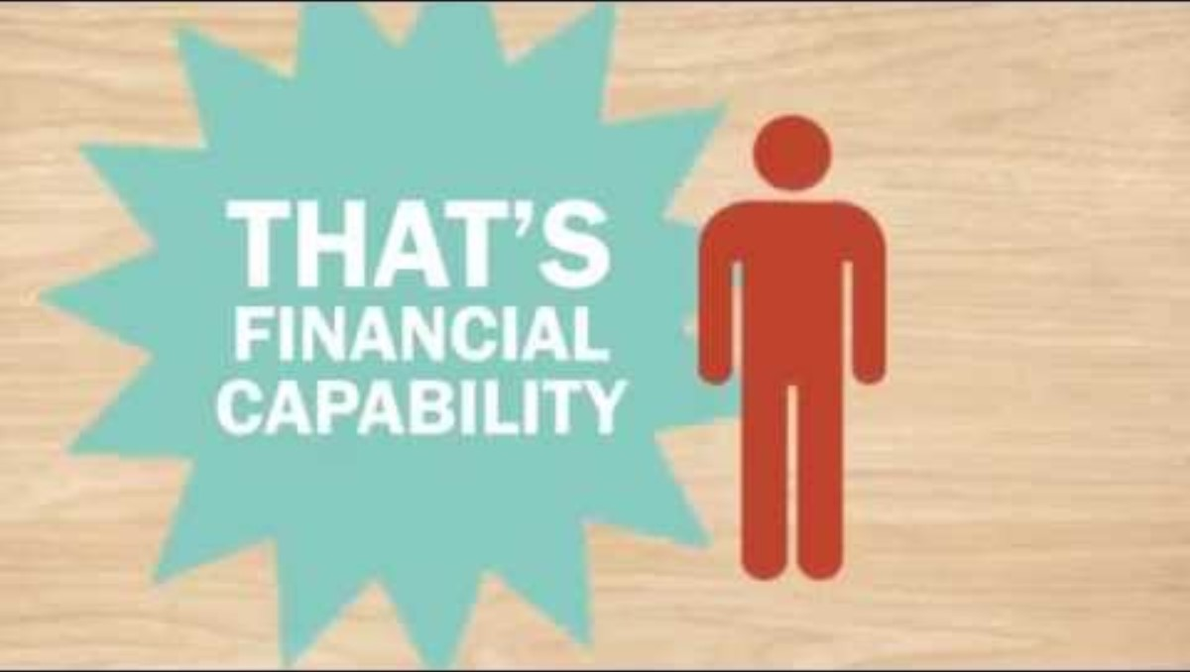
Financial Capability
SOURCE: Neighborworks America. (September 10, 2014). What Is Financial Capability? Retrieved from: https://youtu.be/pUbv6CpXmSI?si=4Kxylz32QZioHuBI.
Used with permission.
Notes:
Show the video on financial capability by clicking on the image of the video (stop it at 1 min, 20 seconds).
The video is imbedded in the slide and can also be found on YouTube here: https://www.youtube.com/watch?v=pUbv6CpXmSI

Slide 23



Wrap Up: Questions or Comments?
NEXT TIME
We will share our vision boards or written goals.
“Key 2: Understanding Credit History”
Date: ___________
Time: ___________
23
Notes:
Ask participants if they have any questions about what was covered in the Key or any last comments.
Confirm the date and time for the next workshop.
Thank everyone for attending and participating and give out your contact information so they can reach you with any questions.

