Slide 1
Agenda: List of Training Activities
TRAINING METHOD | TOPIC | TIME ESTIMATED
Presentation | Welcome and Session Objectives; Icebreaker | 5 minutes
Presentation and Facilitated Discussion | Your Financial Reputation; Key Activity: Saif’s Financial Reputation | 7-10 minutes
Presentation and Group Activity | What Is a Credit History? Key Activity: Voting Thumbs Up | 10 minutes
Presentation | Credit Report; What Is on a Credit Report? (POLL); Mistakes Are More Common Than You Think; What Is on a Credit Report? | 10 minutes
Small or Large Group Exercise | Key Activity: Reading a Credit Report OR Watching FICO® Video | 3 – 10 minutes
Presentation | Why Get and Review Your Credit Report?; Disputing Inaccurate Items on a Credit Report; Getting a Credit Report; Credit Reports for Young People Under Age 18 | 5 minutes
Presentation and Group Activity | Credit Scores; How Creditors and Lenders Use Your Score; What’s in Your Score?; Key Activity: Camera On/Camera Off Review | 10 minutes
Presentation and Facilitated Discussion | Building a Positive Credit Score; Secured Credit Card; Credit Scam Warnings: Is This a Good Option to Fix Your Credit? Why or Why Not?; Where Can I Get Legitimate Help With My Credit?; Reflection Question | 10 minutes
Closing | Questions? What Is One Thing Learned? Next Training Date and Time | 5 minutes
TOTAL TIME ESTIMATE |  | About 1 to 1.5 hours
Notes:
For internal use by facilitators. This is a sample agenda that mirrors the agenda in the facilitator guide with the virtual adaptations.
To keep it one hour, the biggest difference is not doing the credit report reading and instead watching the 3 minute FICO video.

Slide 2
Keys to your financial future
Key 2: Understanding Credit History
Jim Casey Youth Opportunities Initiative®
Notes:
Facilitator will introduce self.
Ask participants to take themselves off mute and say their names, or, if they are more comfortable, put their names in the chat box.

Slide 3

What You’re Going to Know or Be Able to Do
Explain what makes a positive credit history and why your credit history matters.
Get and review your credit reports.
Identify errors and, when there are errors, file a dispute advocating for yourself with credit reporting agencies.
Describe actions that make credit scores go up or down or remain unchanged.
Know where to get help understanding and fixing your credit history as well as credit report businesses and scams to avoid.
Notes:
Discuss the content that is covered in Key 2: Understanding Credit History.
Let the participants know that there is a lot of material in the Key and you will not be able to cover it all in a virtual workshop. Encourage them to use the participant guide to receive the entire content.
Let the young people know that the original Keys and their Participant Guides can be found at: https://www.aecf.org/resources/keys-to-your-financial-future-participant-guides/#:~:text=Updated%20in%20August%202019%2C%20Keys,developed%20by%20the%20Annie%20E.&text=The%20curriculum%20was%20created%20with,as%20they%20transitioned%20into%20adulthood.
Be sure that you cover these 2 main points during this workshop:
It’s important to get your credit report every year and make sure that everything is correct
Pay bills on time to help your credit score

Slide 4









Icebreaker
Did you think about your vision?
What are some steps that will help you reach your vision or goals?
graduate college
house
community
Isabella’s Vision Board
good school district
happy son
Do you think credit is important to achieving any of the things on your vision board or achieving your goal?
garden
volunteer
accounting
Notes:
Do the fun icebreaker question following up on Key 1. Participants can take themselves off of mute to answer questions or put answers in the chat box. Mention that you talked about creating a vision for the future and how that vision helps them set goals to achieve the vision. Ask if they thought about their vision or notice any financial values or habits that were not discussed during the last session?
Since you will be discussing credit during this session, ask what they think of when they hear the word “credit”?

Slide 5
Your Financial Reputation
Your credit history and credit score are a big part of your financial reputation.
Remember: credit = trust.
The good news is that you can change your financial reputation if you mess up.
Consistently doing what you promise to do over time will earn you more trust and more credit.
Notes:
Facilitator: Use the white board feature in Zoom or share your screen and show a blank Word document. Ask participants what they think of when they hear “credit” and ”financial reputation.” Type the responses so they can see them. Discuss their answers. Go back to sharing the screen to continue with Key #2.
State that this session is focusing on a person’s financial reputation and that a credit report and credit score are a big part of that reputation. Getting credit or a loan from a company means that the company trusts that you will pay the money borrowed back so “credit equals trust.”
Mention that sometimes things happen in life, such as using a lot of credit when you don’t have emergency savings, or maybe you miss a payment on a loan. If that happens, there may be fees or lenders may not think the person is handling the credit as expected, but the person can always get back on track and improve their credit history.
Have a participant read the last sentence.

Slide 6

Saif’s Financial Reputation
Saif has been living independently for three years. He has an apartment that he shares with three friends. His roommate pays the bills after he has collected everyone’s share. Saif is commonly late with his share.
He borrowed $1,000 from his aunt to cover living expenses when he started living on his own. He has not repaid her — not even a little bit.
Saif pays his cell phone bill on time and has never missed a car payment.
How would you describe Saif’s financial reputation?
How can he change it?
Notes:
Ask a participant to read the scenario on the slide, Saif’s Financial Reputation. Then, ask the questions in the blue box:
How would you describe Saif’s financial reputation? Ask participants if they think that Saif has been trustworthy with credit?
How can he change it?
Answers may include:
He is trustworthy with his cell phone.
He is causing a burden with his roommate.
He could start paying his rent on time.
He could talk to his aunt about how to repay her.

Slide 7
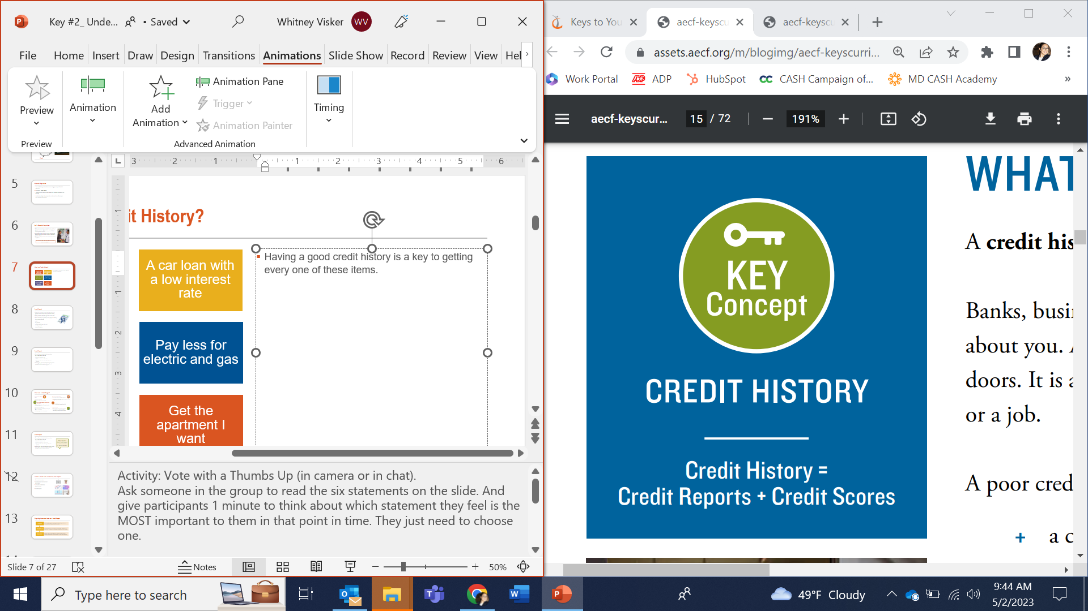
What Is Credit History?
Credit history is a record of how a person has handled or is handling borrowed money.
Having a good credit history is a key to getting every one of the items listed on the right.
A poor credit history may prevent you from getting some of these items — or result in you paying more for these items.
Open a credit
card with a low interest rate
Obtain a car loan with a low interest rate
Receive a low-cost cell phone plan
Pay less for electric and gas
Get a mortgage for a home — someday!
Rent an apartment
CREDIT HISTORY
Credit history = credit reports + credit scores
Notes:
Activity: Vote With a Thumbs Up (on camera or in the chat).
Ask someone in the group to read the six statements on the slide.
Give participants one minute to think about which statement they feel is the MOST important to them right now. They just need to choose one.
After a minute, read each statement and ask participants to put a thumbs up on their camera or in the chat, when you have read the statement that they have chosen.
Ask if anyone would like to share the reasons that they have chosen that item as most important to them.
Transition by stating that having a good credit history is a key to getting every one of these items and having a poor credit history can affect them. Not listed here: A poor credit history may also prevent you from getting a job or utilities (such as electricity, gas, cable).
Finally, explain again that credit history is credit reports + credit scores.
Explain that we will start by examining what a credit report is and how to understand it.

Slide 8

Credit Report
A report that is compiled by credit reporting bureaus on an individual’s history of debt, credit and borrowing behavior.
Banks, businesses, employers and others use your credit history to make decisions about you.
What do you think banks or businesses are looking for when they look at your credit report?
They are evaluating how much they can trust you to repay borrowed money.
Your credit report includes:
  how much money you owe or have owed in the past;
  whether you pay your debts on time; and
  other information that relates to your financial reputation.
Notes:
Ask a participant to read the first bullet. Explain that credit reporting companies give businesses insights into a consumer's past borrowing behavior, similar to the way in which an insurance company might use a driving record or a prospective employer might use a college transcript.
Read the question on the slide and encourage participants to answer in the chat or raise their hand.
These insights are used to make decisions about a person’s stability and ability and willingness to repay debt.
Therefore, banks, businesses, employers and others use your credit history to make decisions about you.
Return to the previous slide. Ask a participant to read the items that will be hard to obtain if they have negative credit history.
Remind them that “credit = trust.”

Slide 9
What Is on a Credit Report? (Activity: poll)
Your gender
Debit card information
Credit card information
Student loan information
Savings balance
Accounts in collections
Child support payments
Your race
Credit inquiries
No
No
Yes
Yes
No
Yes
No
No
Yes
Notes:
Activity: What Is on a Credit Report?
Read the list, bullet point by bullet point, and ask participants to answer yes or no: Do they believe that item is included in a credit report?
Remind them that credit = trust and it’s about an individual’s behavior when they get borrowed money (either credit card or loans). That’s why savings and checking accounts are not on the credit report, because they are not borrowed money.

Slide 10

Mistakes Are More Common Than You Think!
You have the right to accurate information in your credit reports, but ensuring any inaccuracies are corrected is your responsibility.
Mistakes on credit reports are not uncommon and can occur for many reasons. Errors may come from a typo on your name or Social Security number or from identity fraud.
Reviewing your credit reports regularly is one of the best ways to find out if someone is using your financial reputation as their own — and hurting you!
Notes:
Ask a participant to read the first bullet.
Discuss mistakes on credit reports that can range from a simple typo to someone committing identity theft and opening accounts with someone else’s credit information.
Ask a participant to read the last bullet. Let them know that the federal government enforces the Fair Credit Reporting Act to ensure that the data that is on someone's credit report is accurate. Ensuring that errors are corrected, however, is your responsibility.

Slide 11
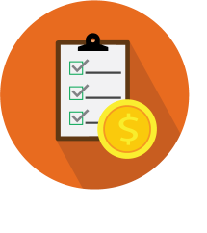




What Is on a Credit Report?
Personal information:
Name
Social Security number
Employment information (sometimes)
Accounts in collections:
Accounts turned over to collection agencies: This might happen if you quit paying your light bill or car note or forget to pay a medical bill.
    Account information
    (credit cards and loans):
Credit cards, store cards and loans you have, and how long you’ve had them
The amount of money you owe
The percentage of your credit limit you’ve used, also known as “credit utilization rate”
Whether you pay on time or have paid late
    Public records:
Bankruptcies, wage garnishment, etc.
Credit inquiries:
“Hard inquiries” when a business or potential
lender checks your credit to decide if they
want to lend you money or offer you a service
11
Notes:
Review the categories of information that are on a person's credit report.
Ask a participant to read the personal information category. Note that it’s important to ensure the personal information listed is accurate. For example, if the report shows several addresses where the young person has never lived, it could be an indication that someone else has obtained credit in their name and is having the mail redirected. The young person can remove the inaccurate addresses.
You can choose to have other participants read other sections or review them yourself.

Slide 12
Why Get and Review Your Credit Report?
Let’s look at a
sample
credit report.
Activity:
Turn to Page 12 of the Participant Guide to see a sample credit report.
Notes:
Emphasize that credit reports affect many areas of people’s life, as mentioned earlier, such as getting credit, an apartment, favorable cell phone plans and more. So why not ensure that these reports are accurate?
Not only is it a good practice to make, but also it is our federal right as consumers to do so. As participants become older, this responsibility to obtain and review credit reports will fall on them.
Activity: Option A (Time: 10 minutes):
Tell the participants to turn to Page 12 of their Participant Guide to view the sample credit report or provide them the PDF link to the participant guide (link below). Give them five minutes to review it. Together, try to answer the questions:
Who does this credit report belong to? Answer: Jadarius Jay Jackson AKA Jadarius J. Jackson and JJ Jackson.
Where does the person live? Answer: 765 Rose Ave.., Apt. C, Anywhere, IA 78617
Has the person had a bankruptcy? Answer: Yes. Chapter 7 bankruptcy in August 2016.
How many credit accounts does this person have open? Answer: Three
Activity: Option B (Time: 2.5 minutes):
If time does not permit the activity, an alternative option is to go to MyFICO.com online to show the video Understanding Your Credit Report (2 minutes, 19 seconds). Link: https://www.myfico.com/credit-education/credit-reports.
SOURCE: FICO® and myFICO® are trademarks of the Fair Isaac Corporation, which created a scoring system for summarizing a person’s creditworthiness. https://www.myfico.com/credit-education/credit-reports.
Link to the Participant Guide: https://assets.aecf.org/m/blogimg/aecf-keyscurriculumparticipant-key2-2019.pdf

Slide 13
Disputing Inaccurate Items on a Credit Report
INFORM
Tell the credit company in writing what information you believe is inaccurate. Include supporting documentation
EVIDENCE
Identify each item on your report you are disputing, state facts and explain why you dispute the information. Request for it to be removed.
SEND IT!
Enclose a copy of the report with items in question circled. Send by certified mail with return receipt requested or online with screenshot.
Notes:
Let participants know they have a right, under federal law, to dispute any item on their credit report that is inaccurate. They can do this by writing a letter or by filing an online dispute with the individual credit reporting agency.
Step 1: File the dispute and let the credit reporting agency know what item(s) are inaccurate. If there is any supporting documentation, such as a receipt for a bill that was paid, include copies of it.
Step 2: Ask a participant to read the Evidence paragraph.
Step 3: Submit the dispute letter either by mailing it or sending a screenshot online and getting an email confirmation. Let participants know that it’s important to be able to prove that they are submitting a dispute, and when it was submitted, since federal law requires the credit reporting agency to investigate the dispute and respond to the consumer within 30 days.

Slide 14
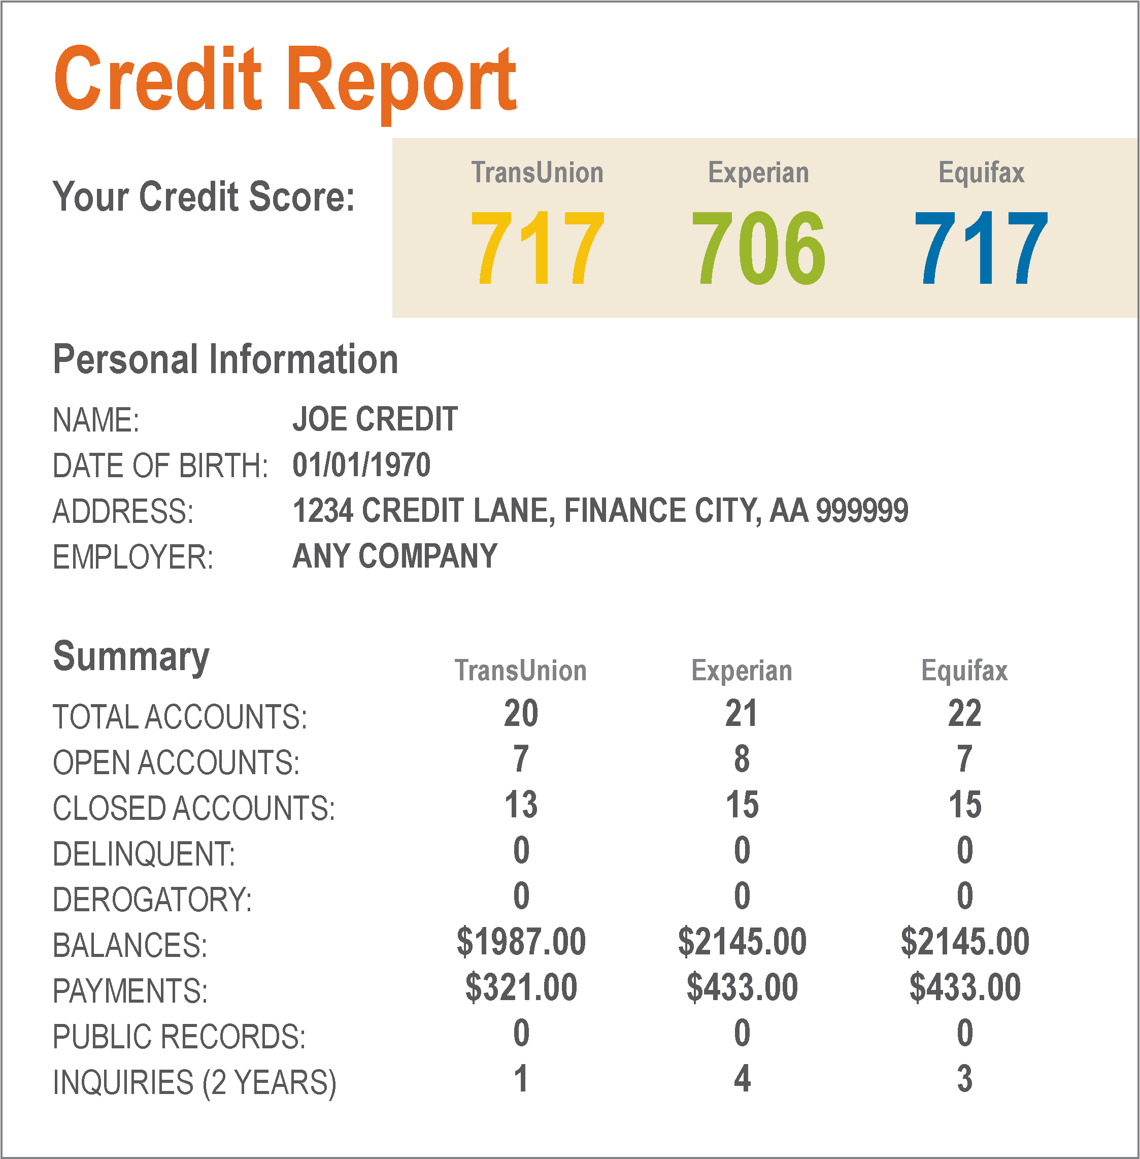
Getting a Credit Report
If you’re age 18 or older, you can get one free copy of your credit report from each of the three credit reporting bureaus every year.
www.annualcreditreport.com
Call 1-877-322-8228
Notes:
Ask if anyone has checked their credit report in the past, either by getting it themselves or having a family member or case manager get it for them and show it to them.
Let them know that checking their credit report regularly is important, in case someone else has used their identity information to obtain credit (using their financial reputation) and possibly hurting their chances of getting credit on their own.
Anyone over 18 has the legal right under federal law to obtain one free copy of their credit report from each of the credit reporting agencies each year. There are other conditions under which they can also get a free copy, such as if they are unemployed. The three bureaus have also currently extended a program that allows consumers to check their credit report for free once a week at each agency through AnnualCreditReport.com
Explain that the website listed is the place to go to get a free report, and that people can get one at a time or all three at one time. There will be security questions that they will have to answer to get the report online, but if they have difficulty with the questions, they can call the number listed. Also, at the website, they can download a form, print it out and mail it to the credit reporting bureau.

Slide 15

Credit Reports for Young People Under Age 18
If you are under age 18, you should NOT have a credit report, except in very rare circumstances.
If you do, it is VERY LIKELY that someone has stolen your identity and is using your financial reputation as their own.
If you are in foster care, the child welfare agency is required to check to see if you have a credit report once a year, starting when you are age 14.
Ask your case manager about it!!
Make sure it is happening!!
Notes:
Explain that if a young person is under age 18, they should not have a credit report. If they do have one, it is very likely that they are a victim of identity theft and need to file a dispute with the credit reporting agency.
Read the Key Right. Emphasize that young people may need to ask their case manager if the child welfare agency has checked their credit report as required by federal law. They can ask for proof that this has been done and for confirmation that there is nothing on their credit report indicating that there is a problem.

Slide 16
Credit Scores
Your credit score is a summary of your credit report.
A high score = Lenders and creditors are more likely to believe that you will pay back what you owe on time and as agreed.
A low score = Lenders and creditors are more likely to believe that you may not pay back what you owe on time or as agreed.
750 – 860
700 – 749
650 – 699
550 – 649
350 – 549
High Trust
Low Trust
Notes:
State that credit scores came into existence because lenders found it too time consuming to read all of their customers’ credit reports. The credit reporting agencies developed a math formula to automate the assessment of all the data on a credit report and give a number, or a score, of a person’s creditworthiness.
Ask a participant to read the sentences on the slide.
Review the ranges of the credit score, from low to high.
Mention that there are multiple credit scores because:
Lenders are not required to report data to all three of the main credit reporting agencies, so there might be differences in the information they each have about a person.
There are different scoring models for auto loans, mortgages, credit cards and other credit products.

Slide 17

How Creditors and Lenders Use Your Score
Creditors and lenders use your score
to decide:
if they are going to give you credit;
how much credit they are going to give you — the amount of the loan or credit limit; and
how much they’re going to charge you for the credit — the interest rate and fees.
FICO® PAYMENT CALCULATOR
Notes:
Activity:
Share your screen and go to the FICO® Payment Calculator at https://www.myfico.com/credit-education/calculators/loan-savings-calculator/
Select Auto Loan
Type in $15,000 for the loan amount.
Select a 48-month used for the loan type.
It will generate a chart for you to show the different credit score categories and corresponding APR* (Interest Rate), Monthly Payment and Interest Paid (over the term of the loan)
Ask participants for their thoughts on the difference in amount of money paid for the loan at different score levels.
*Annual percentage rate (APR) refers to the yearly interest generated by a sum that's charged to borrowers or paid to investors.

Slide 18
What’s in Your Score?
Watch Video: What Is a Credit Score?
SOURCE: Investopedia. (May 07, 2025). What Is a Credit Score? Retrieved from: https://www.investopedia.com/terms/c/credit_score.asp. Used with permission
© 2025 Dotdash Meredith. All rights reserved. Reproduction in any manner in any language in whole or in part without written permission is prohibited.
Notes:
Explain that FICO® is another company that provides credit scores. FICO® Scores are calculated using many different pieces of credit data in your credit report. This data is grouped into five categories: payment history (35%), amounts owed (30%), length of credit history (15%), new credit (10%) and credit mix (10%).
Share your screen and show the “What is a Credit Score” video from Investopedia. The link is embedded in the slide and can be found here: https://www.investopedia.com/terms/c/credit_score.asp
Ask if anyone has heard of these scores and if there are any comments on credit scores?
Mention that credit scores, under federal law, are not required to be free. Credit reporting agencies offer them for a fee. However, a lot of companies, such as banks and credit card companies, are giving their customers access to their credit score for free.
Ask if anyone has heard of, or is using, Credit Karma. This is a website that provides credit scores for free. There will likely be discussion on using this site. Point out that while Credit Karma provides credit scores for free, they only have scores from two of the three credit reporting agencies and not FICO®. Also, they earn money on the advertisements on the site and target marketing to their users for financial products.

Slide 19
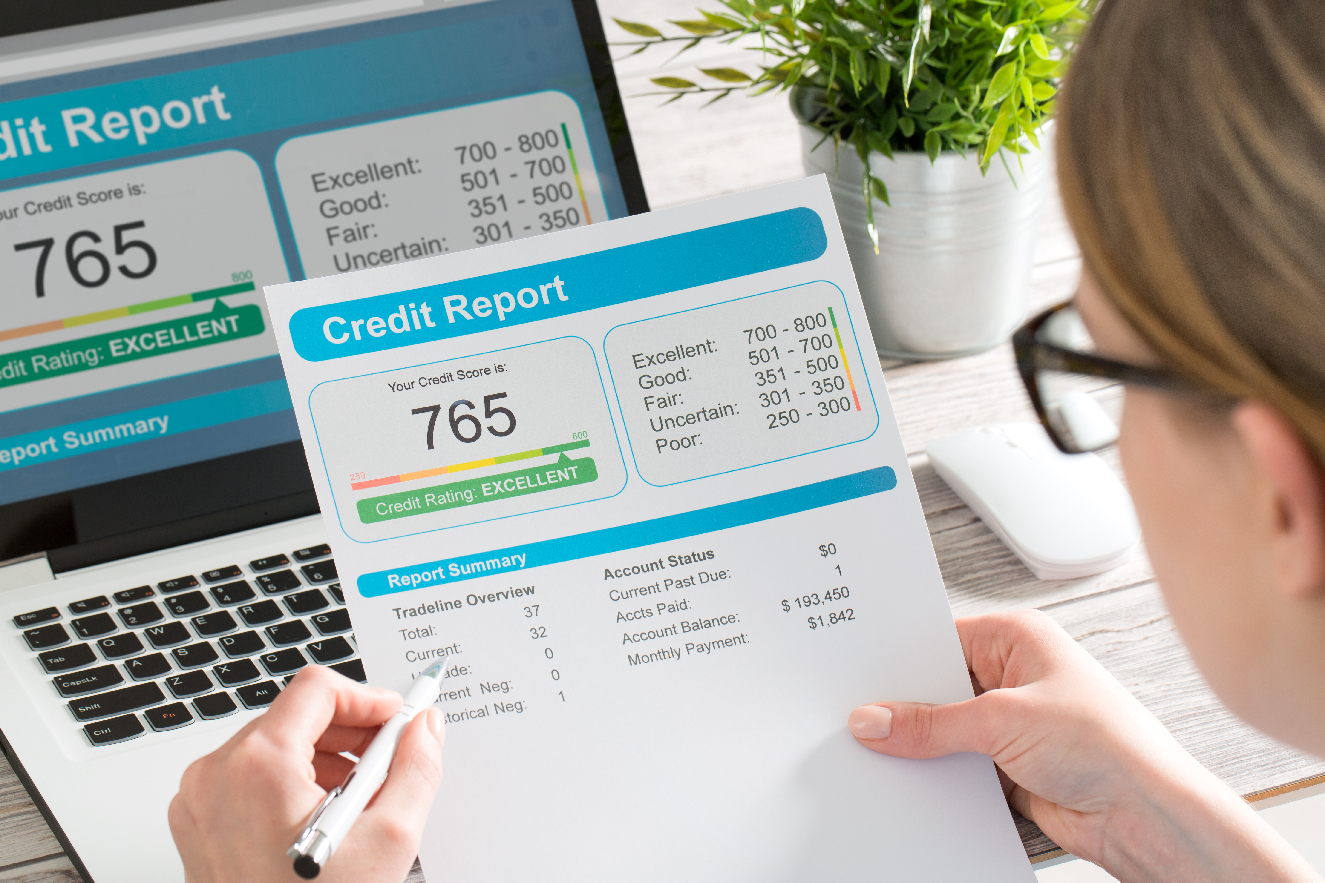
Camera On/Camera Off Review: What’s in Your Score?
Notes:
Activity:
This is the virtual version of the Stand Up/Sit Down Review activity that appears on Page 58 in the facilitator guide.
Have participants turn off all their cameras and stop screen sharing the presentation.
Tell the group that you will read items to them. They should turn on their cameras ONLY if they think an item is factored into their credit scores. If they think the item is not a factor in their credit scores, the participants should leave off or turn off their camera.
Read these items: (Answer key: YES means camera should be on.):
Age
Different kinds of credit accounts (YES)
On-time payments (YES)
Race
How long you have had credit (YES)
Receiving public assistance
Employment history
Late payments (YES)
After the review, return to the slides.
Summarize/Transition: Remember, you may have many credit scores if you have information in credit reports. Credit scores are informed by credit reports, which is why it’s important to get into a habit of getting and reviewing your credit report — and disputing any errors in them.

Slide 20
Building a Positive Credit Score
Top Two Strategies | More Strategies
1. Pay your bills on time every time. If you cannot, contact your lender or landlord before the bill is due and ask them to work with you. 2. Pay down debts so that you owe less money. Always pay more than the minimum payment that is due. | 3. Never use more than 30% of your credit limit. 4. Open a secured credit card or get a secured loan. 5. Keep your first credit card open and active. 6. Never open a bunch of credit accounts at once.
Notes:
Facilitator:
Familiarize yourself with credit-building strategies by reviewing Page 63 in the Key 2 Facilitator Guide.
Review the six strategies listed on the slide by reading them or asking participants to read certain ones.
Refer to the information that you have already reviewed in the credit score video related to #1, #3 and #6.
Strategy #2 refers to the amount of credit being used or, the “credit utilization” part of the credit score (similar to #3 but you want to emphasize the point of trying not to have too much debt).
Strategy #5 refers to the length of credit history that is part of the credit score.
If participants have a question about the “secured credit card” in strategy #4, that information appears on the next slide.

Slide 21
Secured Credit Card
This is a credit card that is secured with your money.
Your money is placed into an account at a bank or credit union, and you are allowed to borrow only up to the amount that you’ve put down. (For example, if you put down $500, you can only borrow up to $500.)
The bank or credit union uses this money as security to cover the debt if you do not pay it back in time.
As you use this secured credit card and pay on time, you are establishing a financial reputation that banks and credit unions view as “trusting,” which may help your credit score go up.
You will get your security deposit back according to the terms of the account, usually after a year.
WATCH OUT FOR RISKS
High fees
If you don’t pay on time, you will be charged a late fee. If you continue to not pay, you will likely have an increased interest rate and can lose your security deposit.
Usually, these credit cards have low credit limits, so you must be very careful to only use 30% or less of the available credit limit to prevent your score from dropping.
Notes:
Facilitator: Tell participants that you are going to talk about one way to build credit, which is a secured credit card. A secured credit card is a type of credit card that is backed by a cash deposit from the cardholder.
Young people can save up the amount needed to get this type of card, typically between $300-$500. They then choose a bank or credit union to apply for the card. There is usually a fee to get the card, $40-$50. The cash deposit is placed in an account and is only used if the cardholder doesn’t pay for any charges they have made.
Review the statements on the slide. Ask if any participants have used a secured card to build credit.
Note that at the end of the stipulated time, the company will return the deposit to the cardholder and convert the card to an “unsecured” card.

Slide 22

Is This a Good Option to Fix Your Credit? Why or Why Not?
Avoid any business or individual that:
Promises to fix your credit for you. No one can remove accurate information from your credit report.
Demands a fee upfront to repair your credit.
Offers to create a new identity for you.
Offers to sell you the opportunity to piggyback off the credit of someone you do not know.
Offers to settle your debts for a fee, which can have downsides.
Notes:
Facilitator: Ask young people if they think any of the listed items are good options for fixing a credit report.

Slide 23




Where Can I Get Legitimate Help With My Credit?
Bank or credit union
United States Department of Housing and Urban Development-approved housing counseling agency
Nonprofit consumer credit counseling agency
Community Development Financial Institution (CDFI)
Notes:
Review these options and any local resources in your communities.

Slide 24



Wrap Up: Questions or Comments?
NEXT TIME
Search a credit product that you would be interested in.
“Key 3: Getting the Credit and Loans You Need”
Date: ___________
Time: ___________
24
Notes:
Ask participants if they have any questions about what was covered in the Key or any last comments.
Confirm the date and time for the next workshop.
Thank everyone for attending and participating and give out your contact information so they can reach you with any questions.

