Slide 1
Agenda: List of Training Activities
TRAINING METHOD | TOPIC | TIME ESTIMATED
Presentation | Welcome and Session Objectives | 5 minutes
Presentation and facilitated discussion | Borrowing Money — Credit and Loans Key Activity: Pop Quiz | 7-10 minutes
Presentation and group activity | How Are Credit Decisions Made?; Key Activity: What Would You Want to Know if You Were Giving Someone a Loan? | 10-15 minutes
Presentation and facilitated discussion | The Different Types of Credit | 5 minutes
Presentation and small group exercise | How You Repay: Installment Loan vs. Revolving Credit and Key Activity: Installment Loan vs. Revolving Credit | 15 minutes
Presentation and large group and pair exercise | Which Debt to Pay First and Key Activity: Prioritizing Debt Payments | 10 minutes
Presentation and pair exercise | Paying Off Credit Cards and Key Activity: Reading a Credit Card Statement | 10 minutes
Presentation and facilitated discussion | Comparison Shopping for Credit Cards and Loans and Key to Your Financial Future: Shopping for Credit Cards and Loans Checklist | 5 minutes
Presentation and pair or small group exercise | The Trouble With Some Credit and Key Activity: The Trouble With Some Credit Case Studies | 20 minutes
Closing | Questions? What Is One Thing You’d Share? Next Training Date and Time | 5 minutes
TOTAL TIME ESTIMATE |  | Approx 1 – 1.5 hours
Notes:
For internal use by facilitators. This sample agenda mirrors the agenda in the facilitator guide. Recent updates to the curriculum appear in this slide but may not yet appear in the facilitator guide. Updates to the guides are in progress. Facilitators will want to keep close track of session time and balance delivering the content and encouraging discussions to keep the session one to 1.5 hours long.

Slide 2
Keys to your financial future
Key 3: Getting the Credit and Loans You Need
Jim Casey Youth Opportunities Initiative®
Notes:
Facilitator: Introduce yourself. Ask participants to take themselves off mute and say their names, or if they are more comfortable, they may say hello by putting their name in the chat box.

Slide 3

What You’re Going to Know or Be Able to Do
Explain the difference between installment and revolving credit and how they work
Explain how interest works when you owe money — the relationship
between amount borrowed, interest rate and how long money is borrowed
Differentiate secured and unsecured credit and explain why it matters
Prioritize debt payments
Define basic terms associated with applying for and understanding credit
Read a credit card statement
Compare credit and loan offers
Know where to go in your community for help applying for and understanding credit and loan offers
Understand the life cycle of debt and rights in debt collection
Notes:
Discuss the content that is covered in Key 3: Getting the Credit and Loans You Need.
It will focus on the ins and outs of borrowing money, including how credit decisions are made, how credit works, prioritizing debt payments, what it takes to pay off credit cards, comparison shopping for credit and loans.
Let the young people know that there is a lot of material in the Key and you will not be able to cover it all in this virtual format. Encourage them to check the participant guide for the entire content.
Let them know that the Key Participant Guides can be found at: https://www.aecf.org/resources/keys-to-your-financial-future-participant-guides.
Be sure that you cover these two main points during this workshop:
Choose credit products carefully
Try to minimize debt and create a plan to manage any debt effectively

Slide 4

Icebreaker
Has anyone researched a credit product that they would be interested in using?
  Why that specific product?
CREDIT = TRUST
Notes:
Do a fun icebreaker question following up on Key 2 where young people can take themselves off of mute and say their answer to the questionor put in chat box, such as:
Did anyone read an article about credit?
What are your thoughts on debt? Sometimes young people believe all debt is bad. Discuss how manageable debt can be helpful. It can be hard to afford a car, mortgage or sometimes college costs without getting a loan. Using credit also builds a person’s credit score. Let them know that this session will cover how to get a loan that is positive and helps them achieve a goal and build credit history vs. a predatory loan that may damage their financial situation.

Slide 5

Borrowing Money — Credit and Debt
How is debt different from credit?
Debt is the result of using credit.
You make a commitment with the lender to return the borrowed money per the terms of the agreement.
Debt = liability.
Credit is the ability to borrow money. You commit or obligate future income to buy items on credit today.
Interest is money you pay on that borrowed money.
Notes:
Ask a young person to read the blue box. Then follow up with the question on the right.
Talk about how borrowing money to buy something means they get in debt and are obligated to pay that money back.

Slide 6
Pop Quiz: When Should You Use Credit?
Which of the following activities can be done by using credit?
Best times to use credit are…
When investing in assets that are likely to increase in value.
When you feel confident in your ability to afford the payments toward that purchase.
When the impact of using that credit product won’t significantly deteriorate your financial stability.
Buy a brand-new Mercedes Benz car
YES
Be able to attend college
YES
Have better relationship with friends
NO
Start a small business
YES
Own a home
YES
Buy a new laptop for school
YES
Get better grades in school
NO
Notes:
Tell young people that while credit is important, today we will take a moment to discuss when are appropriate times to use credit.
First, let’s recap what activities can be done by using credit. Follow up with the quiz.
For those items that were ”yes,” explain that while these are accessible with credit – it doesn’t always mean that we should use all of them. The best time to use credit is when investing in assets that are likely increase in value, such as getting a college degree or starting a small business.
Also, affordability is very important. If you need a car, credit may make it easier to access a Mercedes Benz but that doesn’t mean the monthly payments will be affordable. If you simply need a car to get to and from work, a lower-cost car could be enough.
While avoiding debt can be unpractical, we still want to be able to use credit as a tool that is an asset in our lives. At the end of the day, we are obligated to pay back the money. We don’t want to make commitments we can’t keep that will break our financial reputation.

Slide 7
Pop Quiz: Who Are Lenders?
Which of the following are lenders of credit?
Banks/credit unions
YES
Imagine you were someone who didn’t have access to any of the lenders listed on the right. How else would you borrow money for your needs and/or wants?
Chime, Venmo, other similar apps
YES
Your pet
NO
Auto finance companies
YES
Department stores
YES
U.S. government
YES
Credit card companies
YES
Notes:
Ask young people if they have ever borrowed money from any of the types of lenders listed here. Give an example of your own. Ask them to list some of the positive experiences or difficulties with these types of lenders. Answers may include: Payday lenders offer expensive credit due to fees; it was easy to borrow from a family member; there were a lot of steps involved in borrowing from a bank.
Emphasize that there are a lot of companies that loan money and young people need to carefully select which ones to borrow from. Check reviews of the company and read ALL the paperwork involved in the loan. Try to borrow as little as possible and make sure to make all the payments on time!

Slide 8
Lending Realities and Discrimination
For people without access to credit products, they turn to:
Friends
Family
Payday lenders
Pawnshops
Social lending circles
Or they don’t get the asset/item they were seeking because it was only possible through a credit product.
Notes:
Friends and family can offer informal ways of receiving borrowed money. When people are unable to get a loan at a traditional lender, they turn to some businesses that offer alternative financial services such as payday lenders and pawnshops. There are concerns about the loans from these businesses because of the fees and interest rates that are charged. We will talk more about these later in the session.
There are also social lending circles, known as rotating savings and credit associations, which are groups of trusted people who contribute regularly to a shared fund. This fund is then lent to each member in rotation, essentially allowing them to borrow from the group without interest or fees.
OR They, simply didn’t get the item they wanted because credit was the only way to attain it — such as homeownership.

Slide 9
How Are Credit Decisions Made?
The Equal Credit Opportunity Act makes it illegal for a lender to discriminate in any aspect of credit transactions solely based on race, color, religion, national origin, sex, marital status, age and receipt of public assistance.
Thinking like a lender: What information would you want to know if you were giving someone a loan?
CAPACITY | COLLATERAL
Do you have the financial ability to pay back the loan? | Do you have an asset (such as a car or a home) that can be pledged against the loan?
CAPITAL | CHARACTER
Do you have other assets that can be used or sold to cover the loan? | Are you likely to pay back the loan as agreed?
Notes:
Thinking like a lender: This could be a breakout group where young people can talk about it, or a word cloud exercise, or a call out activity.
When they return, show them the four C’s: Capacity, Collateral, Capital and Character.
Summarize by saying, “Now that you know how credit decisions are made, you are going to look at two basic kinds of credit and how credit works.”

Slide 10

Loan Basics
SOURCE: Clarifi. (Aug 18, 2017). Loan Basics. Retrieved from: https://youtu.be/AOP5wiu7mRU?si=8uwARHXRAfEoabUu. Used with permission.
Notes:
Share your screen and show this video: https://www.youtube.com/watch?v=AOP5wiu7mRU
End the video at 2 mins/24 seconds.

Slide 11







Understanding How Credit Works
What are the terms of using this credit?
Principal
Annual percentage rate (APR)
Fixed or variable rates (Intro Offer)
Fees (e.g., late, ATM, annual)
Pay your minimum monthly payments every month
Secured or unsecured credit?
Installment loan or revolving credit?
Notes:
Consider creating a Kahoot game for the credit terms.
Ask the young people to teach the entire group about what they learned from the video on what is interest? Note that variable interest means the rate being charged can increase and that fixed means the interest rate is the same during the time of the loan. Discuss fees such as late fees for payments that were not paid on time, over-the-limit fees for when a person goes above their credit limit on a credit card and the annual fee for some credit cards. Emphasize the need to limit fees. State that a secured loan is a loan backed by collateral — financial assets they own, like a home or a car — that can be used as payment to the lender if they don't pay back the loan. Emphasize that the lender will take the collateral, or car, if the loan is not paid according to the terms. Explain that a car loan is a type of Installment Loan, where there are fixed, equal payments throughout the term of the loan as opposed to Revolving Credit, like a credit card that allows you to borrow money, pay it back and borrow it again. Tell them that the Minimum Payment on a credit card is the smallest amount the lender will allow them to pay on their outstanding debt. They have to pay at least this amount but paying more will reduce the amount of interest paid. Summarize that borrowing money = Debt that has to be paid back.

Slide 12
Getting a Credit Card
Step 1 Know your credit score
Step 2 Research cards
Step 3 Gather info: Social Security number, employer, address
Step 4 Apply
Step 5 Act like it’s your money — pay it off every month
Step 6 Review your credit card statements at least once a month
Notes:
Ask a young person to read the steps to Getting a Credit Card. Remind them where they can get their credit score from Key 2 (www.annualcreditreport.com or their bank/credit union if that is provided with the account). Tell them they can research different credit cards online via the resources listed in their Supplemental Resources handout. Ask what information/documents they think are needed to apply for a credit card (Social Security number, income, employer, address, contact information). Inform them that they can apply online or at their bank/credit union. Let the young people know that companies issue credit cards to make money. Just because a company offers a credit card to young people, it doesn’t mean they should take it. They need to pick the best one for them. You will cover what factors to consider in a few slides.
Summarize that the best way to use a credit card is to only purchase what they can afford at the time and pay off the balance every month. Note that sometimes that isn’t possible, such as having to buy tires for a car when they don’t have enough money in savings to buy them. The strategy then is pay the debt off as quickly as possible to reduce the amount of interest paid on the money borrowed.
Review the differences between the following 3 cards:
A store card is one that they can only use at a specific store. These are becoming less frequent but can be used to buy items from that store and pay for them later.
A traditional credit card is one that can be used at multiple locations or online.
Ask the young people if they remember what a secured credit card is from Key 2. A secured credit card is a card that is backed by a cash deposit from the cardholder. They can save up the amount needed to get this type of card, typically between $300–$500. Then choose a bank/credit union to apply for the card. There is usually a fee to get the card, $40–$50. The cash deposit is placed in an account and is only used if the cardholder doesn’t pay for any charges they have made.

Slide 13
Credit Offer
Is this store offering you credit — the ability to buy now and pay later?
What interest rate is the store offering?
What is the term of the loan?
Is there anything about this ad that feels suspicious?
CREDIT = TRUST
Notes:
Discuss this common advertisement for credit, often found in furniture stores. Go through the questions listed. Note that the big letters, 40% and 12 Months are meant to get their attention but that they have to read the fine print.
If the young people do not identify this, add that the little cross symbols next to 40% off and 12 months are a giveaway that something important is hiding in the fine print and that this offer may not be as good as it looks. Also add that the fine print on this part of the ad states that you have to make this purchase on an Ashley Advantage credit card. They are trying to get you to sign up for a credit card.

Slide 14
Credit Equals Trust
“No interest will be charged on the promo purchase if you pay the promo purchase amount in full within 12 months. If you do not, interest will be charged on the promo purchase from the purchase date.”
“APR is 29.99%”
So, if you got $1,200 worth of furniture through this deal,
but then missed a payment, they would charge you …
No interest if paid in full within 12 Months††
⁠On qualifying purchases made with your Furniture Store® Synchrony credit card. Minimum purchase of $499 required online. Interest will be charged to your account from the purchase date if the promotional balance is not paid in full within 12 Months. Minimum monthly payments required.
††Qualifying purchase amount must be on one receipt. No interest will be charged on the promo balance if you pay it off, in full, within the promo period. If you do not, interest will be charged on the promo balance from the purchase date. The required minimum monthly payments may or may not pay off the promo balance before the end of the promo period, depending on purchase amount, promo length and payment allocation. Regular account terms apply to non-promo purchases and, after promo period ends, to the promo balance. New Accounts as of 07/16/24: Purchase APR 29.99%. Penalty APR 39.99%. Min Interest Charge $2. A promo fee will be charged equal to 2% of the amount financed on an equal payment no interest promotion of 18 months or more. Existing cardholders: See your credit card agreement terms. Subject to credit approval.
Notes:
Share with the young people that this is the fine print below the main part of the ad. It’s so tiny that they are HOPING you don’t read it!
Ask someone to read the fine print. Emphasize that if the loan is not paid on time, the company can charge them interest from the date of purchase, or for the entire 12 months of the loan. Ask young people to share how they would feel if they had to pay the higher amount noted. Ask them if they think this is a good deal. Help them understand that it might be a good deal if they already have all the money saved and just pay over 12 months, but otherwise it’s a risk! If something happens and they lose hours at work or lose their job, it means they can’t make their payment. Ask them if they think this happens to people. Highlight that that is how this company plans to make money off of this so-called deal.

Slide 15
Shopping for Credit Cards and Loans Checklist
 | CREDIT CARD OR LOAN 1 | CREDIT CARD OR LOAN 2 | CREDIT CARD OR LOAN 3
1. Annual percentage rate (APR)
2. Fixed or variable rate If variable, when does the rate change? By how much?
3. Introductory rate When does it change? What does it change to? (credit cards only)
4. Finance charge — total cost of the loan over the life of the loan (loans only)
5. Fees not included in APR
6. Penalty fees and rate How much? When do they kick in?
7. Credit limit (credit cards only)
Notes:
Review the handout with the young people on the factors to consider when choosing a loan or a credit card. Ask someone to put in the chat box or take themselves off mute and say which factors they think are most important. Ask if anyone has a credit card. How did they choose it? How do they use it? This handout is also included in the Supplemental Resources handout and is located on page 17 of the online in person Participant Guide.

Slide 16

Loan Calculator Time
Notes:
Share your screen and go to the website for a calculation on the total cost of an auto loan. The website can also be found here: https://www.nerdwallet.com/article/loans/auto-loans/total-cost-owning-car?trk=nw_gn1_4.0
Enter in $350 for the car payment, $100 for insurance, $250 for gas, $50 for maintenance and repairs, and $15 for registration and fees. Alternatively, ask young people for the numbers and put those into the calculator. Discuss the final amount. Emphasize that being able to afford the car payment alone is not enough and that these other expenses need to be included. Young people need to put the amount of money for repairs in a separate savings account so that when repairs are needed, the money will be there.

Slide 17
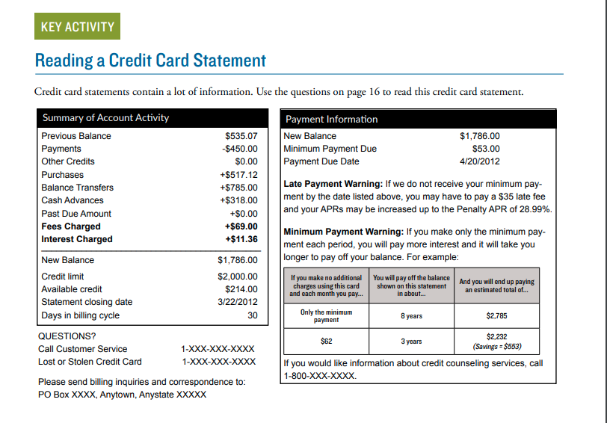
Credit Card Statement Activity
What is the current balance?
When is the payment due?
What is the minimum payment?
What happens if the payment is late?
How long will the balance take
to repay if only the minimum
payment is made each month, assuming no changes?
Notes:
Ask the participants the questions in boxes on the slide (bonus points if they can tell you where on the statement the information is found).
Alternative activity: Use the credit card statement activity in the participant guide as it is written but create groups through the breakout feature on Zoom. Then have them come back with the answers they found.

Slide 18
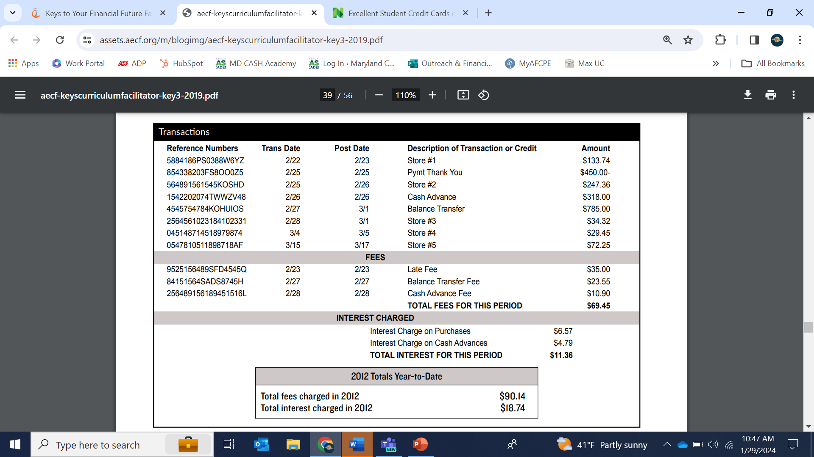
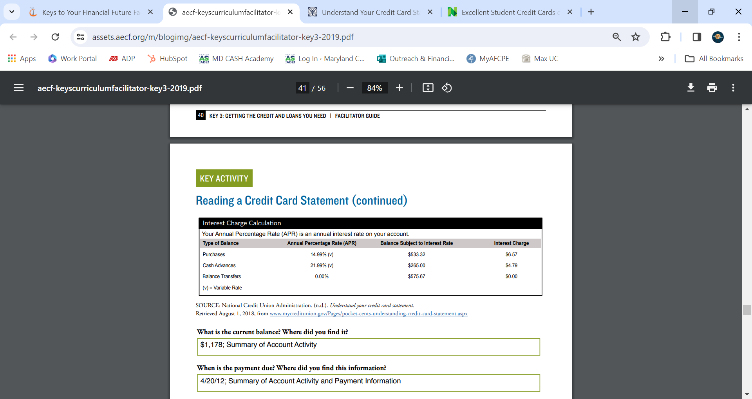
Credit Card Statement Activity, Continued
What is the APR on purchases?
What is the APR on cash advances?
What is the APR on balance transfers?
Describe three different kinds
of transactions made during
the month.
Notes:
Ask the participants the questions in boxes on the slide (bonus points if they can tell you where on the statement the information is found).
Alternative activity: Use the credit card statement activity in the participant guide as it is written but create groups through the breakout feature on Zoom. Then have them come back with the answers they found.

Slide 19

What are some reflections you have after the credit card statement activity?

Slide 20
Jamal Visits a Payday Lender
Jamal was short on money. Living on his own since transitioning out of foster care, he knew where to get resources if he needed them. This month, he knew that with the amount he had in his checking account he would not be able cover his rent the following week. And the next payday was still two weeks away.
Jamal went to Cash Fast and got a payday loan. In exchange for $500, he provided a $525 check post-dated for three days after the day he would be paid. He was confident he would have the cash in his account to cover this loan.
Notes:
Ask someone to read Jamal’s story. After they finish reading this slide, ask all young people what they think is going to happen next.

Slide 21
Jamal Visits a Payday Lender
The following week, he paid his rent on time and in full. The next day, his car tire blew out. He used up all the money in his checking account to replace the tire. When payday came around, he really couldn’t afford to hand over $500 to Cash Fast. So, he renewed the loan for another $25.
It took Jamal six months to pay back the loan. He renewed the loan twice per month, paying the $25 fee every time.
How much did Jamal pay to borrow $500?
6 | (months)
x 2 | (twice per month)
X $25 | (fee each time)
= $300 | in total fees
Does this seem like a good deal?
Notes:
Ask a different person to read the second part of Jamal’s story. Ask the questions listed.
Possible follow-up question: Let’s help Jamal out with some advice. What else could he have done once he realized he was going to be late on rent instead of getting this expensive loan?
Answers might include: Just take the late fee (cheaper), call his landlord and ask for a few extra days, borrow money from friends or family, make a partial payment on rent, etc.

Slide 22
Why would people use services like payday lenders?

Slide 23
Danielle and Rent to Own
 | COST TO BUY | WEEKLY PRICE | TOTAL PAYMENTS | NUMBER OF PAYMENTS
Living room set | $1,637 | $29.99 | $2,729 | 91
Television | $859 | $19.99 | $1,439 | 72
Queen bedroom set and mattress | $1,372 | $39.98 | $2,298 | 58
TOTALS | $3,868 | $89.96 | $6,466
Notes:
Tell everyone Danielle’s story: “Danielle has saved enough money to get her own studio apartment. After years of sharing rooms and apartments, she is happy to be on her own. But she doesn’t have any furniture. After paying the first month’s rent and a security deposit, she has little to spend on things to put into the apartment. She visits secondhand shops at the encouragement of some friends. But then her partner tells her about rent-to-own stores. She can get a complete living room set, a queen bed and mattress with a matching nightstand and television for $89.96/week.”
Ask someone to put in the chat box or take themselves off mute and say how much Danielle would pay for the furniture if she bought it outright instead of doing rent to own. (Answer: $3,868). Ask how much she would pay IN TOTAL for the furniture if she did rent-to-own (Answer: $6,466). What advice would you give Danielle?

Slide 24
Life Cycle of Debt
Get credit or loan
Make payments
as agreed
Pay off debt
But if you are late many times or default, your debt may get charged off and go to collections.
Make late or
miss payments
Go into default
Debt charged off
Debt goes
into collections
May be sued
for payment or
garnishment
To keep a debt from going to collections, work with your creditor to make a payment arrangement you can afford. Get the new agreement in writing.
Notes:
Review this flow chart of debt and emphasize the need to pay off debt on time to avoid interest payments and the potential of getting in so much debt that payments are not made to the creditor who then may take legal action.

Slide 25

Debt
Track spending on credit cards
Know how much you owe
Pay on time
Get professional help if you’re concerned
Notes:
Tell the young people that it is very important to track how much they charge on a credit card. It can quickly add up to a large amount if not careful. Ask how they think they can track their credit card spending. Some ideas are accessing the credit card company’s app and checking it every day or every week, or creating an Excel spreadsheet with debts listed and updated every month, etc.
It’s also important to keep track of all debts and the amount of money borrowed overall. Paying on time is the largest component of their credit score and will avoid late payment fees.
If anyone is concerned about the amount of debt they have, there are nonprofits or companies they can go to for help. However, there are also a lot of scammers out there trying to make money off of people who are worried about their debt, so it is important to be careful about who you trust to help you with debt. Mention they can reach out to you separately if they would like a referral to get this help.

Slide 26
Prioritizing Debt
It’s helpful to set some rules or priorities for yourself about what debts and expenses you will pay first if money runs tight and you can’t pay them all.
The best time to make these rules or set your priorities is BEFORE you run into money trouble.
Here is one way to prioritize:
  #1 Protect my job and income
  #2 Protect my shelter
  #3 Protect my credit and minimize interest
What are some other rules or priorities you would suggest?
Notes:
Tell the young people that having some debt at some point in their life is likely, and that it’s also possible that they will have a situation come up when they can’t pay all their debts one month. To avoid feeling panicked if that happens and making decisions on the fly and in crisis, it’s helpful to think about rules and priorities for debt before this problem comes up. Ask someone to read #1–#3 and discuss. Why do you think that some people choose to make protecting their job and income their number one priority when it comes to deciding which debts to pay first? What do you think would be an example of a debt (bill) that someone would need to pay to make sure they keep their job or income? (Car note if they need a car to get to work; child care if they need to have their kids in day care to be able to work). Ask if there are other rules that they can think of when it comes to prioritizing debt.

Slide 27



Wrap Up – Questions or Comments?
NEXT TIME
Come up with a slogan for credit for people that are new to it.
“Key 3: Understanding Your Income”
Date: ___________
Time: ___________
Notes:
Ask participants if they have any questions on what was covered in the Key or any last comments.
Confirm the date/time for the next workshop. Tell them the task for the next class which is to put together a slogan for credit aimed toward people that are new to it.
Thank everyone for attending/participating and give out your contact information so they can reach you with any questions.

