Slide 1
Agenda: List of Training Activities
TRAINING METHOD | TOPIC (SLIDE TITLE) | TIME ESTIMATED
Presentation | Welcome and Session Objectives; Icebreaker | 10 minutes
Presentation and Large Group Exercise | Participant Poll: What Is Income?; How Do You Get Paid?; Understand Your Paycheck Stub (Video); Paystub Example | 20 minutes
Presentation and Open Discussion | Taxes - Why?; Filling Out the W-4 Form (Video); W-2 Example; Free Tax Preparation | 15 minutes
Presentation and Open Discussion | Participant Poll; Increasing Income; Need More Money? Education Pays; The Career Path Does NOT Have to Be Linear; Urban Institute; Paying for Education | 20 minutes
Closing | Questions? What Is One Thing Learned? Next Training Date and Time | 5 minutes
TOTAL TIME ESTIMATE |  | Approx 1 hour
Notes:
For internal use by facilitators. This sample agenda mirrors the agenda in the facilitator guide. Recent updates to the curriculum appear in this slide but may not yet appear in the facilitator guide. Updates to the guides are in progress. Facilitators will want to keep close track of session time and balance delivering the content and encouraging discussions to keep the session one to 1.5 hours long.

Slide 2
Keys to your financial future
Key 4: Understanding Your Income
Jim Casey Youth Opportunities Initiative®
Notes:
Facilitator: Introduce yourself. Ask participants to take themselves off mute and say their names, or if they are more comfortable, they may say hello by putting their name in the chat box.

Slide 3

What You’re Going to Know or Be Able to Do
Explain the different ways to get income
Describe the different ways you can be paid (receive income)
Read a paycheck and paycheck stub
Complete a W-4 and understand the reason for it and how it affects both take-home pay and how much income tax you have to pay
Understand when to file an income tax return, generally how to file an income tax return and the information needed to complete an income tax return
Know where in the community to get good, no-cost help with filing taxes or when there are problems with tax payments/returns
Notes:
Discuss the content that is covered in Key 4: Understanding Your Income.
Let the young people know that there is a lot of material in the Key and you will not be able to cover it all in this virtual format. Encourage them to check the participant guide for the entire content.
Let them know that the Key Participant Guides can be found at: https://www.aecf.org/resources/keys-to-your-financial-future-participant-guides.
Be sure that you cover these two main points during this workshop:
Be aware of your income and ways to increase it
Be sure to file taxes, use free tax preparation services and get all the tax credits/deductions you are eligible for.

Slide 4

Icebreaker
Sharing credit slogans: A short phrase to help people better understand credit
As we finish our credit basics, what are your thoughts on using a
credit card?
Sail Through Life With Great Credit!
CREDIT = TRUST
Notes:
Do a fun icebreaker following up on Key 3, where participants can take themselves off of mute and say their credit slogan or put it in the chat box, such as:
Sail Through Life With Great Credit!
Review the concept that credit = trust.

Slide 5
How You Are Paid — Matching Activity
Salary | 1
Hourly | 2
Commission | 3
Contract | 4
Tips | 5
Under the table | 6
Bonus | 7
Business profits | 8
A | Money paid when you achieve a goal.
B | Money paid for a good service.
C | Money paid in cash, not reported.
D | Money paid based on hours worked.
E | Money from your business profits.
F | Paid when part or all work is done.
G | Money paid for excellent work.
H | Money paid based on annual total.
Notes:
Use this activity to discuss the eight different ways people can get paid. Go through the methods one by one, asking the youth to say which definition in the box on the right matches the word, then click on the word to see the line that connects to the correct definition. Emphasize that understanding these differences when conducting a job search is important because it can determine the timing of income and how one receives it.

Slide 6

LET’S SHARE:
What careers have we envisioned for ourselves?
What are common ways to pay a person in that career?

Slide 7
How Do You Get Paid?
Paper Paycheck
Direct Deposit
Payroll Card
Cash/deposit for free at your bank
Cash for free at your employer’s bank
PAY to cash it — at grocery store or check casher
Paycheck is automatically transferred into your bank account(s) on payday
You can put your whole check into one account — like a checking account — or you can split it and have some automatically put into a savings account, too
Your paycheck is loaded onto a reloadable debit card
These often have HIGH FEES
Your employer CANNOT require you to receive your pay on a payroll card; they must give you at least one other choice
Costs you $$
Costs you $$
7
Notes:
Ask three different people to read these three different ways to get their income. Note the ones that cost money to use. Emphasize the concept of not paying fees to get their income, e.g., using direct deposit at a bank or credit union vs. using a check cashing service that charges a percentage of the paycheck.

Slide 8

Understanding Your Paycheck Stub
Gross Pay vs. Net Pay
Gross pay minus deductions = Net pay
Gross pay is what you make
Net pay is what you take home
Are the
deductions correct?
Watch Video: Understanding Your Pay Stub
SOURCE: Gusto. (August 9, 2018). Here's How to Read a Pay Stub [With Sample Paycheck]. Retrieved from: https://youtu.be/-4qkis2FooU?si=TW3jyxU45wResS0S. Used with permission.
Notes:
Ask a participant to read the Key Concept. Share your screen and show the “Understanding Your Pay Stub” video, which was created by a payroll company and shows the components of a paystub. The video can be found here: https://www.youtube.com/watch?v=-4qkis2FooU
Emphasize that young people should check their paystubs regularly to ensure the deductions are correct. Sometimes mistakes are made, e.g., parking fees taken out that should not be or not getting paid for all the hours they are working. etc.

Slide 9
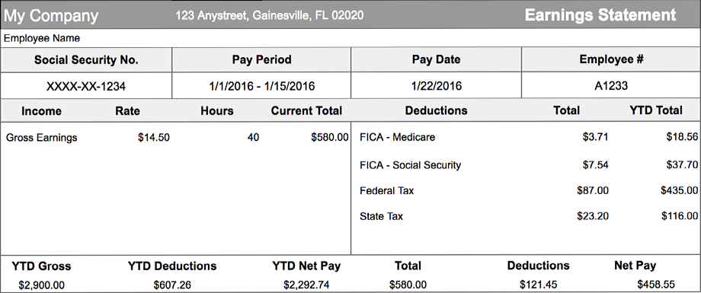
How many hours did
the employee work in
this pay period?
How much did they have taken out of their check
for “deductions”?
What is their
take-home pay?
9
Notes:
Review this sample paystub. Ask the questions in the boxes. Explain that the federal government is entitled to a portion of income from every paycheck. This is known as withholding tax — a partial payment of annual income taxes that gets sent directly to the government. These payments are managed by the IRS. The amount of money withheld for federal taxes depends on the amount of money that the person earns and the information given to the employer in a W-4 form, which will be reviewed in a few slides. Also, the federal government requires every working American to contribute a portion of their paycheck to Social Security, a system of supplemental retirement programs established in 1935. The Social Security fund provides benefits to current Social Security recipients. In addition, the federal government requires every working American to contribute to Medicare, a U.S. government insurance plan that provides hospital, medical and surgical benefits for Americans aged 65 and older, and for people with certain disabilities.

Slide 10

Taxes — Why?
Public Schools
Social Services
National Defense
Public Library
Health Care
Financial Aid
Police and Fire Departments
Notes:
Public goods and services — benefits that cannot be withheld from those who don’t pay for them, and benefits that may be “consumed” by one person without reducing the amount of the product available for others. Examples include national defense, streetlights and roads and highways. Public services include welfare programs, law enforcement and monitoring and regulating trade and the economy.
Our taxes are required payments of money to governments that are used to provide public goods and services for the benefit of the community as a whole.
Ask participants: Would you rather pay for each of these items with tax dollars or as each service is used?
Students should be allowed to voice their opinions freely and differ on the value of specific programs. Try to build a consensus that items on the list are public goods that benefit and are used by all in such a way that no one uses them up (highways, education, job training, libraries, defense); a public responsibility (nutrition, unemployment benefits, health care); and/or an investment in future productivity and human resources (job training, drug programs, research).

Slide 11

How do employers know how much to deduct from gross earnings for taxes?
11
Notes:
Review this sample paystub. Ask the question in the blue box. Explain that the amount of money withheld for federal taxes depends on the amount of money that the person earns and the information given to the employer in a W-4 form, which will be reviewed in the next slide.

Slide 12
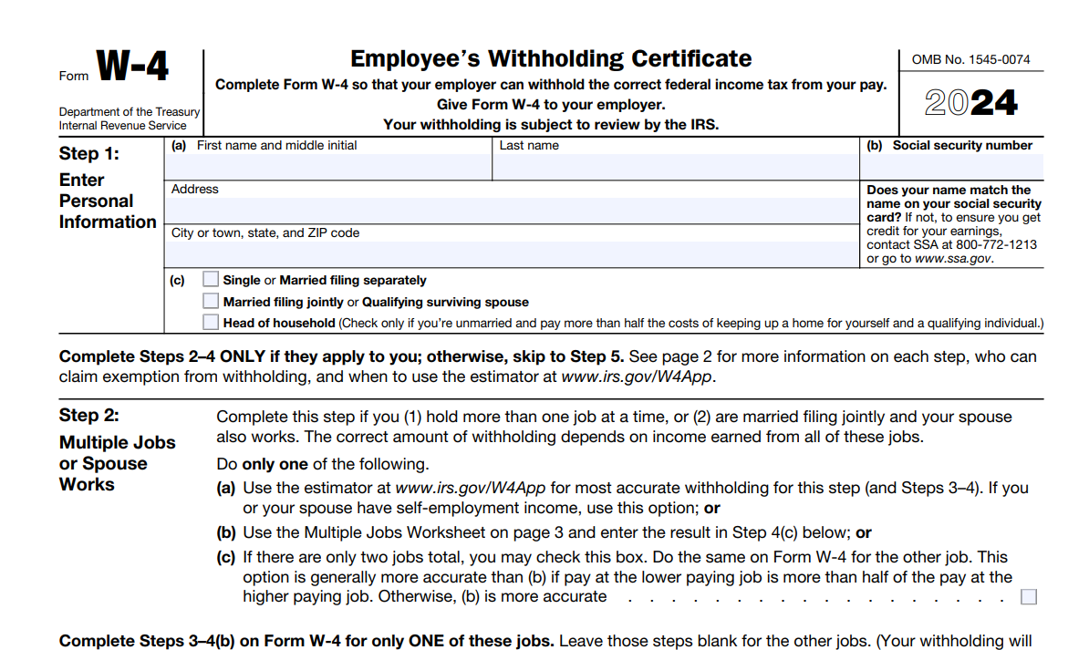
Filling Out the
W-4 Form Video
12
SOURCE: Internal Revenue Service. (2024). Employee’s withholding certificate (Form W-4). U.S. Department of the Treasury.
Notes:
Explain that when a young person starts working for an employer, they will fill out a form for the IRS that is a W-4 form. This form lets the employer know how much money to take out of the young person’s paycheck for taxes.
Share your screen and show the video on filling out a W-4 form. The video is embedded and can be found here: https://www.youtube.com/watch?v=ap5Uz64tbzk

Slide 13
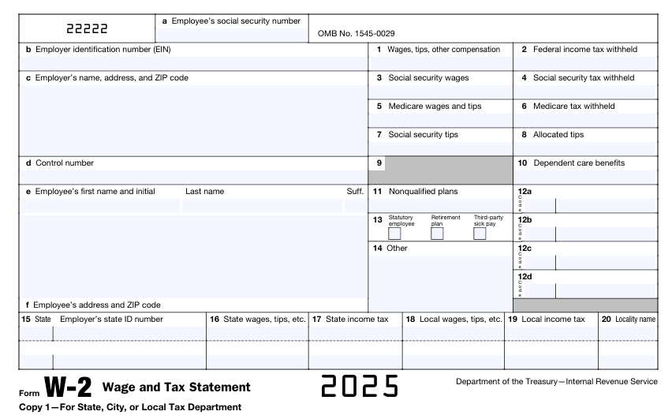
185999995
8260000952
21104.47
22918.49
1420.95
State of Maryland
P.O. Box 12345
Baltimore, MD 21201
22918.49
332.32
Mary
Doe
DD
15255.84
X
P.O. Box 67891
Baltimore, MD 21201
MD
000001114
21104.47
13.00
13
SOURCE: Internal Revenue Service. (2025). Employee’s withholding certificate (Form W-4). U.S. Department of the Treasury
Notes:
Tell participants that they will receive a form from their employer in January that will be used for filing their taxes. It’s a W-2 form and lists their income for the year and the amount they have paid in taxes. This information will go in their tax return, along with other items, to determine if they get a refund of taxes they have paid or if they owe additional taxes. Emphasize using a tax preparation service that they trust, preferably a VITA site.

Slide 14
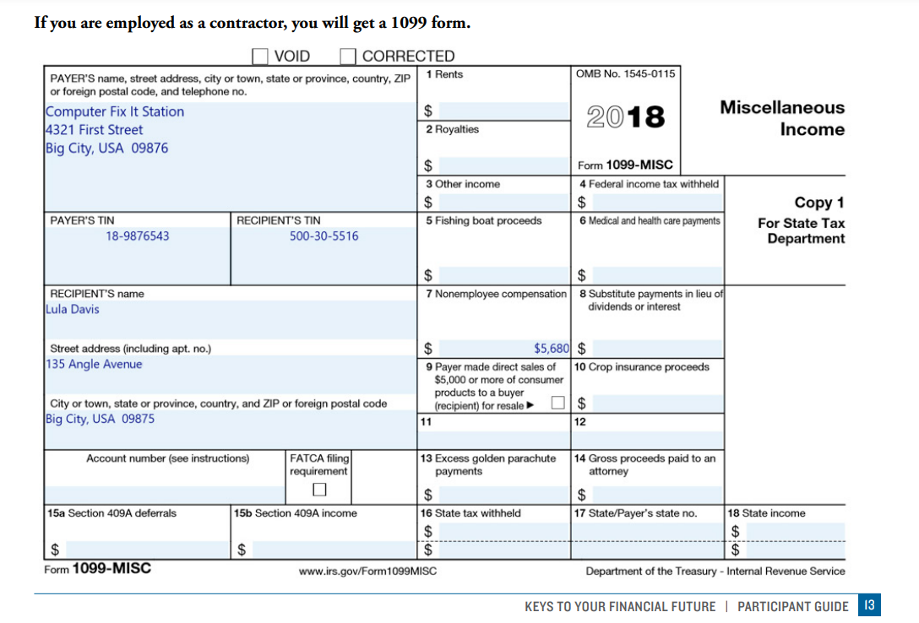
14
SOURCE: Internal Revenue Service. (2018). Employee’s withholding certificate (Form 1099-MISC). U.S. Department of the Treasury
Notes:
Explain that if a company is hiring someone as a consultant or independent contractor, then they have to give them a IRS 1099 form so the person can file their tax return. The person is responsible for paying all their taxes and withholdings themselves.

Slide 15
Do you think it’s fair for families and individuals to get additional support or incentives for their lifestyles or family circumstances?
Notes:
Ask participants to take themselves off of mute and say their answer to the question or put it in the chat box.

Slide 16
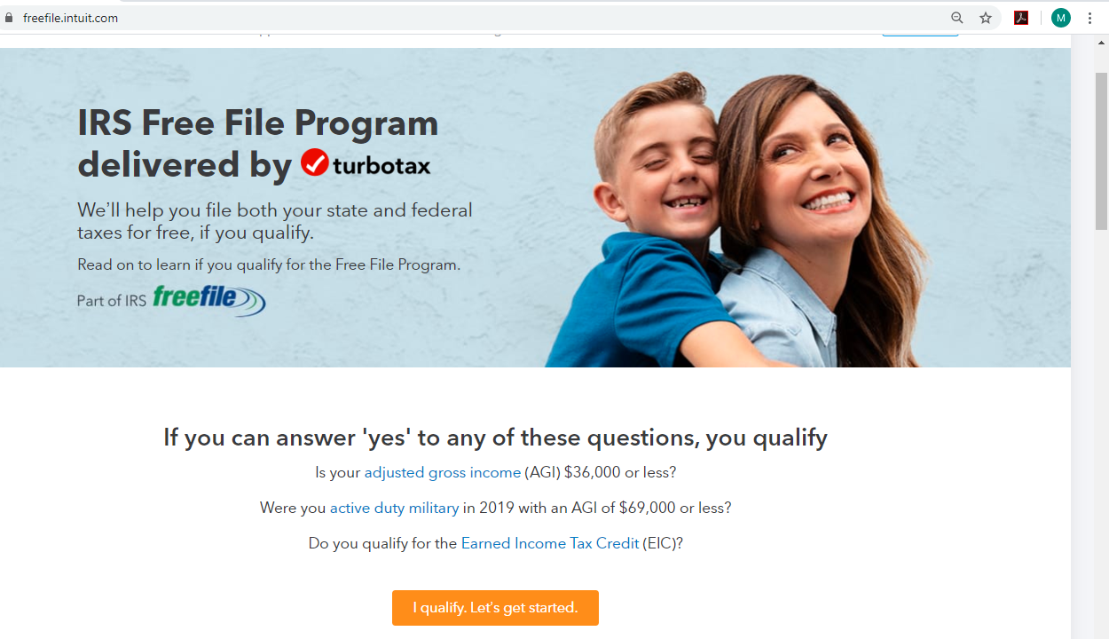
Free Tax Preparation
You do NOT have to pay someone to do your taxes for you.
If your household makes less than $36,000, you can file your federal and state taxes for free at https://freefile.intuit.com.
AND
If your household makes less that $57,000, you can find a free VITA tax preparation site in your community by visiting https://irs.treasury.gov/freetaxprep.
SOURCE: Reprinted with permission. © Intuit Inc. All rights reserved.
Notes:
Tell the young people that they will need to file taxes at some point in the future and it’s important to pick a reliable organization to help them with it. The IRS’s Volunteer Income Tax Assistance (VITA) sites offer free basic tax return preparation to qualified individuals. The VITA program has operated for over 50 years, offering free tax help to people who generally make $57,000 or less, persons with disabilities and limited English-speaking taxpayers who need assistance in preparing their tax returns. VITA services are not only free, they are also a reliable and trusted source for preparing tax returns. All VITA volunteers who prepare returns must take and pass tax law training that meets or exceeds IRS standards.
Refer them to your local VITA program or the youth can find a program on the IRS website.
Let them know that tax preparation companies who will give them their refund instantly (as opposed to waiting a few days/or two weeks depending on the service) are not doing this for free. They are basically loaning them the money and will charge a fee for this. Ask the young people if they would prefer to wait a short time and have all that money instead of just some of it.

Slide 17


Participant Poll: Increasing Income
Notes:
Create a poll with the terms below and ask the participants to select the ways they can increase their income:
Work more hours (Yes)
Sell something you don’t need anymore on Facebook Marketplace (Yes)
Apply for public benefits (Yes)
Start a business (Yes — note that it needs to be profitable)
Work less hours (No)
Sell a product you make or provide a service for a fee (Yes)
Buy a new cell phone (No)
Ask them for other ideas on ways to increase income.

Slide 18
Need More Money? Education Pays
EARNINGS AND UNEMPLOYMENT RATES BY EDUCATIONAL ATTAINMENT, 2022
All workers $1,123
Total: 3.0%
Note: Data are for persons age 25 and over. Earnings are for full-time wage and salary workers. Source: U.S. Bureau of Labor Statistics, Current Population Survey.
Notes:
Tell participants that income often corresponds to the amount of education someone has. The chance of being unemployed also relates to education. Review the average income for a person who did not finish high school. Ask someone to put in the chat box what the average income is for someone who has a bachelor’s degree. Ask someone to do that math and figure out the difference ($656) and point out that this is WEEKLY income. Review the average unemployment rate for these two categories as well (2.2% for bachelor’s degree vs 5.4% for less than a high school diploma).

Slide 19
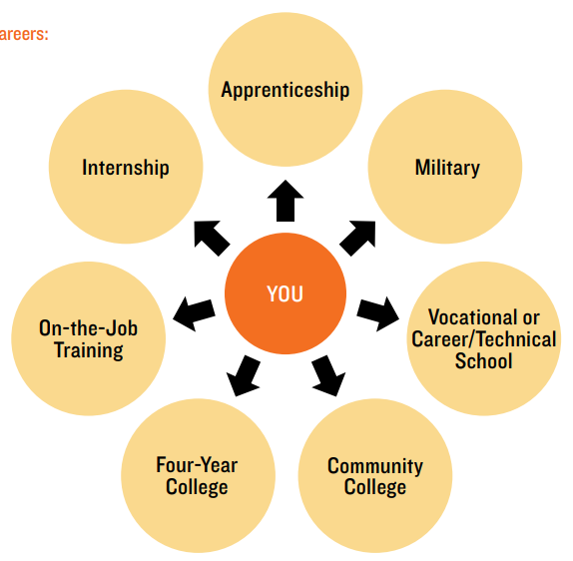
The Career Path Does NOT Have to Be Linear
People often think of a career path as:
Graduate From
High School
Go to College
Get a Job
What education and/or credentials are needed to get this job?
What are the job advancement opportunities? What education is required?
Is there demand for this career or a decrease?
There are many other paths to careers:
Notes:
Discuss the numerous paths that young people can take to obtain higher education and training to get a job.

Slide 20

Obtaining Skills/Job Training
YouthBuild provides construction and other industry training and high school completion options to young people who are out of school and out of work, using a positive youth development approach. Young people with the greatest need within the K–12 education system and labor market are served. We visited Detroit, Michigan, to learn more about how YouthBuild is implemented there. SER-Metro’s YouthBuild program was part of the 2018 national YouthBuild evaluation and was recommended by YouthBuild USA leadership as a well-established program.
Notes:
Explain to the participants that there are many organizations who help young people obtain training for a specific skill or job. This is an example of a program called YouthBuild, which is sponsored in part by the federal government and is meant to support young people who face inequities and challenges with K–12 education. This specific program was in Detroit, Michigan, and helped 67 youth over two years. They supported the youth with training in the construction field, helped with their education to earn a GED, provided a mentor and helped the young people find an internship or job. Ask if anyone has looked at training for a specific job and what they liked/had concerns about. Let the participants know that there are “private career schools” that offer training in a wide variety of specific jobs, but they can be very expensive, and it takes a lot of research to learn if they can expect to get a job in that field.
Emphasize the need to look for local organizations who will help young people find training programs. Please insert the name of a local program that you know of to make this more relevant.

Slide 21

Paying for Education
Scholarships
Grants
Tuition Waiver
Income
Student Loans
529 State Matching Programs
LOANS, GRANTS AND SCHOLARSHIPS
If it must be paid back under any circumstance, it is a loan. You can get federal loans from the federal government, federal loans through your school or private loans from banks or credit unions.
If it never has to be repaid, it is a grant or a scholarship. Grants come in the form of federal aid and state grants. They are generally given to students who have financial need.
COMPLETING THE FREE APPLICATION FOR FEDERAL STUDENT AID
The FAFSA asks questions to figure out if you are dependent or independent. If you are independent, your resources — income and assets — are counted differently. In most cases, being considered independent will make you eligible for more aid.
One specific question on FAFSA is: “At any time since you turned age 13, were both of your parents deceased, were you in foster care or were you a dependent ward of the court?” If you answer “yes,” you will be considered independent even if you are living with a foster family or already 18 years old and not involved in the child welfare system.
Notes:
Tell the young people that there are a lot of ways to pay for education or career training. Ask them what they know about any of the options listed. Ask if they know where to look for scholarships and grants. Mention that there are some ideas on the Resources page. Emphasize the need to fill out the FAFSA form and where they can get help in your area with filling it out.
Let them know they could consider working a part-time job while working on getting a degree or training to pay for some of the costs. Caution them to be careful about the number of hours they work, to make sure they can still do well in school.
Tell them that student loans are a last choice for paying for education and have to be repaid. A rule of thumb to consider is to only borrow an amount equal to (preferably less) than the amount of money they will earn in the first year of the career they study for.

Slide 22



Wrap Up – Questions or Comments?
NEXT TIME
Look for a job description for the type of job you envision for yourself.
“Key 5: Paying Bills and Budgeting”
Date: ___________
Time: ___________
Notes:
Ask participants if they have any questions on what was covered in the Key or any last comments.
Confirm the date/time for the next workshop.
Thank everyone for attending/participating and give out your contact information so they can reach you with any questions.

