Slide 1
Agenda: List of training activities
TRAINING METHOD | TOPIC | TIME ESTIMATED
Presentation | Welcome and Session Objectives; Icebreaker | 5 minutes
Presentation and facilitated discussion | Needs/Obligations/Wants Video; Key Activity: Layla’s Needs, Obligations and Wants | 10 minutes
Presentation | Bills vs. Expenses; Key Activity: Benefits and Risks of Different Ways to Pay; Bill Calendar | 10 minutes
Facilitated discussion | Budget Chat | 5 minutes
Small or Large Group Exercise | Bean Game — Short Version | 15 minutes
Presentation | Spending Tracker; Budget Tools; Money Lessons; Develop Good Habits or “Rules of Thumb” | 15 minutes
Closing | Questions? What Is One Thing Learned? Next Training Date and Time | 5 minutes
TOTAL TIME ESTIMATE |  | Approx 1 hour
Notes:
For internal use by facilitators. This sample agenda mirrors the agenda in the facilitator guide. Recent updates to the curriculum appear in this slide but may not yet appear in the facilitator guide. Updates to the guides are in progress. Facilitators will want to keep close track of session time and balance delivering the content and encouraging discussions to keep the session one to 1.5 hours long.

Slide 2
Keys to your financial future
Key 5: Paying Bills and Budgeting
Jim Casey Youth Opportunities Initiative®
Notes:
Facilitator: Introduce yourself. Ask participants to take themselves off mute and say their names, or if they are more comfortable, they may say hello by putting their name in the chat box.

Slide 3

What You’re Going to Know or Be Able to Do
Explain the differences among needs, wants and obligations
Explain the difference between expenses and recurring bills and the consequences of not paying certain bills and expenses
Describe ways to pay bills and the risks associated with each
Use a spending tracker — paper, mobile or online — to document how money is spent and identify patterns in spending as well as opportunities to make changes
Describe different approaches to budgeting
List strategies for living within your means — with the income and financial resources you have
Notes:
Discuss the content that is covered in Key 5: Paying Bills and Budgeting.
Let the participants know that there is a lot of material in the Key and you will not be able to cover it all in this virtual format. Encourage them to check the participant guide for the entire content.
Let them know that the Key Participant Guides can be found at: https://www.aecf.org/resources/keys-to-your-financial-future-participant-guides.
Be sure that you cover these two main points during this workshop:
Pay bills on time
Create a budget and track money being spent to make sure it is going where you need it to go

Slide 4

Icebreaker
From last class, would you preferred to be paid by direct deposit, by a paper check or by a prepaid debt card? Why?
Notes:
Do a fun icebreaker question following up on Key 4 where young people can take themselves off of mute and say their answer to the question or put it in the chat box.

Slide 5
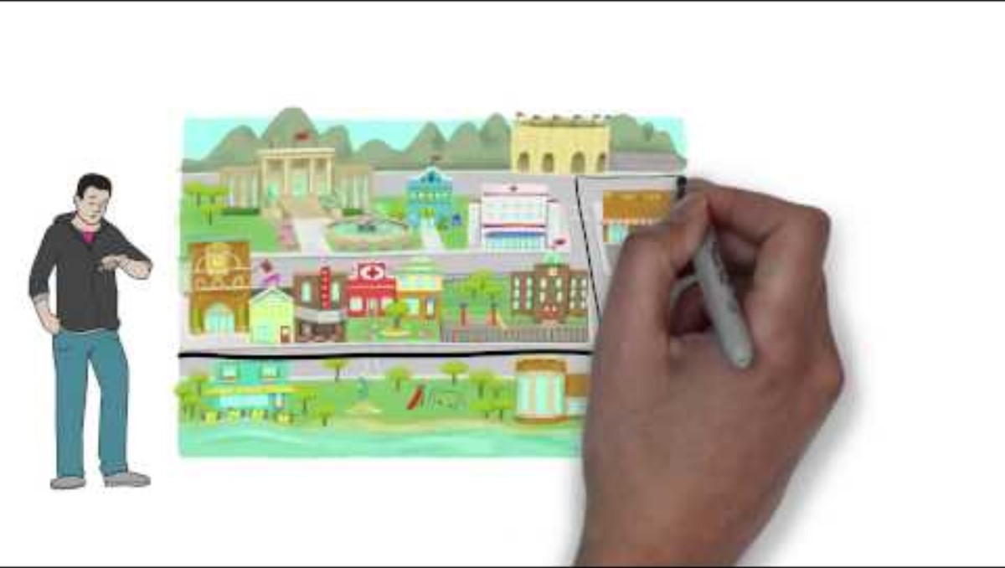
Needs, Wants and Obligations
5
SOURCE: Columbia College. (August 20, 2015). Needs vs Wants. Retrieved from: https://youtu.be/QyuU4wFIz3o?si=AAAp7Z64ons5uefz. Used with permission.
Notes:
Ask everyone to take themselves off mute or put in the chat box what they think is a need, a want and an obligation. Following are some examples:
Needs — housing, transportation, clothing, food, cell phone;
Wants — lots of clothing, personal grooming, pets, video games, vacations.
But it’s important to note that even within a “Need” category there are essentials and wants within it. For example, groceries are a need, but we may want to buy all organic or extra snacks that aren’t essential, etc. In addition, the definition of need vs. want is unique to each of us. A vacation may be a need to one person and a want to another.
Show the Columbia College’s “Needs vs. Wants” video. The video is embedded in the PPT and can be found here: https://www.youtube.com/watch?v=QyuU4wFIz3o
Define an obligation as something a person is morally or legally bound by; a duty or commitment. For example, if someone signs a contract to buy a car, that means they are legally obligated to pay for the car.
Some things might be both a need and an obligation. Ask participants for some examples.

Slide 6


Layla’s Needs, Wants and Obligations
Layla:
Got a new job
Bought clothes and makeup for work
Did not sign up for 401(k)
Went out to lunch with coworkers every day
Missed two child support payments and took out a cash advance on her credit card for this
Was late on her cell phone payment
Has a car payment due next week
Needed to buy groceries
Was stressed and got a massage
6
Notes:
Familiarize yourself with Layla’s scenario, on page 13 in the original Key 5 Facilitator Guide and summarize by reading the bullets.
Ask youth what are Layla’s needs: Answers may be clothing for work, cell phone, car for work
Ask youth what are Layla’s wants: Answers may be lunch with co-workers, expensive clothes and makeup, massage
Ask youth what are Layla’s obligations: Answers may be child support, credit card bill
Ask youth what are their ideas on how Layla could spend her money

Slide 7





Bills vs. Expenses
Bills are recurring — this means they happen regularly and predictably.
Then there are ongoing expenses that aren’t bills, but you must spend money on them.
Bill
Monthly Expense
Bill
Monthly Expense
Periodic Expense
Why would it be important to pay bills on time — all the time?
7
Notes:
Wrapping up the previous discussion of Layla, tell the group that it’s our job to organize our expenses and bills. Explain that bills are obligations we have and discuss the difference between bills and expenses — expenses are things we spend money on but don't have a contract involved with them. Go through the examples of car, groceries, rent/mortgage, gas and books for school, asking the youth to decide if one is a bill or an expense. Note that buying books for school not only is an expense but also is considered a periodic expense (not monthly) since it happens once a semester.

Slide 8
Key Activity: Benefits and Risks of Different Ways to Pay
PAYMENT METHOD | PROS | CONS
Cash | Easy to get and use | No record of payment
Prepaid Card | Easy to get, may be safer than cash | Fees, fees and more fees
Check | Record of payment | Possibility to overdraw account
Automatic Bill | Will not be late on payments | May forget to cancel
Online Banking | 24-hour access to account | More difficult to access
Peer-to-Peer Payment Service | Convenient to set up and use | Exposure to scams and fraud
Save receipts to prove you made payments!
It’s important to prioritize your bills and expenses because there are consequences
for not paying your bills. But some consequences are worse than others.
8
Notes:
Ask young people to unmute themselves or put in the chat box how they pay bills or how they see those around them paying bills. Ask them to share some of the pros and cons of each payment method. Discuss their ideas along with:
Paying with cash: no fees involved but time consuming to go to the place of business to pay
Using a prepaid card: easy to get one but need to watch for fees
Online bill pay using their bank/credit union: convenient to use, need to be sure the money for the bill is in the account to avoid overdraft fees. This is covered in Key 7 but emphasize the need to know how much money is in their checking account at all times.
Peer-to-peer payment such as Venmo/Cash App: easy to set up and use, not as many protections as online bill paying and no protection if you send the money to the wrong person.
Encourage participants to share stories and personal experiences using each of these types of payment methods by asking questions like: Have you ever sent the wrong person money on Cash App? What happened? What does it mean to overdraft your checking account and what happens if you do?
Emphasize the need to save all receipts to document their payments in case the company states the payment was not received and the need to pay on time.

Slide 9

Bill Calendar
Sunday | Monday | Tuesday | Wednesday | Thursday | Friday | Saturday
1 | 2 | 3 | 4 | 5 | 6 | 7
8 | 9 | 10 | 11 | 12 | 13 | 14
15 | 16 | 17 | 18 | 19 | 20 | 21
22 | 23 | 24 | 25 | 26 | 27 | 28
Platinum Properties $425
Southbell Cell
$59.99
Department Store Charge Card
$25
Community YMCA
$20
Community Credit Union $130.95
National Credit Card Company $50
State USA Auto Insurance $102
Keeping track of multiple bills can be difficult, the bill calendar helps solve the problem.
This tool can also help track income leftover.
Super Satellite Television Service $22.50
Notes:
State that one way to make sure all their bills get paid on time is to use a Bill Calendar. To make a bill calendar, you put down the due dates for all your bills on a calendar where you can see the whole month. There is a sample in the Supplemental Resources Handout, but young people can download a calendar page or use a Word template for a calendar to create their own. They can list their income on the days when they get it as well. Ask a participant to read the bills that are due on the week of August 8. Share your screen and use a calculator to add up the total money needed to pay all of those bills on time ($327.95). Ask them what they think could be done if the person didn’t have that amount in their account that week? Point out that they could call the company and ask that the due date for the bills be moved for all future bills. For example, the Community Credit Union bill’s due date could move to the 18th.
Ask young people if they have any other ways to track when their bills are due to make sure they pay them on time. Emphasize that Key 2 showed that paying bills on time will avoid late fees and is the highest factor in credit scores.

Slide 10

Budget Chat
Activity
What is a budget?
How do you feel about a budget?
Why is it hard for some people to use a budget?
10
Notes:
Ask young people to unmute themselves or put ideas in the chat box as you ask whether they already use a budget or track their spending and how they do it. Ask the questions listed.
If it doesn’t come up in conversation, describe a budget as a plan to use your money to reach your goals. Mention that everyone’s budget will be different and will be based on the goals and values discussed in Key 1. Budgets are not meant to be restrictive but rather a tool to make sure your money is going where you want it to go, versus just going.
Budgets include income, fixed expenses, such as rent and car payment, and flexible expenses such as clothing and groceries. Let young people know they will learn more about the categories in a game they will play shortly.

Slide 11

Bean Game — Short Version
HOUSING
Live rent-free with relative
Rent with roommate
Rent own place
TRANSPORTATION
Walk or bike
Public transit
Buy used car
INSURANCE
No coverage or Medicaid
Group Coverage
Individual insurance
FOOD
Use food assistance
Cook at home
Eat out frequently
PERSONAL CARE
Get at local hygiene bank
Buy generic products
Brand products
FUN
Use public library
Streaming services
Pet and expenses
11
Notes:
This is the short version of the Bean Game on: https://dhewd.mo.gov/ppc/documents/TheBeanGame.pdf
The instructions: Tell participants that they will pretend to have eight beans. Tell them that you will give them two minutes to figure out how to spend their eight beans in each category on the slide (housing, transportation, insurance, etc.). They cannot skip any category except the fun. Each category is free or costs 1–2 beans.
After two minutes, ask 1–2 participants to share how they decided to spend their beans (taking off mute or putting in the chat).
If time permits, give them scenarios that could change their decisions.
Has reduced hours at work, lose one bean.
Got a promotion, get one extra bean.
Public transportation is out of order for a month — change answer.

Slide 12
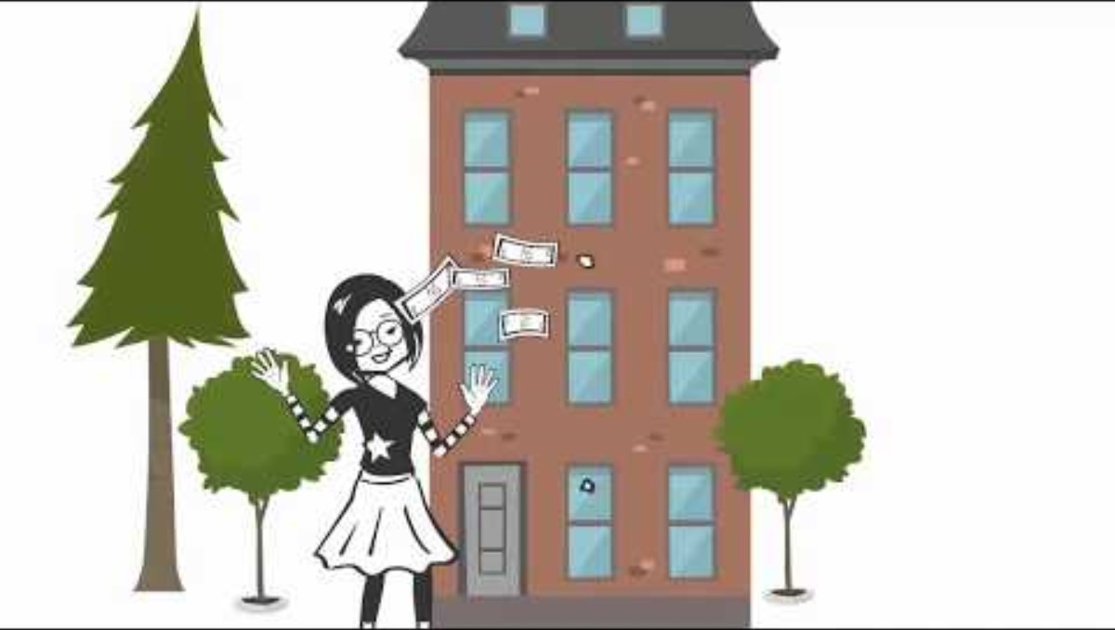
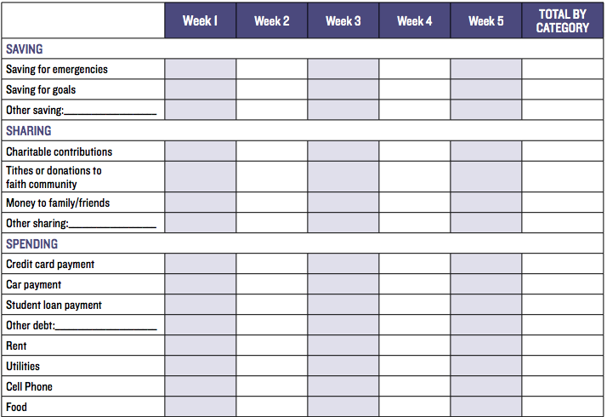
Spending Tracker
SOURCE: UC ANR Money Talks. (September 19, 2017). Monthly Budgeting. Retrieved from: https://youtu.be/SGcmAHzT0h0?si=2n0WuXiAZJ5PEeih. Used with permission.
Copyright (c) 2024 Regents of the University of California. This work is licensed under the Creative Commons Attribution-NonCommercial-NoDerivatives 4.0 International License. To view a copy of this license, visit http://creativecommons.org/licenses/by-nc-nd/4.0/ or send a letter to Creative Commons, PO Box 1866, Mountain View, CA 94042, USA.
12
Notes:
State that the first step in creating a budget is to track every dollar spent for at least a month. Using that information will help young people create categories for their budget, input the accurate dollar amounts for each category and let them look at their needs, wants and obligations. Let them know that this tracking sheet is available in the Supplemental Resources Handout. Ask young people how they track their expenses now. Some ideas may include using an app or online tool.
Watch the University of California’s Monthly Budget Video, which is hyperlinked on the slide (stop at 1:54) and can be found here: https://www.youtube.com/watch?v=SGcmAHzT0h0&t=24s

Slide 13
Budget Tools
ENVELOPE METHOD
Grab a set of envelopes and label each one with an expense category such as food, clothes and savings. Put your income, in cash, in each category that the cash will be spent.
EXCEL/NOTEBOOK METHOD
Use a spreadsheet or notebook to list all monthly expenses. Include your monthly income. Use it as a guide to allocate income throughout the month.
MOBILE BUDGET APPS
There are financial technology apps with budgeting tools. They often connect with your bank account(s) so they can import information automatically.
13
Notes:
Ask participants to unmute themselves and read these three types of budget tools.
Ask young people what they think of the different options. What tools to do they currently use for a budget? What do they think they will use in the future?
Tell the participants that if they want to use a mobile budgeting app, to carefully research it first. Let them know to check what data the app will collect, what if any cost there is for the app and the reputation of the company. Remind them that their financial institution may have tools to help them with budgeting as well.

Slide 14
Develop Good Habits or “Rules of Thumb”
Automate your savings
Save half of any raise, gift, tax return or other unexpected money
Use text and email alerts to remind you about upcoming bills
Use online bill payments to automatically pay your bills on time
Pack your lunch
Shop with a list and never shop when you’re hungry
Always buy less than you can afford
14
Notes:
Let young people know that there are some general ideas or “Rules of Thumb” to help them be in control of their money. Ask a participant to read the ones listed. Ask them to put in the chat box their favorite one. Ask if they know of any other ideas.
Summarize by saying that creating a budget and tracking their spending can help them take charge of their financial well-being and make decisions to reach their goals.

Slide 15

Wrap Up – Questions and Comments?
NEXT TIME
Know where your money goes: Take two minutes to review your monthly transactions.
“Key 6: Saving and Investing”
Date: ___________
Time: ___________
Notes:
Ask participants if they have any questions on what was covered in the Key or any last comments.
Confirm the date/time for the next workshop.
Thank everyone for attending/participating and give out your contact information so they can reach you with any questions.

