Slide 1
Agenda: List of training activities
TRAINING METHOD | TOPIC (SLIDE TITLE) | TIME ESTIMATED
Presentation | Welcome and Session Objectives; Icebreaker | 10 minutes
Presentation and Facilitated Discussion | Saving vs. Investing; The Difference Between Investing and Saving; Where Do People Save and Invest?; Stock Market: Stocks, Bonds, Mutual Funds (Video); Foundation for Investing and Saving | 15 minutes
Large Group Exercise | Key Activity: Alejandro Plans to Save or Invest; Alejandro – Save or Invest | 10 minutes
Presentation and Large Group Exercise | Investing – Why? (Video); Key Activity: Haruto’s and Hailey’s Investment; Compound Interest (Optional Activity) | 10 minutes
Presentation and Facilitated Discussion | Retirement Savings Plan (Video); Net Worth = Assets – Liabilities | 10 minutes
Closing | Questions? What Is One Thing Learned? Next Training Date and Time | 5 minutes
TOTAL TIME ESTIMATE |  | Approx 1 – 1.5 hours
Notes:
For internal use by facilitators. This sample agenda mirrors the agenda in the facilitator guide. Recent updates to the curriculum appear in this slide but may not yet appear in the facilitator guide. Updates to the guides are in progress. Facilitators will want to keep close track of session time and balance delivering the content and encouraging discussions to keep the session one to 1.5 hours long.

Slide 2
Keys to your financial future
Key 6: Saving and Investing
Jim Casey Youth Opportunities Initiative®
Notes:
Facilitator: Introduce yourself. Ask participants to take themselves off mute and say their names, or if they are more comfortable, they may say hello by putting their name in the chat box.

Slide 3

What You’re Going to Know or Be Able to Do
Differentiate between saving and investing
List ways to find money to save in your budget and identify strategies that will work for you
Explain where you can save and where you can invest
Define key terms about saving and investing
Explain inflation and the reasons it’s important to understand when saving and investing
Explain the time value of money and compounding
Notes:
Discuss the content that is covered in Key 6: Saving and Investing. Let the young people know that there is a lot of material in the Key and you will not be able to cover it all in this virtual format. Encourage them to check the participant guide for the entire content.
Let them know that the Key Participant Guides can be found at: https://www.aecf.org/resources/keys-to-your-financial-future-participant-guides.
Be sure that you cover these two main points during this workshop:
It’s important to find ways to save money for emergencies, for paying bills if for some reason there’s a job loss (no money coming in) or for goals.
When young people are financially stable (and are able to pay all bills on time), have savings in place and have extra income, investing can be a way to grow wealth.

Slide 4

Icebreaker
Would you rather receive $10,000 in 30 days OR receive one penny today and have it doubled each day for 30 days?
Notes:
Do a fun icebreaker question where participants can take themselves off of mute and say their answer to the question or put it in the chat box.

Slide 5
Watch What Happens to a Penny Over 30 Days
Day 1 | Day 2 | Day 3 | Day 4 | Day 5 | Day 6 | Day 7
$.01 | $.02 | $.04 | $.08 | $.16 | $.32 | $.64
Day 8 | Day 9 | Day 10 | Day 11 | Day 12 | Day 13 | Day 14
$1.28 | $2.56 | $5.12 | $10.24 | $20.48 | $40.96 | $81.92
Day 15 | Day 16 | Day 17 | Day 18 | Day 19 | Day 20 | Day 21
$163.84 | $327.68 | $655.36 | $1,310.72 | $2,621.44 | $5,242.88 | $10,485.76
Day 22 | Day 23 | Day 24 | Day 25 | Day 26 | Day 27 | Day 28
$20,971.52 | $41,943.04 | $83,886.08 | $167,772.16 | $335,544.32 | $671,088.64 | $1,342,177.26
Day 29 | Day 30
$2,684,352,56 | $5,368,709.12
Notes:
Review this chart of doubling a penny every day for 30 days. Note how many may have said they would take the $10,000 but that this chart shows the growth of the penny method.

Slide 6
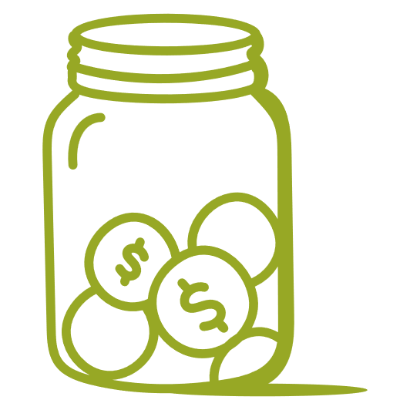

Saving vs. Investing
WHAT IS SAVING?
Saving money is setting aside income today for a use in the future.
Saving can be for short-term use or long-term use.
WHAT IS INVESTING?
Investing is putting money into an asset with the expectation of achieving a profit.
Investing is usually for long-term future use.
Notes:
Ask a participant to read the “What is saving?” and the the corresponding definition. Ask someone else to read the “What is investing?” and definition.
Mention that you will discuss these in more detail, but a key point is that investments have risk because they can go up and down in value. Investors need to be able to leave their money in an investment for a longer period of time to see the growth in the money they earn. It’s not a good strategy to start an investment and try to cash it out in six months.

Slide 7

What’s been your experience with seeing people save or invest in your household or community or through media?
Notes:
Ask participants to take themselves off of mute and say their answer to the question or put it in the chat box.

Slide 8
The Difference Between Saving and Investing
SAVING
INVESTING
Money is set aside in a specified location (piggy bank or account)
Money is placed into something else
(e.g., stock), so it earns more money
Can start with as little as a penny
Usually has a minimum amount to start with third-party vehicle
Safe if stored in federally insured bank or credit union = low risk
Achieving high returns on money is not guaranteed = high risk
Generally low interest rates earned
On average, higher rates of return
Can withdraw amount saved easily
Can access the money invested
but takes longer
Notes:
Ask a participant to read the Saving box. Discuss the points: that saving can start today by just saving the change they have, and that savings accounts at banks/credit unions are insured by the government so no one will lose the amount in the account. However, those accounts usually offer low “returns” or interest rates so they will not earn a lot of money on the accounts. Account holders can withdraw money from these accounts, up to six times a month, for any needs such as emergencies, etc. Ask if participants already have a savings account and if they know how much interest they earn.
Tell the participants that while they need to save up money for it, investing is different from saving. It usually has a higher minimum to start investing and there is no insurance for investments, which means there is risk. However, it also usually has a higher rate of return on average, which means they can make more money in an investment than a savings account. Investors can sell their investments, but it will take a while to get their money.

Slide 9
Where Do People Save and Invest?
SAVING
Storing money in:
Savings jar at home
Savings accounts
Certificates of deposits (CDs)
Money market accounts (MMAs)
INVESTING
Putting money into:
Stocks
Bonds
Mutual funds
Retirement funds — IRA, 401(k)
Notes:
Ask young people where they save their money? Ask if anyone has saved their change and put it in a jar at home.
Explain that some people use a prepaid card to put their savings on. Most people use a savings account with a bank or credit union. Explain that Certificates of Deposits or CDs are savings vehicles into which money is deposited for a fixed time period at a fixed return. The higher the amount invested and the longer the time period, the higher the interest rate you will earn. Money market accounts are interest-bearing savings accounts with limited transaction privileges (six withdrawals with no more than three as checks), higher minimum balance requirements and higher rates of interest than a savings account.
Mention that they will see a video shortly that will explain the terms listed for investing and note that these are common ways that people start with investing.

Slide 10
What if There Isn’t Enough to Save or Invest?
Keep the change
Use direct deposit
Pay your bills on time
(avoid fees)
Shop smart
Save unexpected income
Supplement income with public benefits
Consider increasing income
Notes:
Reference back to page 10 about strategies to find additional money to save:
Keep the change and put into a designated jar or box
Use direct deposit to receive your income
Pay your bills on time to keep from paying fees
Shop smart by using generic products, comparing prices, avoiding CashApp/Venmo fees
Save unexpected income like a tax refund
Supplement income with public benefits like SNAP, housing, or energy assistance
Consider increasing income with a side job (selling a service or a product)
Ask the group for any additional ideas on ways to find extra money to save or invest.

Slide 11
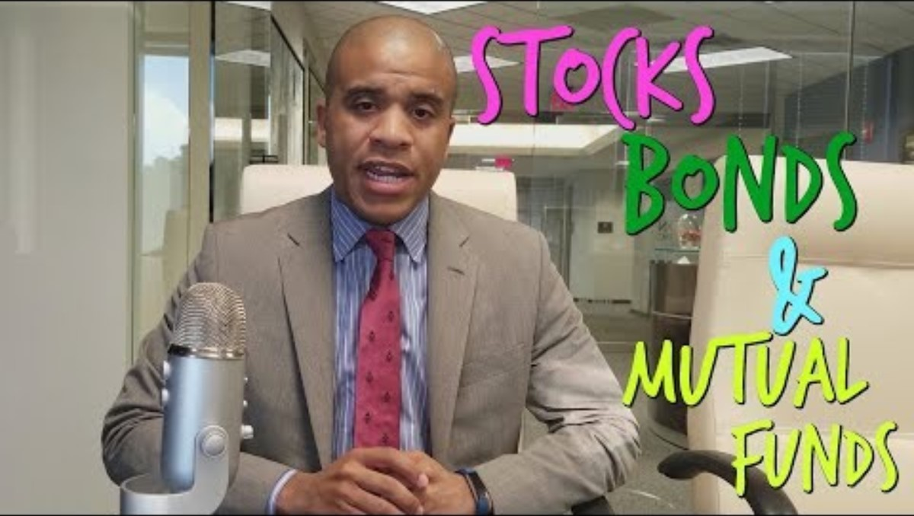
Stock Market: Stocks, Bonds and Mutual Funds
SOURCE: “Stocks, Bonds and Mutual Funds Explained.” Investment Basics with Brenton Harrison, New Money, New Problems. Used with permission. https://www.youtube.com/watch?v=pyjX9Nwh49Q.
Notes:
State that common investments are buying stocks and bonds through different ways to invest in the stock market, buying real estate, or even investing in a specific business (whether their own or others). Show the Stocks, Bonds and Mutual Funds Video that explains those three types of investments. (Stop at 2 min, 47sec) The video is embedded in the slide and can be found here: https://www.youtube.com/watch?v=pyjX9Nwh49Q
State that investments involve different levels of risk, usually the more potential to earn money means the more risk. The rule of thumb is: Greater Reward = Greater Risk.
Mention that it’s important to understand how much risk they are willing to take with their investments and that there are some risk assessment quizzes they can take in the Supplemental Resources Handout.

Slide 12

Foundation for Saving and Investing
Before putting your money in a savings or investment vehicle, answer these questions:
What are you investing for and how much do you need? This is your goal.
When do you need that money? This is the time frame.
How much risk can you take? This is your risk tolerance.
The answers to these questions help determine where to save or invest your money.
Notes:
Ask a young person to read the Key Concept. Discuss the questions.

Slide 13

Alejandro Plans to Save or Invest
Alejandro:
Is 18 years old
Graduates in 15 months
Wants to go to trade school to be an electrician
Estimates that Education Training Voucher and state will cover his tuition, fees and books
Needs money for equipment and living expenses
Notes:
Familiarize yourself with the Alejandro scenario in the original Key 6 Facilitator Guide content: https://www.aecf.org/m/resourcedoc/aecf-keyscurriculumfacilitator-key6-2019.pdf
Tell the participants that you are going to talk about an example of a young person who is trying to decide whether to save his money or invest it. Summarize his situation with the statements on the slide.

Slide 14

Alejandro — Save or Invest?
1% Interest Savings Account
VS.
$51 share price
High risk tolerance
Can save $200 a month
What do you think Alejandro should do?
Notes:
Continue to talk about Alejandro by saying that he has a high tolerance for risk and is willing to invest his money to earn a higher return. State that he is working part time while finishing high school and thinks he can save $200 a month for those 15 months = $3,000. He has a savings account that earns 1% interest but is interested in investing in Facebook, which would cost $51 a share.
Ask the participants to summarize Alejandro’s goals: Save for the equipment he will need in electrical school and for living expenses. Ask them what they think he should do — save or invest? Direct the conversation as to why saving would be the best option for him.
After discussion, emphasize that investing is not a short-term strategy so Alejandro may not earn enough in the investment to warrant the risk. Point out that he could lose money on the investment, which would harm his goal. Point out that once he is done with school, has a job with a steady income and has emergency savings, he might want to consider investing then.

Slide 15
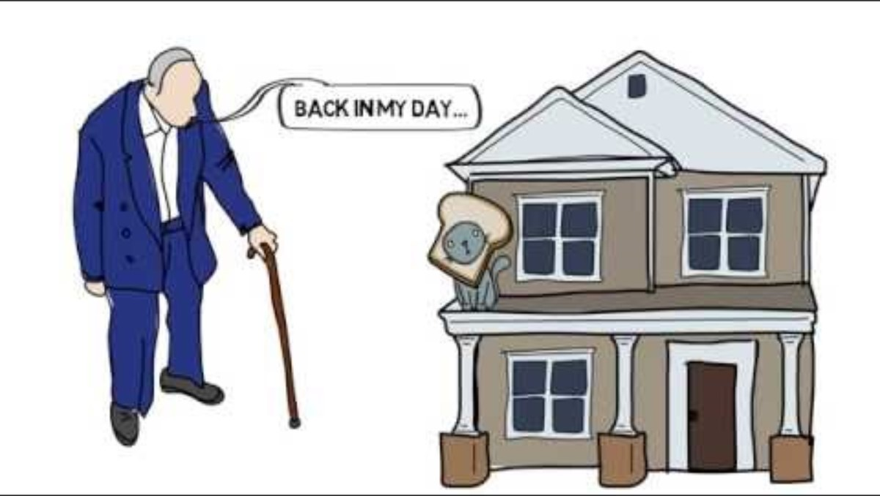
Investing — Why?
SOURCE: MoneyCoach. (July 16, 2016). Why Invest? Retrieved from https://moneycoach.io/videos. Used with permission
Notes:
Facilitator shares their screen and shows the “Why Invest” video that shows the risk of only using a Savings Account to grow wealth vs Investing. The video in embedded in the slide and can be found here: https://www.youtube.com/watch?v=x7msE3tx8QI
Ask for comments.

Slide 16
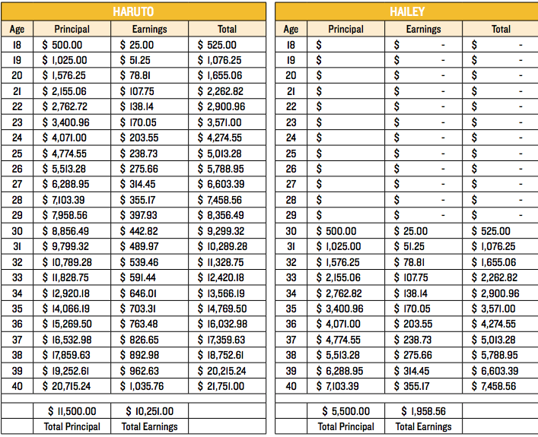
Key Activity: Haruto’s and Hailey’s Investments
How much total money did Haruto and Hailey invest (PRINCIPAL)?
How much total money did their investments earn (RETURNS)?
Any ideas on why Haruto’s total investments are higher?
Compound Interest
Notes:
Read the scenario for the two investors: Haruto and Hailey. Ask a participant to say at what age Haruto started investing, and what age Hailey started. State that they each saved $500 a year and received a return of 5% on their investments after fees. Ask the same person to read the boxes highlighted in yellow on how much Haruto and Hailey have in their investments. Ask if anyone has any ideas on why Haruto’s is higher? Answers may include: compound interest, Haruto started 12 years earlier and had more time for his money to grow, etc.

Slide 17

Compound Interest
Compound Interest Activity
SOURCE: Investor.gov, U.S. Securities and Exchange Commission.
Notes:
Optional activity - Tell young people that “When you deposit money in a savings account or a similar account, you’ll usually receive interest based on the amount that you deposited. For example, if you deposit $1,000 in an account that pays 1% annual interest, you’d get $10 in interest after a year. Compound interest is interest that you earn on interest. So, in the example, in year two, you’d earn 1% on $1,010, or $10.10 in interest payouts. Compound interest accelerates your interest earnings, helping your savings grow more quickly.” (Source: Bankrate.com)
Facilitator shares their screen and goes to the website Investor.gov, which is embedded in the slide and is here — https://www.investor.gov/financial-tools-calculators/calculators/compound-interest-calculator — to do an activity on compounding. Enter in $500 as the initial investment amount and use 10 years and initial interest rate of 5% and 5 for the Interest rate variance range to show the different results in the chart. Discuss how compound interest helps money to grow or increase.

Slide 18
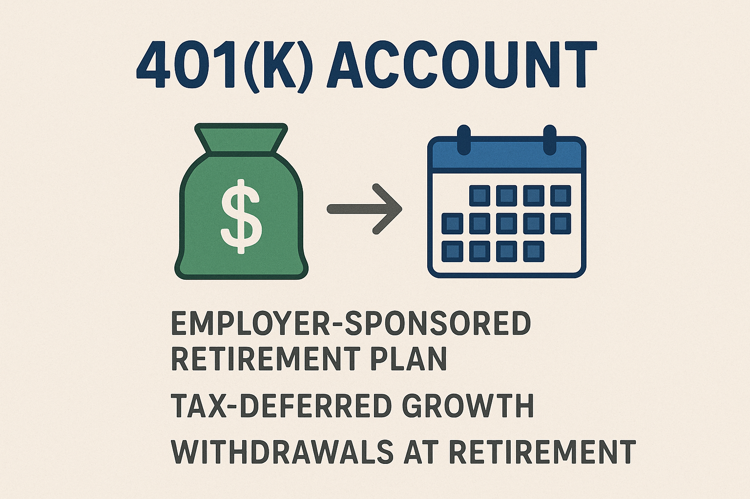
Retirement Savings Plans
Tips:
When getting a full-time job, ask if the employer offers a 401(k) account and a matching 401(k) contribution.
If your employer has a contribution match, at the very least, contribute up to that percentage.
What does this look like?
Notes:
Let the participants know that one common method of investing for their future is if their employer offers a plan for retirement savings, 401(k) [or a 403(b) for a nonprofit]. According to the IRS, a 401(k) plan is a defined contribution plan where an employee can make contributions from his or her paycheck either before or after tax, depending on the options offered in the plan. The contributions go into a 401(k) account, with the employee often choosing the investments based on options provided under the plan. In some plans, the employer also makes contributions such as matching the employee’s contributions up to a certain percentage.
Ask if the young people know anyone who has this type of plan and what their thoughts are on it. Emphasize that if they work for an employer who offers a “match” on the plan, where the employer contributes money to it, they should consider participating in it. Otherwise, the young people will not get that money from the employer.

Slide 19
Net Worth = Assets - Liabilities
ASSET BUILDING is about saving money and investing that money in assets that will help you achieve your goals and your life vision.
LIABILITY is something you owe.
DEBT is money you owe to another person, business or the government.
Notes:
Summarize by reviewing that there are Assets and Liabilities, which were covered in Key 1. Read the Key Concept and the text in the orange box. Emphasize that the goal is to build assets and keep liabilities as low as possible. Say that investing is one way to build assets. However, since it is risky and there is potential to lose money, it’s important that when they are ready to invest, they learn the necessary terms and choose an investment option carefully.

Slide 20



Wrap Up – Questions or Comments?
NEXT TIME
Research one company that has a savings or investing account that you would be interested in using.
“Key 7: Banking”
Date: ___________
Time: ___________
Notes:
Ask participants if they have any questions on what was covered in the Key or any last comments.
Confirm the date/time for the next workshop.
Thank everyone for attending/participating and give out your contact information so they can reach you with any questions.

Slide 21
Compound Interest

