Slide 1
Agenda: List of training activities
TRAINING METHOD | TOPIC (SLIDE TITLE) | TIME ESTIMATED
Presentation | Welcome and Session Objectives; Icebreaker | 5 minutes
Presentation and Large Group Exercise | Key to Your Financial Future: Your Identification and Critical Documents and Key Activity: Your Identification and Critical Documents Scavenger Hunt | 15 minutes
Presentation, Open Discussion and Pair Exercise | Identity Theft and Key Activity: Signs Your Identity May Have Been Stolen | 10 minutes
Presentation and Small Group Exercise | Getting Help; Key to Your Financial Future: Steps to Take When Your Identity Has Been Stolen; and Key Activity: Nola Has Her Identity Stolen | 10 minutes
Presentation and Pair Exercise | Key Activity: Ways to Prevent Identity Theft | 10 minutes
Closing | Questions? What is one thing learned? Next training date and time | 5 minutes
TOTAL TIME ESTIMATE |  | Approx 1 hour
Notes:
For internal use by facilitators. This sample agenda mirrors the agenda in the facilitator guide. Recent updates to the curriculum appear in this slide but may not yet appear in the facilitator guide. Updates to the guides are in progress. Facilitators will want to keep close track of session time and balance delivering the content and encouraging discussions to keep the session one to 1.5 hours long.

Slide 2
Keys to your financial future
Key 8: Protecting Your Identity
Jim Casey Youth Opportunities Initiative®
Notes:
Facilitator: Introduce yourself. Ask participants to take themselves off mute and say their names, or if they are more comfortable, they may say hello by putting their name in the chat box.

Slide 3

What You’re Going to Know or Be Able to Do
List the identification and critical documents you may need and the reasons you need them
Know where to get identification and critical documents
List ways to determine if your identity has been stolen
Describe the steps to take if you suspect or know your identity has been stolen
List specific ways to prevent identity theft
Notes:
Discuss the content that is covered in Key 8: Protecting Your Identity.
Let the participants know that there is a lot of material in the Key and you will not be able to cover it all in this virtual format. Encourage them to check the participant guide for the entire content.
Let them know that the Key Participant Guides can be found at: https://www.aecf.org/resources/keys-to-your-financial-future-participant-guides.
Be sure that you cover these two main points during this workshop:
Minimize who has access to your personal information
Be on alert for ways that ID Theft occurs so you can protect yourself

Slide 4

Participant Poll: What’s Your Digital Footprint?
Notes:
Do a fun poll for participants. Add these questions:
I have had the same password for more than two years. Yes or No
I know where all my important documents are located (SSN card, credit card, passport, etc.). Yes or No
My phone has a strong passcode to get into it (e.g., it’s not 1234). Yes or No
I am consciously mindful of the personal information I share on social media. Yes, No, Sometimes

Slide 5

Icebreaker
Identification documents are proof that we really are who we say we are.
What are some types of identification documents/cards that exist?
Notes:
Do a fun icebreaker question following up on Key 7 where participants can take themselves off of mute and say their answer or put in chat box, such as:
SSN card, school ID, credit cards, passport, license, birth certificate, etc.

Slide 6

Identification Documents
Birth certificate
State ID card or driver’s license
Social Security card or green card
U.S. passport
Medical records
Voter registration card
School ID card
Notes:
Tell the participants that in the U.S. economy, a person has documents that establish his or her identity. These identification documents are proof to the government, a bank or credit union, a college or a business that you are who you say you are. These identification documents help a person obtain an apartment, a loan, open a bank account, apply for financial aid, apply for public benefits, travel in and outside the U.S., or simply get student discounts at various stores.

Slide 7

Identification Documents
KEY RIGHTS
Getting Your Official Documents From the Child Welfare Agency
If you are a young person in foster care, the child welfare agency in your state is required to ensure you have your birth certificate, Social Security card, health insurance information, medical records and driver’s license or state-issued photo ID.
Check with your caseworker, foster parent or another trusted adult to ensure this happens for you as is required by federal law.
Notes:
State that It’s important to have access to these documents. Ask a young person to read the Key Rights box. Tell them that there is a checklist of important documents and where they can get them from, in the Supplemental Resources Handout. Let them know that it’s important to keep those documents in a safe place so no one else can have access to them. Try to have local resources available who young people can turn to for help in getting their documents.

Slide 8
Matching Game: Getting Your Official Documents
Social Security card
Birth certificate
Immunization records
Official school transcript
State picture identification card
Passport
Office of Vital Records
State Dept. of Motor Vehicles
Social Security Administration
Medical office/guardian/school
School that you attended
U.S. Department of State
Notes:
State that It’s important to have access to these documents. Even though they currently have a large support team to help them get their documents, down the road they may have to do this on their own (getting married, moving to a new state, etc.). Play the matching game with them, where you read each document one by one and ask them to match it to the agency that issues that document. They can call out or add the answer in the chat.

Slide 9
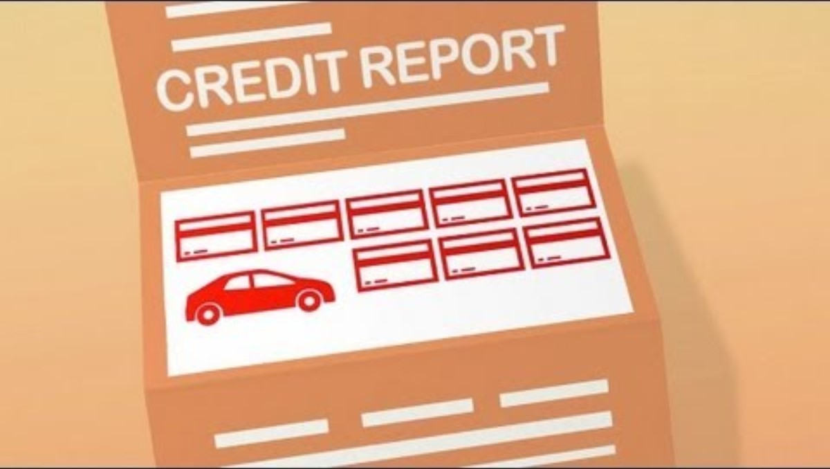
Participant Poll: What Is Identity Theft?
SOURCE: Federal Trade Commission. (January 4, 2013). Why Care About Identity Theft? Retrieved from: https://youtu.be/k3yh9hjnE44?si=OmTP1vT5Wa8S12nC. Used with permission.
Notes:
Ask if anyone has been, or knows someone who has been, the victim of ID theft? Discuss briefly.
Create a poll with the terms below to ask the young people what their personal information can be used for if it is stolen from them:
Open a credit card (Yes)
Rent an apartment (Yes)
Access and drain your bank account (Yes)
Open a bank account (Yes)
Help you get better grades in school (No, an ID thief is using the information to help themselves, not the young person)
Open utility accounts (Yes)
Apply for public benefits — food stamps/SNAP benefits or housing assistance (Yes)
Get a phone and phone/data plan (Yes)
File a tax return and get your refund (Yes)
If time allows, show this video by the FTC’s “Why Care About Identity Theft?” available at https://consumer.ftc.gov/media/79861

Slide 10
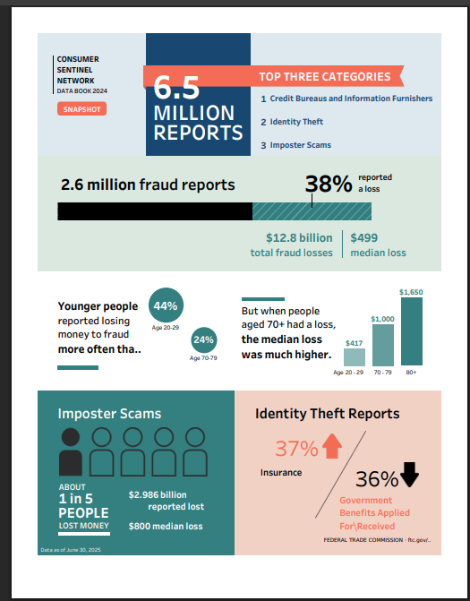

Fraud and Consumer Issues
Notes:
Source: https://www.ftc.gov/news-events/explore-data
State that the federal government's Consumer Protection Agency, the Federal Trade Commission or FTC, compiles data on consumer complaints every year and creates these reports. Highlight the data points with the arrows (animated). Ask the participants if they have ever had or heard about consumer complaints.

Slide 11
Identity Theft Reports by Age (2022)
Of the 1,107,209 total identity theft reports in 2022, 87% included consumer age information.
SOURCE: Federal Trade Commission. (n.d.). Explore data. https://www.ftc.gov/exploredata
Notes:
Let the young people know that this chart shows the number of ID theft cases by age range and how much money was lost. Ask one person to read the number of cases and amount lost for the ages 20 to 29. Note the number for 19 and under and state that even though a thief should not be able to get credit using the personal information of someone under 18, it does happen.

Slide 12
Top Median Losses for People Ages 20 to 29 (2022)
FRAUD AFFECTS EVERY GENERATION DIFFERENTLY
Top Median Losses for People Ages 20–29
Payment Method
Contact Method
Fake Check Scams
Job Scams and Employment Agencies
Business and Work-at-Home Opportunities
Miscellaneous Investments and Investment Advice
Government Imposters
Pyramids and Multi-Level Marketing
$2,000
$1,875
$1,800
$1,438
$1,000
$1,000
E-mail
Text
Payment App or Service
Debit
Card
Social Media
(#1)
Website or Apps
Other
This ranking excludes fraud types with fewer than 100 reports.
Not all reports include usable age information. Age comparisons in Fraud Loss Reports per 100K Population are based on (1) reports indicating any monetary loss, and (2) population estimates are based on U.S. Census Bureau population estimates for 2019. Percentages are based on the number of people reporting a monetary loss by age and a payment/contact method.
SOURCE: Federal Trade Commission. (n.d.). Pass it on. https://www.ftc.gov/PassItOn
Notes:
Review the statistics in this chart.

Slide 13
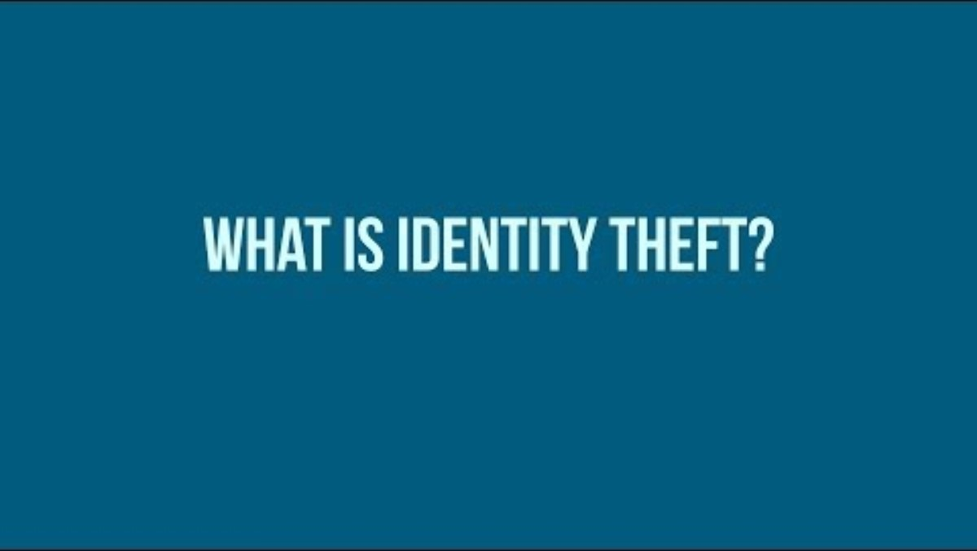
What Is Identity Theft?
SOURCE: Association of Certified Fraud Examiners. (November 12, 2018). What is Identity Theft? https://youtu.be/kDFeSUUwRnA?si=C2AHygOCSdkVSF1G
Used with permission.
Notes:
Ask the participants if they have any ideas on how ID theft happens? How do thieves get people’s personal information? Show the “What Is Identity Theft?” Video from the Association of Certified Fraud Examiners (2 min, 31 seconds) . The video is embedded in the slide and can be found here: https://www.youtube.com/watch?v=kDFeSUUwRnA
This video covers dumpster diving, imposter scams, malware and data breaches. Mention that romance scams happen where a person pretends to want a relationship with them but is really out to take their money.

Slide 14
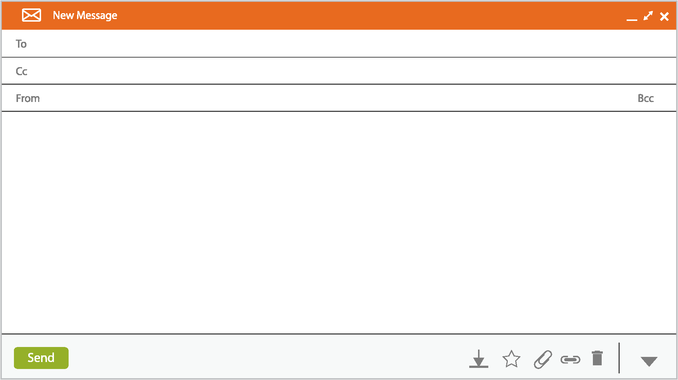
Identity Theft — How Does It Happen?
Mary Doe
customerservice@yourfinancialinstitution.com
1
Confirm Information!
Security Alert: Please read this important message
Due to a technical update, we ask that you verify your online banking membership details. Please confirm your information at the link below.
Please follow the link below to complete the Details Confirmation form: http://www.personalconfirmation.com/goto/update/login894kf/order or call 555-1234
If you don’t verify, we will be forced to terminate your account.
2
3
Highlighted text = warning sign
Notes:
Review the sample of an email that is pretending to be from a person’s bank with a security alert. It’s asking the person to click on the link to verify some information or their account will be “terminated.” State this is an example of a thief trying to get personal information and/or install malware on the person’s phone/computer. Tell the young people never to click on these types of links and delete these emails. If they think there is a problem with their bank account or credit card, call the company or go directly to their website. Best practice is to never click on an email from a financial institution but to go directly to the financial institution’s website. In addition, always look for the indicators that a website is secure:
The word secure next to the website and an icon of small lock.
Use of the S is an url: https

Slide 15
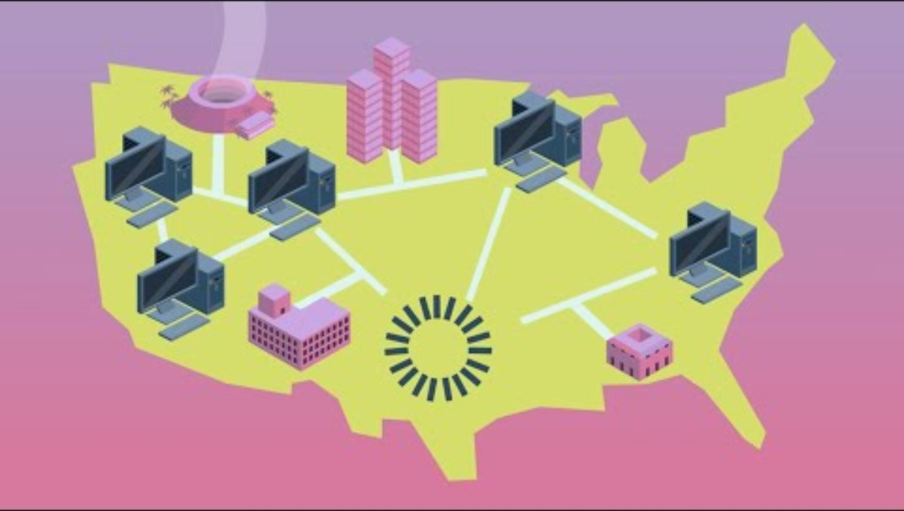
Identity Theft — How Does It Happen?
SOURCE: WGBH Educational Foundation and Public Broadcasting Service. (September 15, 2014). A Cyber Privacy Parable. Retrieved from: https://mpt.pbslearningmedia.org/resource/nvcy-sci-parable/a-cyber-privacy-parable/ . Used with permission
Notes:
Let participants know that asking for personal information over the phone, either by a phone call or text, is another way that thieves try to steal information. Also, devices that thieves attach to ATMs or gas pumps, called Skimmers, are another way they can steal information. The lock on this gas pump is used by the gas station to make sure no one can install a Skimmer. Lastly, mention that a lot of ID theft is committed by friends and family. This may be a sensitive topic for young people in the event that this has happened to them and may generate a lot of conversation. Tell them that you will cover the steps to take if ID theft has happened to them.
Discuss the role of social media in ID theft by showing this video “A Cyber Privacy Parable” from NOVA PBS. (end at 2 mins). The video is embedded in the slide and can be found here: https://www.youtube.com/watch?v=H0I7jQb37bo&list=RDCMUCjHz5SVHeMT0AViCYZvsGDA

Slide 16
Signs Your Financial Identity Has Been Stolen
Small charges on your credit card statement you did not make
Inaccurate accounts, addresses, liens listed on credit reports
Denial of medical care because there are unpaid medical bills or debt in your name created by the identity thief
Calls from debt collectors for accounts you do not recognize
Withdrawals from your bank account you did not make
Notice from IRS when you try to file your tax return that it has already been filed
Notes:
Ask a participant to read the signs listed. Discuss them afterwards.

Slide 17

Steps to Take When ID Theft Happens
Protect your money — call the bank for next steps
Call creditors — dispute fraud
Protect credit — fraud alert or credit freeze
File police and fraud reports with local law enforcement
Monitor all your accounts
Notes:
Tell the participants that there are defined steps to take if they think they have been a victim of ID theft. The first step is to contact their bank to ensure their money is safe. It might mean getting a new debit card or opening a new account. Next is to call the creditors where any unauthorized charges were made and dispute those charges and potentially get a new account number. They can protect their credit by placing either a fraud alert or credit freeze on their credit so no new credit can be opened without additional verification (Fraud Alert) or can not be opened at all (Credit Freeze). It is generally recommended that people file a police report and an ID theft complaint with the FTC. However, some young people may be hesitant to contact the police in the case of identity theft. There may be many reasons for this. One reason is that they may know the identity of the thief — a family member or friend. Try not to make any assumptions or recommendations regarding the course of action young people should take when it comes to reporting this crime to the police. In the end, the young person may decide that family ties are not worth further fraying. On the other hand, a young person may decide to report a family member for stealing their identity.
State that there is a checklist from the Keys and another one from the FTC in their Supplemental Resources Handout that includes more information on Credit Freezes and Fraud Alerts.

Slide 18

Nola Has Her Identity Stolen
Nola:
Is 19 years old
Is working
Wants her own apartment
Does not have any credit cards or loans
Is denied after submitting an apartment application
Discovers that her checking account money is gone
Receives a credit card bill for an unknown card
Notes:
Familiarize yourself with the scenario about Nola in the original Key (https://www.aecf.org/m/resourcedoc/aecf-keyscurriculumfacilitator-key8-2019.pdf) and summarize by reading the bullets listed. Ask the young people what should Nola do since she has been a victim of ID theft? Answers may include:
Call her bank to report the stolen money.
Check her credit report and dispute items that she doesn’t recognize.
Place a fraud alert or credit freeze with the credit reporting agencies.
Contact any businesses that are scheduled to send her bills or payments she must make and let them know what happened, particularly if she does not have money to pay these bills due to the theft from her account.
File a police report.

Slide 19
Prevent Identity Theft
KEY RIGHTS
OPT OUT
One way to protect your identity is to reduce the number of prescreened offers mailed to you. You have the right to opt out. You can opt out of receiving them for five years or opt out of receiving them permanently.
To opt out for five years, call toll-free 1-888-5-OPT-OUT (1-888-567-8688)
or visit www.optoutprescreen.com.
Source: Federal Trade Commission. (2011, March). Prescreened credit and insurance offers. www.consumer.ftc.gov/articles/0148-prescreened-credit-and-insurance-offers
Notes:
Let the young people know that they may get credit card offers in the mail that someone may be able to access and obtain credit in their name. They can stop these offers from coming. Ask a participant to read the Key Rights box.

Slide 20
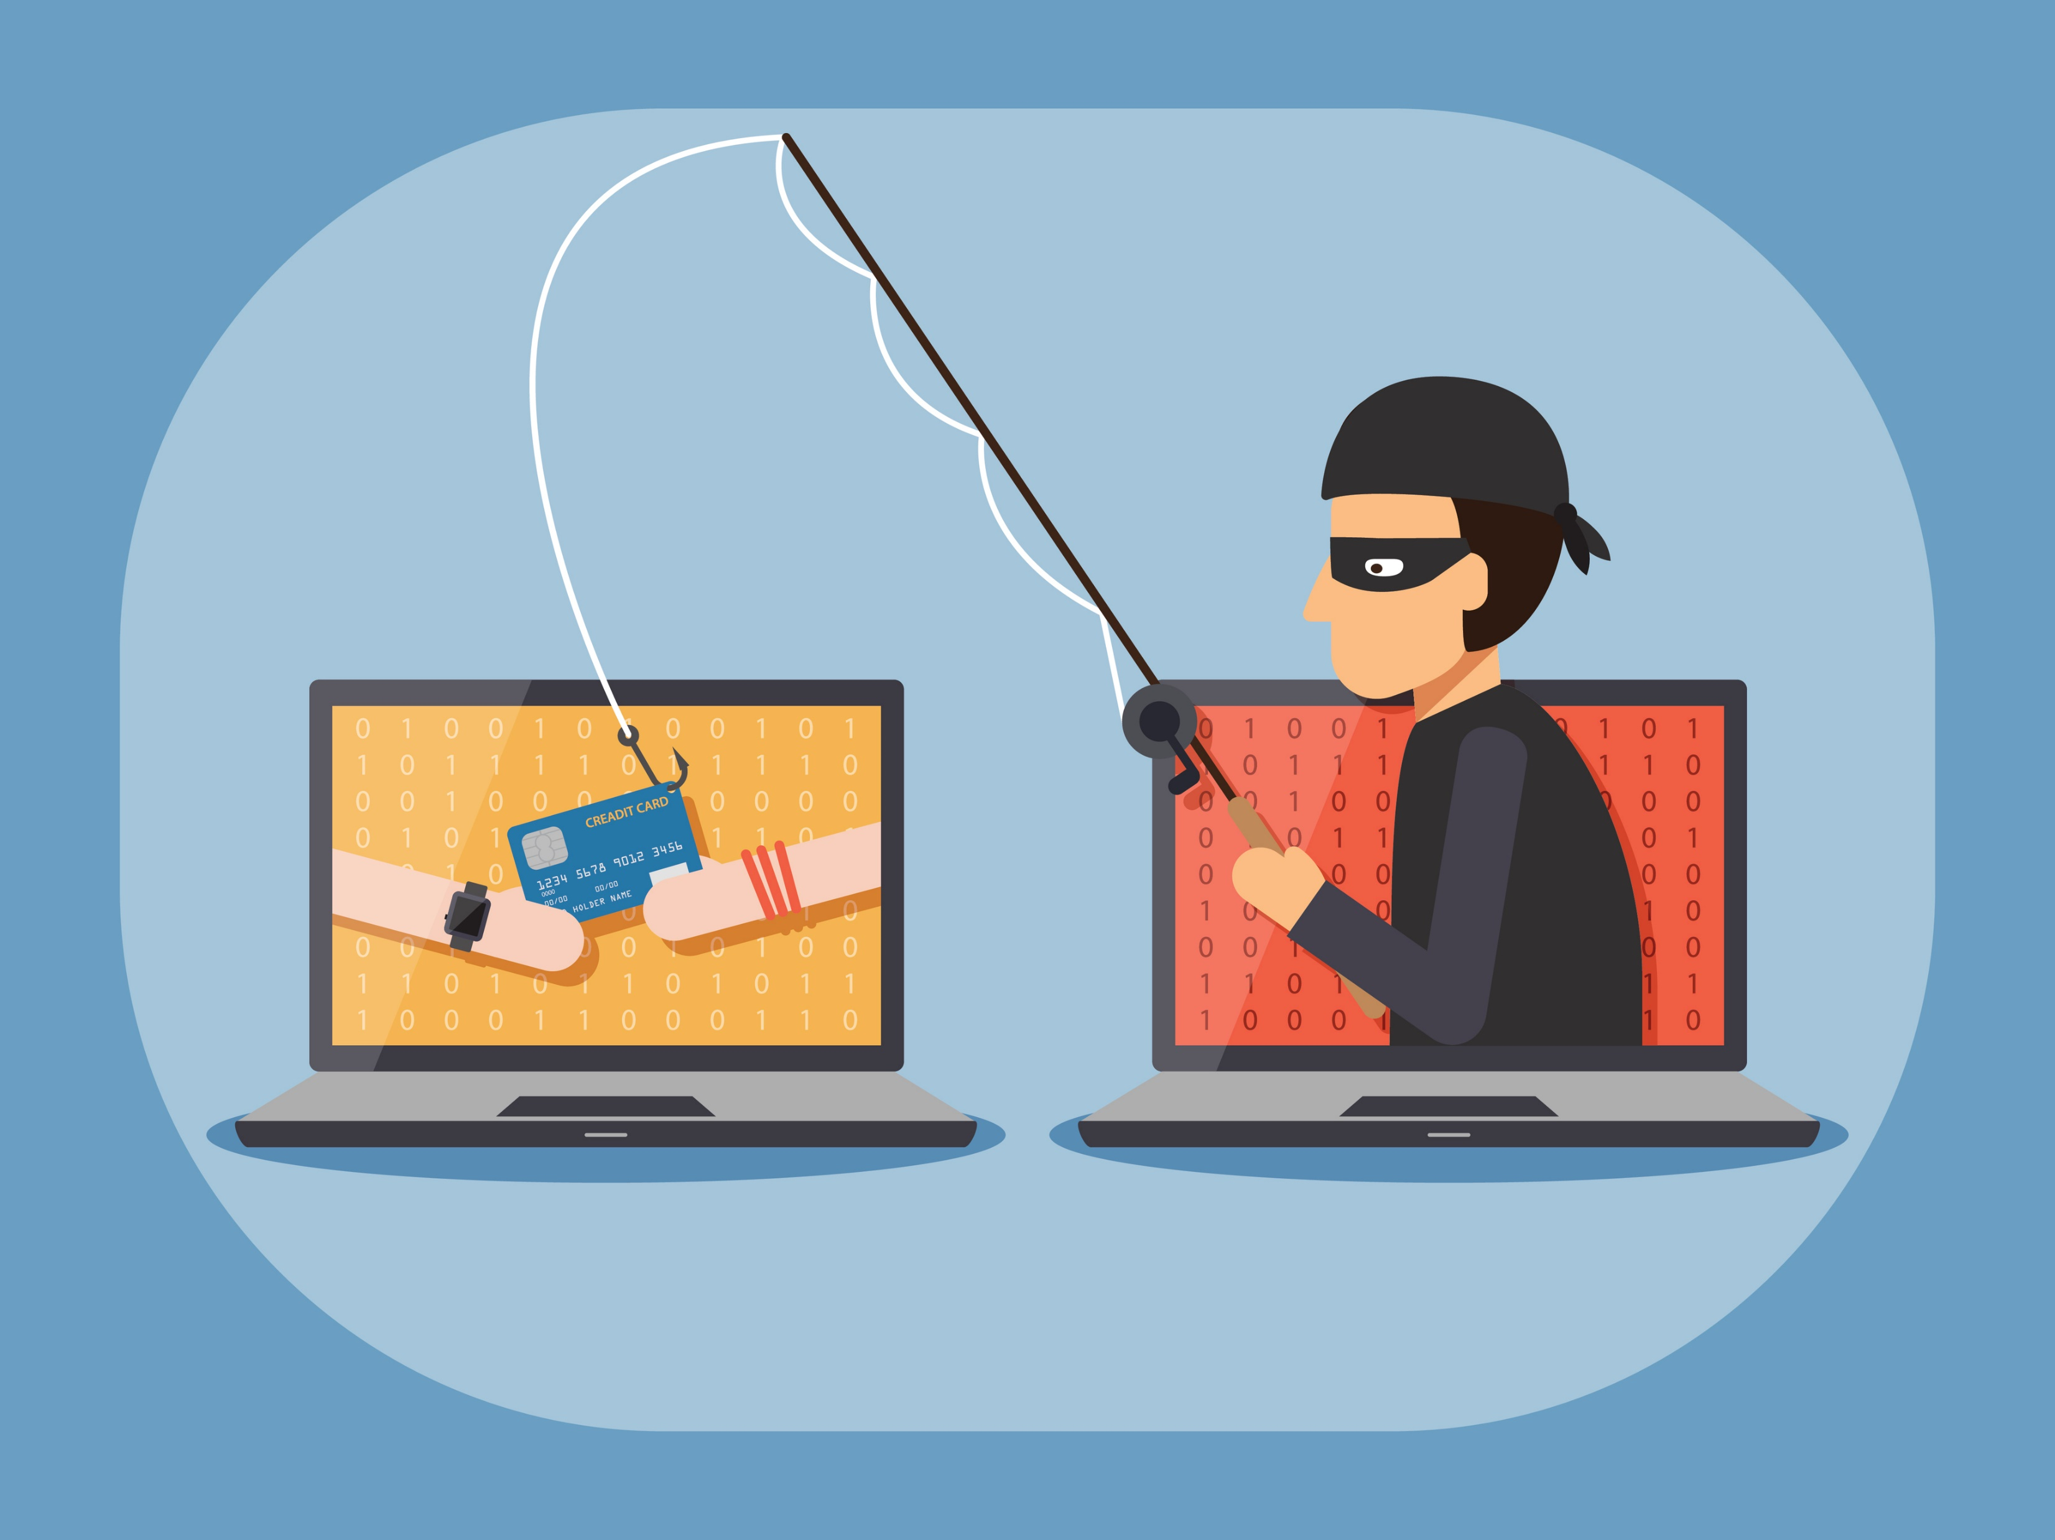
Participant Poll: Prevent Identity Theft
Notes:
Create a poll with the terms below and ask the young people to select the strategies to prevent ID theft. Discuss each one.
Protect your wallet and keep as little in there as needed (Yes)
Do not carry your Social Security card with you (Yes)
Use strong passwords and change them often (Yes)
Never give out personal information over the phone to someone who calls you (Yes)
Use public WiFi for banking transactions (No)
Review bank and credit accounts, either the statement, or online, frequently (Yes)

Slide 21
Protect and Reduce Your Digital Footprint
Set up email or text alerts to notify you when your debit or credit card is used
Set up two-factor authentication on mobile phone, email and accounts
Do not send money to people you don’t know on peer-to-peer payment apps
Remove yourself from promotional mailings or have a spam filter on your email
Use strong passwords and answers for security questions that aren’t easily searchable
Keep social media accounts private
Take the extra step to delete accounts — uninstalling the app doesn’t delete the account
Notes:
Emphasize that these strategies are about prevention and control — making it harder for criminals, scammers, or unwanted third parties to misuse their data.

Slide 22

Personal Information — Questions to Ask
Who will have access to this information?
What will be done with it?
Why do you need this information?
How will you protect this information?

Slide 23



Wrap Up
Questions?
What’s one thing you learned?
Notes:
Ask participants if they have any questions about what was covered in the Key or any last comments.
Ask if anyone will share one thing they learned from these Keys overall.
Thank everyone for attending/participating and give out your contact information so they can reach you with any questions.

