Slide 1
Keys to your financial future
Key 6: Saving and Investing
Jim Casey Youth Opportunities Initiative
September 2021

Slide 2
What You’re Going to Know or Be Able to Do
Differentiate between saving and investing
List ways to find money to save in your budget and identify strategies that will work for you
Explain where you can save and where you can invest
Define key terms about saving and investing
Explain inflation and the reasons it’s important to understand when saving and investing
Explain the time value of money and compounding
Notes:
Discuss the content that is covered in Key 6: Saving and Investing. Let the young people know that there is a lot of material in the Key and you will not be able to cover it all in this virtual format. Encourage them to check the participant guide for the entire content.
Let them know that the original Keys and their Participant Guide can be found at: https://assets.aecf.org/m/blogimg/aecf-keyscurriculumparticipant-key6-2019.pdf
Let the participants know that there is a lot of material in the Key and you will not be able to cover it all in this virtual format. Encourage them to check the participant guide for the entire content.
Be sure that you cover these 2 main points during this workshop:
It’s important to find ways to save money for emergencies, for paying bills if for some reason there’s a job loss (no money coming in) or for goals.
When young people are financially stable, and are able to pay all bills on time, have savings in place and have extra income, investing can be a way to grow wealth.

Slide 3
Introductions
3
Notes:
Facilitator introduces themselves.
Ask participants to say their name.

Slide 4
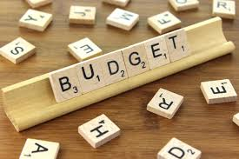
Icebreaker
What are your ideas on a tool to create a budget?
What are your thoughts about saving money?
Notes:
Do a fun icebreaker question where participants can take themselves off of mute and say their answer or put in chat box, such as:
What are your ideas on a tool to create a budget?
What are your thoughts about saving money?

Slide 5
Saving vs. Investing
What is saving?
Saving is setting aside money, holding onto it.
It can be for short-term use or longer-term use.
What is investing?
Investing is putting money into an asset with the expectation of achieving a profit.
It is usually for long-term future use.
Notes:
Ask a participant to read the “What is Savings” and the the corresponding definition. Ask someone else to read the “What is Investing” and definition.
Mention that you will discuss these in more detail, but a key point is that Investments have risk because they can go up and down in value. Investors need to be able to leave their money in an investment for a longer period of time to see the growth in the money they earn. It’s not a good strategy to start an investment and try to cash it out in 6 months.

Slide 6
Saving vs. Investing
Saving
Can be as little as a penny
Savings accounts are insured = minimum risk
Low interest rates
Can withdraw from savings account easily
Investing
Usually has a minimum amount to start
No guarantees = risk
Higher rates of return on average
Can access the money but takes longer
Notes:
Ask a participant to read the Savings box. Discuss the points: that Savings can start today, with just saving the change they have, and that Savings Accounts at banks/credit unions are insured by the government so no one will lose the amount in the account. However, those accounts usually offer low “returns” or interest rates so they will not earn a lot of money on the accounts. Account holders can withdraw money from these accounts, up to 6 times a month, for any needs such as emergencies etc. Ask young people if anyone already has a savings account and if they know how much interest they earn.
Tell the participants that while they need to save up money for it, investing is different from saving. It usually has a higher minimum to start investing and there is no insurance for investments, which means there is risk. However, it also usually has a higher rate of return on average which means they can make more money in an investment than a savings account. Investors can sell their investments but it will take a while to get their money.

Slide 7
Saving vs. Investing
Saving — Insured
Savings Accounts
CDs
Money Market Accounts
Investing — Not Insured
Stocks
Bonds
Mutual Funds
IRA/Retirement Funds
Notes:
Ask young people where they save their money? Ask if anyone has saved their change and put it in a jar at home.
Explain that some people use a pre-paid card to put their savings on. Most people use a savings account with a bank or credit union. Explain that Certificate of Deposits or CDs are savings vehicles into which money is deposited for a fixed time period at a fixed return. The higher the amount invested and the longer the time period, the higher the interest rate you will earn. Money market deposit accounts are interest-bearing savings accounts with limited transaction privileges (six withdrawals with no more than three as checks), higher minimum balance requirements and higher rates of interest than a saving

Slide 8
Saving
Saving — where?
Savings jar at home
Prepaid card
Savings account
Certificate of Deposit
Money Market Funds

Slide 9
Stock Market, Real Estate, Business
FOUNDATION FOR SAVING AND INVESTING
Before putting your money in a savings or investment vehicle, answer these questions:
What are you investing for and how much do you need? This is your goal.
When do you need that money? This is the time frame.
How much risk can you take? This is your risk tolerance.
The answers to these questions help determine where to save or invest your money.
Stock, Bonds, Funds Video
Notes:
Ask a young person to read the Key Concept. State that common investments are buying stocks and bonds through different ways to invest in the stock market, buying real estate, or even investing in a specific business (whether their own or others). Show the Stocks, Bonds, and Mutual Funds Video that explains those 3 types of investments. (Stop at 2 min, 47sec) The video is embedded in the slide and can be found here: https://www.youtube.com/watch?v=pyjX9Nwh49Q
State that investments involve different levels of risk, usually the more potential to earn money means the more risk. The rule of thumb is: Greater Reward = Greater Risk.
Mention that it’s important to understand how much risk they are willing to take with their investments and that there are some risk assessment quizzes they can talk in the Resources Handout.

Slide 10
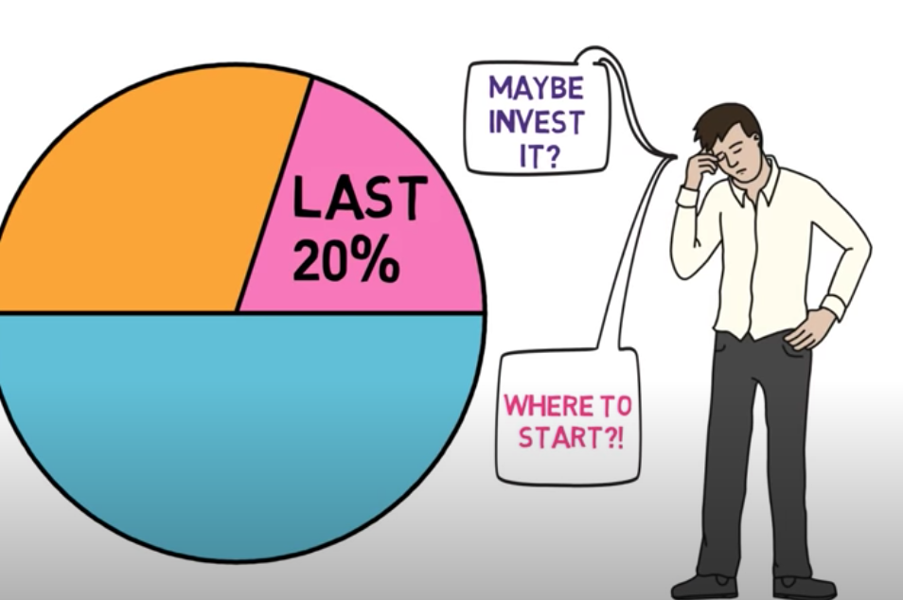
Investing — Why?
Why Invest Video?
Notes:
Facilitator shares their screen and shows the “Why Invest” video that shows the risk of only using a Savings Account to grow wealth vs Investing. The video in embedded in the slide and can be found here: https://www.youtube.com/watch?v=x7msE3tx8QI
Ask for comments.

Slide 11
Alejandro — Save or Invest?
18 years old
Graduates in 15 months
Wants to go to trade school to be electrician
ETV will pay tuition
Needs money for equipment and living expenses
Notes:
Familiarize yourself with the Alejandro scenario in the original Keys content: https://www.aecf.org/m/resourcedoc/aecf-keyscurriculumfacilitator-key6-2019.pdf
Tell the participants that you are going to talk about an example of a young person who is trying to decide whether to save his money or invest it. Summarize his situation with the statements on the slide.

Slide 12
Alejandro — Save or Invest?
1% Interest Savings Account
$51 share price
High risk tolerance
Can save $200 a month
What do you think he should do?
Notes:
Continue to talk about Alejandro by saying that he has a high tolerance for risk and is willing to invest his money to earn a higher return. State that he is working part time while finishing high school and thinks he can save $200 a month for those 15 months = $3000. He has a savings account that earns 1% interest but is interested in investing in Facebook which would cost $51 a share.
Ask the participants to summarize Alejandro’s goals: Save for the equipment he will need in electrical school and for living expenses. Ask them what they think he should do-save or invest? Direct the conversation as to why savings would be the best option for him.
After discussion, emphasize that investing is not a short-term strategy so Alejandro may not earn enough in the investment to warrant the risk. Point out that he could lose money on the investment which would harm his goal. Point out that once he is done with school, has a job with a steady income and has emergency savings, he might want to consider investing then.

Slide 13
Compound Interest
Compound Interest Activity
Notes:
Tell young people that “When you deposit money in a savings account or a similar account, you’ll usually receive interest based on the amount that you deposited. For example, if you deposit $1,000 in an account that pays 1 percent annual interest, you’d get $10 in interest after a year. Compound interest is interest that you earn on interest. So, in the example, in year two, you’d earn 1 percent on $1,010, or $10.10 in interest payouts. Compound interest accelerates your interest earnings, helping your savings grow more quickly.” (Source: Bankrate.com)
Facilitator shares their screen and goes the website that is embedded in the slide and is here: https://www.themint.org/teens/compounding-calculator.html, to do an activity on compounding. Enter in $500 as a savings goal and click on Standard Savings, CD and Stock Market options to show the different results.

Slide 14
Investing — Why?
Mr. Earl’s Investment
Notes:
Tell the young people that you are going to discuss the Racial Wealth Gap and how investing affects it. Remind them from the 1st Key that the median wealth of white households is 16 times higher than African American households. State that Blacks are 35 percent less likely than whites who have similar income to invest in the stock market (Source: Charles Schwab). Investments are a large part of that wealth. Let them know that you are going to show them a story about Mr. Earl who lived in Baltimore. Share your screen and show the video which is embedded in the slide or can be found here:https://www.youtube.com/watch?v=ov3y_tas6J8 that shares how Mr. Earl, who never made more than $12 per hour, yet he has a net worth over half a million dollars.
Ask for comments and if the young people feel they can achieve something similar in their future.

Slide 15
Investing — How?
401(k) Video
Notes:
Let the participants know that one common method of investing for their future is if their employer offers a plan for retirement savings, 401(k) (or 403(b) for a non-profit). Share your screen and show the video that explains 401(k) plans The video is embedded in the slide and can be found here: https://www.youtube.com/watch?v=KrmZDqorxB4
Ask if the young people know anyone who has this type of plan and what their thoughts are on it. Emphasize that if they work for an employer who offers a “match” on the plan, where the employer contributes money to it, they should consider participating in it. Otherwise, the young people will not get that money from the employer.

Slide 16
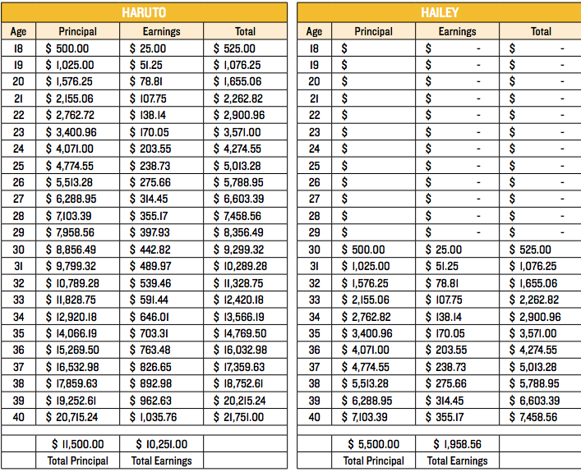
Haruto’s and Hailey’s Investments
Notes:
Read the scenario for 2 investors: Haruto and Hailey. Ask a participant to say at what age Haruto started investing, and what age Hailey started. State that they each saved $500 a year and received a return of 5% on their investments after fees. Ask the same person to read the boxes highlighted in yellow on how much Haruto and Hailey have in their investments. Ask if anyone has any ideas on why Haruto’s is higher? Answer’s may include: compound interest, Haruto started 12 years earlier and had more time for his money to grow etc.

Slide 17
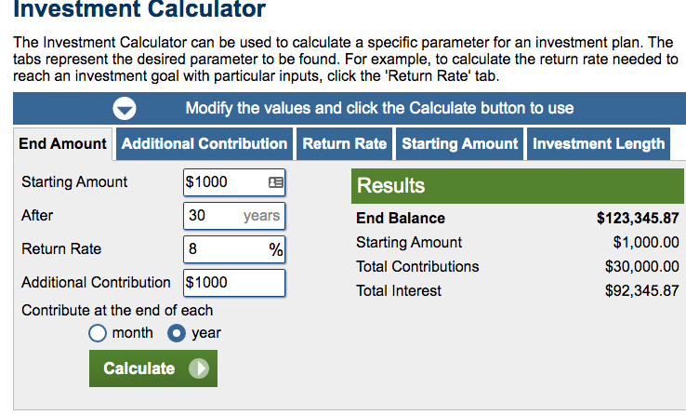
Investments
Making Your Money Work for You
Notes:
Let the young people know that you are going to cover more about how amazing compound interest works. Facilitator shares their screen and goes to the the investment calculator website which is embedded in the slide and can be found here: https://www.calculator.net/investment-calculator.html
Put $1,000 as the initial investment, 30 years at the time frame, 8% as the interest, with an additional $1,000 a year. Discuss the end amount of the investment, $123,345. Point out that $1,000 a year is $83 a month. Also, point our that the money invested was $30,000 but the interest earned was 3x’s that amount = $92,345. Ask for comments.

Slide 18
Assets and Liabilities
Asset building is about saving money and investing that money in assets that will help you achieve your goals and your life vision
Liability is something you owe
Debt is money you owe to another person, business or the government
Notes:
Summarize by reviewing that there are Assets and Liabilities, which were covered in Key 1. Read the Key Concept and the text in the orange box. Emphasize that the goal is build assets and keep liabilities as low as possible. Say that investing is one way to build assets. However, since it is risky and there is potential to lose money, it’s important that when they are ready to invest, they learn the necessary terms and choose an investment option carefully.

Slide 19
Wrap Up
Questions?
What’s one thing you learned?
Notes:
Ask participants if they have any questions on what was covered in the Key or any last comments.
Confirm the date/time for the next workshop.
Thank everyone for attending/participating and give out your contact information so they can reach you with any questions.

